Slide 1
LabVIEW FPGA

Slide 2

What You Need To Get Started
LabVIEW FPGA Exercise Manual
LabVIEW FPGA Course CD
LabVIEW FPGA Course Manual
NI Sound and Vibration Signal Simulator
Two J-type thermocouples
NI 9074 Integrated Controller or equivalent
NI 9211, 9233, and 9263 Modules
Computer running Windows 7/Vista/XP with the following software installed:
LabVIEW 2010 or later
LabVIEW Real-Time
LabVIEW FPGA
NI-RIO 3.5.0 or later

Slide 3

File Locations
Root Directory
Exercises <or> Solutions
LabVIEW FPGA
The course installer places the course files in the following location:

Slide 4
Instructional Methods
Lecture
Topic
Quizzes
Demonstrations
Concept Exercise
Development Exercise
Notes:
Lecture gives a foundation in the topic
Instructor reinforces foundation through demonstrations and quizzes
Use concept exercises to further explore a topic
Watch a simulation, experiment with example VIs
Use development exercises to gain hands-on experience
Demonstration of a finished development exercise further reinforces the learning process

Slide 5
Getting The Most Out Of This Course
Ask questions!
Experiment with hands-on exercises to understand the methods used
Explore solutions
Implementations explore a possible solution—you may find a better one

Slide 6
New User Experienced User Advanced User
LabVIEW Core 1
LabVIEW Core 2
LabVIEW Core 3
Managing Software Engineering in LabVIEW
Advanced Architectures in LabVIEW
LabVIEW Connectivity
Object-Oriented Design and Programming in LabVIEW
LabVIEW Performance
Certifications
Certified LV Associate Developer Exam
Certified LabVIEW Developer Exam
Certified LabVIEW Architect Exam
Other Courses
LabVIEW Real-Time 1
LabVIEW Real-Time 2
LabVIEW FPGA
DAQ & Signal Conditioning
LabVIEW Instrument Control
LabVIEW Modular Instruments
LabVIEW Machine Vision
RF Fundamentals
RF Application Development

Slide 7
Course Learning Map
Lesson 1
FPGA Programming Basics
Lesson 4
Lesson 2
Introduction to LabVIEW FPGA
LabVIEW FPGA Basics
Lesson 3
FPGA I/O
Lesson 5
Single-Cycle Timed Loops
Lesson 8
Lesson 6
Loop Execution and Data Sharing
Data Sharing on FPGA
Lesson 7
Basic Host Integration – PC/Real-Time
Lesson 9
Lesson 10
DMA Data Transfers
Modular Programming

Slide 8
Course Goals
This course prepares you to:
Select and configure NI Reconfigurable I/O (RIO) hardware
Create, compile, download, and execute a LabVIEW FPGA VI and use NI RIO hardware
Perform measurements using analog and digital input and output channels
Create host computer programs that interact with FPGA VIs
Understand and control timing of operations on the FPGA target
Design and implement applications using the LabVIEW FPGA module
Notes:
Refer to the Course Outline posted on ni.com/training.

Slide 9
Configuring Your LabVIEW Environment
Options Dialog Box
Controls/Functions Palettes page
Select Load palettes during launch to make Search Palettes immediately usable after launch
Set Palette to Category (Icons and Text)
Block Diagram page
Uncheck Place front panel terminals as icons to place control and indicator terminals in a compact format
Configure Block Diagram Cleanup to customize your block diagram
Notes:
This is an opportunity before the class starts for individuals to customize their environment with their favorite settings. The settings noted in the slide are suggested changes.
Other possible suggested changes based on instructor discretion:
Check Environment > General > Skip Getting Started window on launch
Uncheck Block Diagram>>Error Handling>>Enable automatic error handling in new VIs

Slide 10
Configuring Your LabVIEW Environment
Functions Palette
Tack the Functions palette and select View»Change Visible Categories then click Select All
Controls Palette
Tack the Controls palette and select View»Change Visible Categories then click Select All
Notes:
Functions Palette (Block Diagram)
Tack the Functions palette and click CustomizeView»Change Visible Palettes then click Select All
Controls Palette (Front Panel)
Tack the Controls palette and click CustomizeView»Change Visible Palettes then click Select All
Make inputs on subVIs required

Slide 11
Lesson 1 Introduction to LabVIEW FPGA
Introduction to FPGA Technology
LabVIEW FPGA System
Comparison with a DAQmx System
LabVIEW FPGA Applications
Notes:
Lesson objectives:
Understand that FPGA is reconfigurable hardware whose logic is defined in software
Understand some benefits of reconfigurable hardware
Understand that a LV FPGA system is comprised of two parts: HW and SW
Understand that no operating system runs on FPGA
Understand that you do not need to know Verilog or HDL to program LabVIEW FPGA
Identify applications for which LabVIEW FPGA is ideally suited
Understand differences in processing and reliability between traditional system and FPGA system

Slide 12
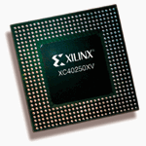
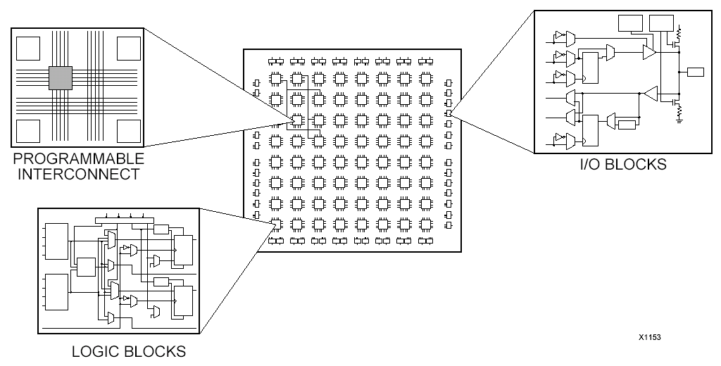
A. Introduction to FPGA Technology
What is an FPGA?
Field programmable gate array (FPGA)
A silicon chip with unconnected gates and other hardware resources
Enables user to define and re-define functionality
How does an FPGA work?
Circuit behavior is defined using software
Circuit specification (gate connection, etc.) is loaded into the hardware
No OS is needed for execution of logic
When is an FPGA used?
Custom hardware, where it doesn’t make sense to pay the high price of developing an ASIC
Reconfiguration required after deployment
Notes:
Introduction to FPGA Technology
Begin by discussing the technology behind LabVIEW FPGA.
Field programmable gate arrays (FPGAs) are silicon chips with unconnected logic gates. You can define the functionality of the FPGA by using software to configure the FPGA gates. FPGAs are often used as processing components in low to medium volume electronics, where the time and cost of developing and fabricating an applications specific integrated circuit (ASIC) is prohibitive. FPGAs are also found in applications that require reconfiguration in the field. Basically, FPGAs are used when customers need custom I/O hardware but also want commercial off the shelf (COTS) hardware.

Slide 13
Benefits of FPGA
Flexibility
Reconfigurable through software
True parallel processing
Simultaneous parallel circuits
No CPU time sharing
High Performance
Reliability
Offload processing
Cost
Notes:
It is important to understand the benefits of FPGAs. FPGAs are reconfigurable through software, making them very flexible. Unlike a microprocessor or application specific integrated circuit (ASIC), FPGAs can have their functionality modified even after being deployed in an application. FPGAs can also execute specific tasks very efficiently within silicon. Since FPGA execution is controlled by the programmable interconnects, users can implement truly parallel tasks within the FPGA that will execute simultaneously and independent of one another. Finally, since applications are actually implemented in hardware without any software involved such as an operating system, FPGAs provide the ultimate in execution reliability.
----------------------
Flexibility:
Reconfigurable through software. Create a chip that is reconfigurable with changes in software, creating new hardware anytime
Parallel Processing:
-You can achieve true, simultaneous, parallel processing. There is no operating system on the module that must divide CPU time between several tasks.
Performance:
In general, execution in hardware is faster than execution in software.
Since FPGA is a hardware solution, implementing algorithms on FPGA has higher performance than implementing same algorithm in SW. With FPGA you can create logic that can execute in one clock cycle.
Note, though, that ASICs generally have higher performance than FPGA, but development cost and flexibility are the tradeoffs.
Reliability:
-Once the FPGA is programmed, it becomes a hardware chip with all of the associated reliability.
-Furthermore, it is highly deterministic. With FPGA, you can implement code that synthesizes deterministic hardware down to the tens of nanoseconds
Offload processing:
-FPGAs can also be used to off-load computationally intensive processing so to free up the CPU for other tasks
Cost:
- When compared with ASICs, the development costs of an FPGA system are often cheaper than designing a custom ASIC and printed-circuit board.

Slide 14
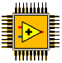
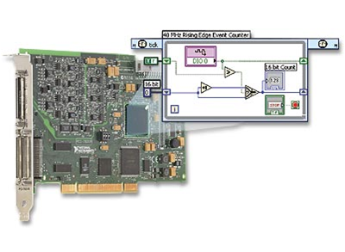
B. LabVIEW FPGA System
LabVIEW FPGA Module
NI-RIO Driver
Reconfigurable I/O (RIO) Hardware
Notes:
While FPGAs have many benefits, there are some challenges when developing FPGAs. Typically, FPGAs are programmed using hardware description language (HDL), such as VHDL or Verilog. These tools have steep learning curves and can become a barrier for using this technology. Additionally, these tools are often not intuitive for test and control engineers.
The LabVIEW FPGA Module allows LabVIEW to target FPGAs on NI Reconfigurable I/O hardware so scientists and engineers can take advantage of the performance and flexibility of FPGAs without needing to learn the low-level design tools. Therefore, the basic components of a LabVIEW FPGA system are the LabVIEW FPGA Module, the NI-RIO driver, and an NI-RIO device, also known as a RIO target.
Instructors: Point out the LabVIEW FPGA chip logo. This helps users know if they have LabVIEW FPGA installed – seen on LV Startup page. This symbol will also be used in subsequent slides to represent the LabVIEW FPGA module.

Slide 15
LabVIEW FPGA Module
Add-on module for LabVIEW
Develop VIs for FPGA target
Develop VIs for host PC or Real-Time interaction with FPGA
Notes:
LV FPGA module is add-on module for LabVIEW. Using the LabVIEW FPGA Module, you can develop custom control and measurement hardware without any prior knowledge of hardware description languages or board level hardware design. VIs created with the LabVIEW FPGA module can be targeted to the FPGAs on NI Reconfigurable I/O, or RIO, hardware. You can also create VIs for your host PC to interact with the FPGA target.

Slide 16
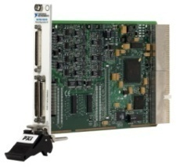
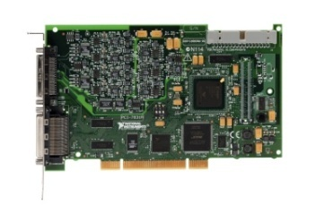
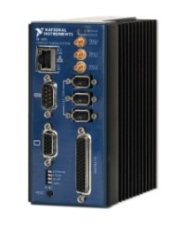
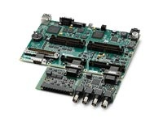
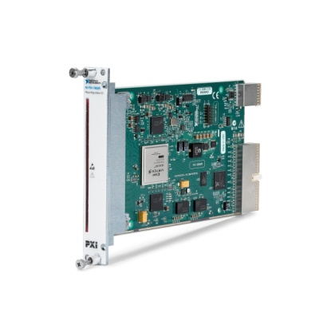
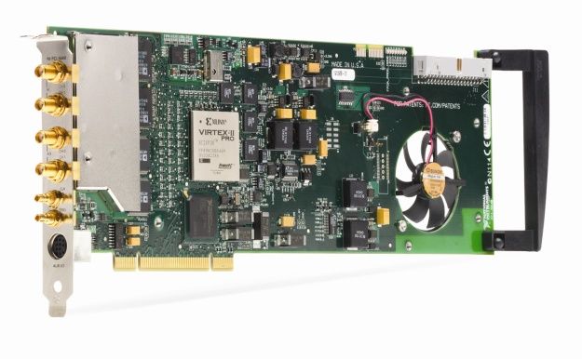
LabVIEW FPGA Targets
CompactRIO
PXI R Series Multifunction RIO
PCI R Series Multifunction RIO
Compact Vision System
Single-Board RIO
FlexRIO
RIO Instruments
Notes:
The following NI hardware platforms have a user-programmable FPGA:
CompactRIO is an embedded system that is used for machine control, in-vehicle data acquisition, and portable NVH applications.
The R Series is a family of general-purpose data acquisition devices. There are multiple versions of both PXI and PCI and include analog I/O and digital I/O.
The Compact Vision System (CVS) and 825x can acquire data from up to three IEEE 1394 FireWire® cameras and the CVS is a complete system for machine vision applications. This system also includes 29 digital lines whose functionality can be configured using LabVIEW FPGA.
FlexRIO is a target which allows you to create a custom device with user-defined I/O.
RIO Instruments are FPGA-enabled instruments such as the PXIe-5641R – which is a PC-based Intermediate Frequency (IF) transceivers that is used in RF dynamic tests, Software-Defined Radio (SDR), and user-defined IF applications.
Make sure that students realize that LabVIEW FPGA is not a general-purpose FPGA design tool for targeting standalone FPGAs. If users need more flexibility in defining the I/O, they should look into using the FlexRIO system.

Slide 17
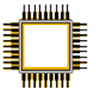

LabVIEW FPGA: How does it work?
LabVIEW FPGA
LabVIEW VI
Xilinx ISE Compiler
VHDL Constraints
LabVIEW FPGA
Bitfile
Xilinx FPGA Chip
User Generated
Auto Generated
Notes:
The LabVIEW FPGA module compiles your LabVIEW application to FPGA hardware through a compile process. Behind the scenes, your graphical code is translated to text-based VHDL code. Then, industry standard Xilinx ISE compiler tools are invoked and the VHDL code is optimized and synthesized into a hardware circuit realization of your LabVIEW design. This process also applies timing constraints to the design and tries to achieve an efficient use of FPGA resources (sometimes called “fabric”).
A great deal of optimization is performed during the FPGA compilation process to reduce digital logic and create an optimal implementation of the LabVIEW application. Then the design is synthesized into a highly optimized silicon implementation that provides true parallel processing capabilities with the performance and reliability of dedicated hardware.
The end result is a bitstream that contains the programming instructions LabVIEW downloads to the FPGA target. When you run the application, the bit stream is loaded into the FPGA chip and used to reconfigure the gate array logic. The bit stream can also be loaded into nonvolatile Flash memory and loaded instantaneously when power is applied to the FPGA target. There is no operating system on the FPGA chip, but you can control the FPGA chip through a host application.
Graphical LabVIEW FPGA code is translated to text-based VHDL code
Applies timing constraints on the circuit design
By default, the FPGA clock runs at 40 MHz
Xilinx ISE compiler tools are invoked
VHDL code is optimized
Logic is reduced
Gate array configuration is synthesized
Bit stream is loaded into the FPGA

Slide 18
Benefits of LabVIEW FPGA System
FPGA technology
Create custom hardware using LabVIEW
No Verilog/VHDL coding or board design
Direct access to hardware terminals
Extensive library of built-in functions
Integration with 3rd party IP
Tools to communicate, monitor and control the FPGA from Windows PC or Real-Time controller
Notes:
Besides all the benefits noted earlier of using FPGA, LabVIEW FPGA provides the following additional benefits:
Use LabVIEW to develop your FPGA custom hardware without VHDL coding or board design. Through the LV block diagram you have direct access to the hardware terminals.
LabVIEW has extensive library of built-in functions (FFT, Filters, signal generation, etc.). There are tools to integrate with 3rd party IP.
Use the LabVIEW environment and LabVIEW VIs to communicate with, monitor, and control the FPGA from a host PC or a real-time controller. Furthermore, LabVIEW FPGA handles many operations that are not natively handled on FPGAs – such as DMA transfers to processor, Ethernet communication for CompactRIO, data storage with special CompactRIO modules, and user interface interaction

Slide 19
C. Comparison with NI-DAQmx System
DAQmx System
LabVIEW
NI-DAQmx
Driver
M Series Device
User Defined
Vendor Defined
Notes:
To understand the paradigm of a LabVIEW FPGA system, it is important to understand the specific components found in a traditional measurement system. A traditional measurement and control system consists of three basic components:
The application software running in Windows or a Real-Time operating system (RTOS). For you, this would be the LabVIEW Development Environment.
The driver software and functions to interface to your hardware. This would be the NI-DAQmx driver.
And finally, the I/O hardware. For this specific example, we are calling out an M-series DAQ device.
With this paradigm, end users receive only the functionality that our developers designed into the ASIC of the M Series. Additionally, an extensive driver is required to make all of the device functionality accessible through software. The drawback to this approach is that all of the device functionality is fixed. The customization of such systems comes through the programming at the application software layer which can result in limitations of the hardware functionality and complex software driver calls to perform particular tasks.

Slide 20
LabVIEW FPGA System
LabVIEW FPGA System
LabVIEW
NI-RIO Driver
LabVIEW FPGA
RIO Hardware
User Defined
Vendor Defined
Notes:
Objective: Show how LabVIEW FPGA is different from a DAQ application, but also emphasize that it’s not too different from the technology they are already familiar with - it just adds an additional layer.
When using a LabVIEW FPGA-based measurement system, the paradigm changes. While you are still using COTS hardware from National Instruments, in this case the R Series DAQ device, you can now modify the hardware functionality of this device using LabVIEW FPGA. On the RIO hardware platforms, the FPGA (instead of an ASIC) defines the device functionality. You still have the application software running in Windows or on an RTOS, however, now there is a very thin driver called NI-RIO that provides the interface functions to our hardware. With this paradigm, end users have an I/O platform with the performance, flexibility, and customization of an FPGA without the added complexity of having to understand FPGA and board-level hardware design.

Slide 21
Decision Making in Software
Crash Possible
Traditional System
I/O
Operating System
Driver API
Application Software
Calculation
UUT
~25 μs
Response
Outputs
Notes:
Many test and control systems perform calculations in software. When executing in software the calculation must be performed after multiple software calls through the application software, driver API, and operating system before actually interfacing with the unit under test (UUT). Even when using an RTOS and optimized algorithms, the fastest response rate you can typically achieve in software is around 25 µs. Additionally, there is added vulnerability within a software-based system because a crash can occur at multiple levels that interfere with the response of the system.

Slide 22
Decision Making in Hardware
Highest Reliability
LabVIEW FPGA System
I/O
Calculation
Operating System
Driver API
Application Software
UUT
25 ns*
Response
Outputs
* Faster response for 80 and 120 MHz clocks
Notes:
When executing calculations in hardware, as with LabVIEW FPGA, you can remove software from the required response to the UUT. Under this configuration, LabVIEW FPGA can respond to digital signals within a single clock cycle. With a default clock rate of 40 MHz, LabVIEW FPGA can respond to a digital signal within 25 ns. You can compile LabVIEW FPGA code at higher rates in some cases.
Performing calculations in hardware provides the highest reliability possible because any crash at any software layer will not affect the execution of your code.

Slide 23
D. LabVIEW FPGA Applications
Typical LabVIEW FPGA applications
Intelligent DAQ
Custom Timing and Synchronization
Custom Counters
Multiple Scan Rates
Ultra-high speed control
Specialized communication protocols
Off-load CPU – Processing
Complex timing and synchronization
Hardware-in-the-Loop (HIL) testing
Notes:
D. LabVIEW FPGA Applications
Now, let’s look at some common applications that are well-suited for the LabVIEW FPGA Module.
LabVIEW FPGA is typically used for applications that require the development of custom hardware. These tasks include:
• Integrating custom timing, triggering, and synchronization
• Integrating a custom mix of analog I/O, digital I/O, counters, and
triggers into a single device
• Integrating custom digital communication protocols
• Parallel processing and data acquisition
• Custom motion control
• Off-loading signal processing
Intelligent DAQ - On-Board Processing:
NI’s R Series Intelligent DAQ devices are often used as alternatives for traditional DAQ applications when users need to customize the behavior.
Although we have lots of timing and synchronization options built into DAQmx and our DAQ products, sometimes you need to tweak them. Maybe instead of a single analog trigger line, you want to trigger off of two different analog signals at different thresholds. Or, maybe you want to control the acquisition start time based on an event not supported by our DAQ products.
Or maybe you need more counters than are typically supported on our multi-function DAQ cards. Maybe you need lots of counters. Instead of buying more boards, you can customize a digital board to be a bank of counters.
Maybe you want to acquire analog signals at different rates. With FPGA you could set a custom acquisition rate for each analog channel.
High-Speed Control:
Use single point I/O with PID or other control algorithms to implement onboard control with loop rates up to hundreds of KHz. You can acquire - process – and output data at higher speeds on the FPGA than to acquire data -- process on the host – and the output.
Digital Communications and Protocols:
Interface with standard and/or custom digital protocols.
Off-Load CPU Processing:
Communicate with direct memory access (DMA) by outsourcing the many processing algorithms that are well suited for FPGA hardware but CPU intensive on processor-based systems.
Complex Timing and Synchronization:
Implement complex triggering schemes, multi-rate acquisition, or supply clock signals to synchronize external devices.
Hardware-in-the-Loop (HIL) Testing:
Simulate sensors, emulate protocols, and implement important parts of HIL systems that are difficult to implement on processor-based systems.

Slide 24
Summary—Quiz
Which of the following are required software components of a LabVIEW FPGA system?
NI-RIO driver
DAQmx driver
LabVIEW Development System
LabVIEW Real-Time Module
LabVIEW FPGA Module

Slide 25
Summary—Quiz Answer
Which of the following are required software components of a LabVIEW FPGA system?
NI-RIO driver
DAQmx driver
LabVIEW Development System
LabVIEW Real-Time Module
LabVIEW FPGA Module
Notes:
DAQmx is not used to program RIO devices.
The LabVIEW Real-Time module is only needed if you are also using a Real-Time target such as CompactRIO. It is not needed when using an R-Series device. You will learn when the LabVIEW Real-Time module is required in the next lesson.

Slide 26
Summary—Quiz
What OS runs on the FPGA?
LabVIEW FPGA
MicroLinux
Unix
PharLap
None of the above

Slide 27
Summary—Quiz Answer
What OS runs on the FPGA?
LabVIEW FPGA
MicroLinux
Unix
PharLap
None of the above
Notes:
FPGAs do not use an operating system. This is why you can achieve parallelism offered by FPGAs.

Slide 28
Summary—Quiz
LabVIEW FPGA allows you to program an FPGA without knowing VHDL or HDL.
True
False

Slide 29
Summary—Quiz Answer
LabVIEW FPGA allows you to program an FPGA without knowing VHDL or HDL.
True
False
Notes:
Although there are ways of incorporating VHDL or HDL into a LabVIEW application, you do not need VHDL or HDL knowledge to program a LabVIEW FPGA system.

Slide 30
Summary—Quiz
Which of the following might be typical reasons for using R Series Multifunction RIO device over a DAQ board programmed with DAQmx?
Need more counters than available on a DAQ board
Need custom trigger logic
Need more analog input channels than available on a DAQ board
Need to simultaneously acquire data on different channels at different rates
Need a high-level/easy-to-use driver

Slide 31
Summary—Quiz Answers
Which of the following might be typical reasons for using R Series Multifunction RIO device over a DAQ board programmed with DAQmx?
Need more counters than available on a DAQ board
Need custom trigger logic
Need more analog input channels than available on a DAQ board
Need to simultaneously acquire data on different channels at different rates
Need a high-level/easy-to-use driver
Notes:
With FPGA you can turn a digital line into a counter. You are not limited to counters available in hardware.
With FPGA you can implement custom triggers that are not available through DAQmx or supported on the device.
You cannot increase the number of analog or digital channels by just going to an FPGA device. I/O are fixed for most RIO devices. With FlexRIO you do have some flexibility, but typically increasing number of analog input channels isn’t a reason to convert your application to using FPGA technology.
You can implement an application where each channel is acquiring data a different specified rates.
DAQmx provides a high-level API and will typically be easier to program than FPGA.

Slide 32
Lesson 2 LabVIEW FPGA Basics
Evaluating System Requirements
FPGA System Architectures
RIO Platforms
Software Installation
Windows Hardware Configuration
Real-Time Hardware Configuration
Creating a LabVIEW FPGA Project
Notes:
Lesson objectives:
Identify steps in LV FPGA development process. And note that some steps are iterative
Identify the two main FPGA architectures: PC/PXI with Windows and Real-Time
Know PC/PXI system includes card connected directly to host
Know that Real-Time system is distributed and FPGA resides on target
Use MAX to configure a cRIO system
Know that a LV FPGA system includes LV, LV FPGA, and NI-RIO software installed in that order on host machine
Use the LabVIEW project to create an FPGA project for both Windows and cRIO system
Understand project hierarchy and identify different "targets" & "devices" in Project
Understand that FPGA device differ by slices/gate count
Impacts amount of logic that can be implemented in HW

Slide 33
FPGA Development Flow
Evaluate
System
Requirements
Select
Architecture
Configure
Hardware
Create a
LabVIEW
Project
Lesson 2
Create
FPGA VI
Simulate on
PC to test
Compile to
FPGA
Create
FPGA Host
VI(s)
Create
Real-Time
Host VI(s)
Lesson 3
Lesson 8
Lessons 4-7, 9-10 build
on the development flow
Notes:
This slide shows the basic steps for developing your LabVIEW FPGA system.
Simulate System Requirements
The first step in any development project is to evaluate the requirements of the system.
Select Architecture
Once the system requirements are set, thought must be put into how the application should work as a whole. You’ll need to select your FPGA architecture and associated hardware.
Configure Hardware
Once you have all your system components, you’ll first configure your hardware in the Measurement and Automation Explorer. If you are developing your application without the hardware available, then you’ll skip this step.
Create a LabVIEW Project
You’ll then launch LabVIEW and create a LabVIEW Project for your system. Use the LabVIEW Project to manage and configure all resources for FPGA devices, such as CompactRIO Modules, I/O, clocks, FIFOs and VIs. When using a LabVIEW Real-Time platform with a LabVIEW FPGA device, you must add the following resources in order:
Real-Time target (if you are using CompactRIO or PXI controller, otherwise My Computer is the target)
FPGA Target (that is, the CompactRIO backplane or R Series device)
CompactRIO Expansion Chassis (R Series only)
CompactRIO Modules (if applicable)
Create FPGA VI
You’ll then start your LabVIEW FPGA VI.
Simulate on PC to test
Because of the technology used in FPGA, compiling FPGA code can take anywhere from minutes to hours and LabVIEW FPGA is no exception. Therefore, before you compile, you’ll want to simulate execution on the PC to catch any problems prior to the compile step.
Compile to FPGA
A Compile Server turns FPGA VI into a bitstream file that is targeted to your FPGA
Create FPGA Host VI
Unless you are creating a standalone application, you’ll want your FPGA VI to interact with your host system. You can use either LabVIEW for Windows or LabVIEW Real-Time as a host.
Create Real-Time Host VI
If you selected a Real-Time architecture, you might also need a Real-Time Host VI. In this case your FPGA Host VI will be on your Real-Time controller and your will create a separate user interface or other host VI for your Windows system.
In Lesson 2, you’ll learn about selecting the different FPGA architectures and related system components. We’ll then configure the hardware for your cRIO system. To understand the differences between the different architectures, we’ll create two different LabVIEW projects – one for a Windows FPGA system and one for a Real-Time cRIO system.
In chapters not noted in the slide, other topics are addressed that built upon these basic steps in the development process. This is simply to show the development process in terms of initial coverage in lessons.

Slide 34
A. Evaluating System Requirements
FPGA?
PCI
PXI
FPGA for Real-Time
CompactRIO
Need FPGA?
Select RIO Architecture
Select a Platform
PXI
Other Considerations
FPGA for Windows
PCI
FPGA “Size”
I/O
Connectors
…
Systems demonstrated in
Course exercises
Notes:
When adopting FPGA the first consideration is the system architecture. Will the system be a Window-based system or a Real-Time system? After that you need to select the packaging or form-factor for your system. Will you use a desktop machine or a PXI system? Do you need a plug-in board? Do you need CompactRIO? Once you’ve decided on the form factor, then there other considerations – What type of I/O channels do you need and how many do you need?
NI’s sales force and ni.com/fpga will help you with these decisions.
Throughout this course the lessons will illustrate concepts for both architectures. Specifically, course exercises will be based around two systems: a PCI R Series board and a CompactRIO system. Most concepts apply to both architectures. However, in areas where the systems differ – such as configuration -- the course material will cover both architectures.
Let’s look at these two reconfigurable I/O architectures in more depth….

Slide 35
B. FPGA System Architectures
LabVIEW FPGA Architecture on Windows
LabVIEW FPGA Architecture with LabVIEW Real-Time

Slide 36
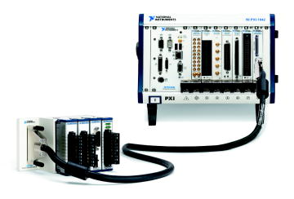

FPGA – Windows
Windows System
Reconfigurable FPGA
LabVIEW
For Windows VI
FPGA
Interface
LabVIEW
FPGA VI
Enterprise
LabVIEW
for Windows
LabVIEW FPGA
Notes:
FPGA – Windows is the first type of FPGA system architecture. In this system, the host device is a PXI or desktop PC running the Windows operating system. The RIO device is either a PXI or PCI plug-in device. This system architecture uses the following VIs:
LabVIEW FPGA VI—Executes on the FPGA of the PXI or PCI RIO device.
Host VI—Executes on the host PC, controls the FPGA, and provides a user interface to the system.

Slide 37

FPGA – Real-Time
Windows System
LabVIEW Real-Time System
Reconfigurable
FPGA
Network
Communication
Inter-Thread
Communication
FPGA
Interface
Windows
Host VI
Normal Priority
VI
Time-Critical
Interface VI
LabVIEW
FPGA VI
User
Interface
Data Storage
LabVIEW
for Windows
LabVIEW FPGA
LabVIEW Real-Time
Notes:
FPGA – Real-time is the other major FPGA system architecture. In this system the FPGA is running within a LabVIEW real-time system. The real-time system is typically on either a PXI or CompactRIO controller. This system architecture uses the following VIs.
LabVIEW FPGA VI—Executes on the FPGA of the PXI or PCIO RIO device.
LabVIEW Real-Time VI—Executes on a dedicated processor running a real-time operating system and adds deterministic, floating-point processing and control algorithms to the system.
Host VI—Executes on the host PC and contains the user interface for the real-time system
Note that users develop all the VIs (FPGA, Real Time, and Host) on the Windows System. The Real-Time and FPGA VIs are then deployed to the Real-Time system.
Refer to the LabVIEW Real-Time Application Development course or visit ni.com/realtime for more information about developing well-architected LabVIEW Real-Time applications.

Slide 38
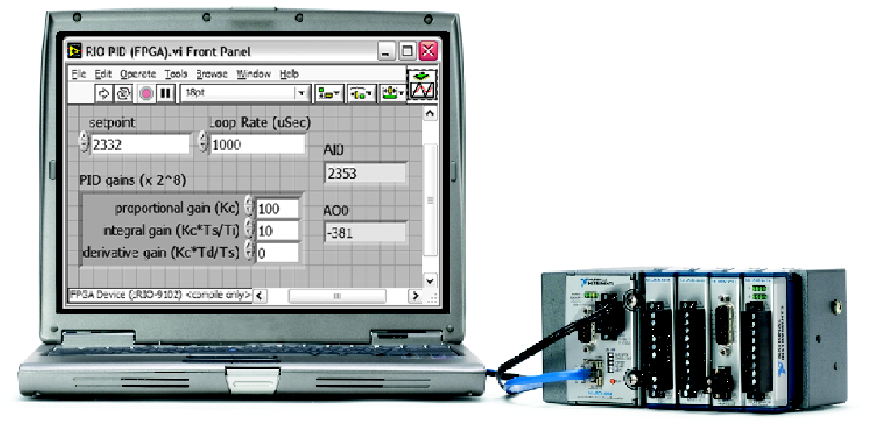
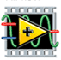
LabVIEW Programming & CompactRIO
User Interface
LabVIEW
Real-Time Processor
LabVIEW Real-Time
Reconfigurable
FPGA
LabVIEW FPGA

Slide 39
C. Common Reconfigurable I/O (RIO) Platforms
PXI Express
PXI
PCI Express
PCI
CompactRIO
Notes:
After you’ve selected your architecture, you’ll need to pick your FPGA platform or form factors. The most common form factors are PXI, PCI, and CompactRIO.

Slide 40
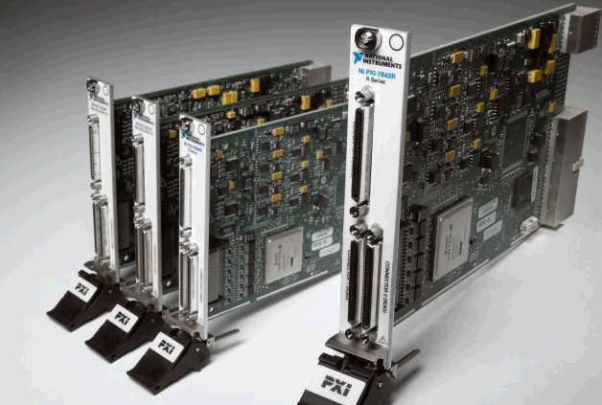
R Series Multifunction RIO
PXI, PXI Express, or PCI form factor
Define custom data acquisition
Integrate FPGA with Analog and Digital I/O
High channel count
Notes:
The R Series Multifunction RIO devices come in either PCI or PXI form factor. The PCI cards are using for Desktop systems running Windows. PXI systems can be either Window-based systems or Real-Time Systems.
You can customize your own data acquisition using the NI R Series Multifunction RIO devices which integrate FPGA technology with analog and digital I/O. These devices are used for high speed applications that require precise timing and control.
The Digital R Series devices have 160 digital lines that can be configured for inputs, outputs, counters, or custom logic at rates up to 40 MHz.

Slide 41
Building a CompactRIO System
Select the Reconfigurable Chassis
Number of slots
FPGA size
Integrated or not
Select the Real-Time Controller
Processor speed
Flash memory size
Select the I/O and Connectivity
Analog Input/Output, Digital Input/Output, …
(Low / high speed, simultaneous / multiplexed)
Standard connector depends on the module
Options: Strain Relief Connector Block, Custom Cable, etc.
Notes:
CompactRIO is an small, rugged embedded control and data acquisition system that is very modular. There are many component considerations when designing your CompactRIO system.
The Controller module is an embedded real-time processor that is the brains of the system. It communicates with the I/O modules, performs embedded control and logging, and communicates via Ethernet and serial. For the controller, you’ll need to consider processor speed and flash memory size. The Controller module communicates with the I/O modules via the FPGA on the Chassis. Some controllers are integrated with the chassis while others are separate components. There are 4 and 8 slot chassis available. Typically the more CompactRIO modules and the more I/O you need, you’ll need a larger chassis and a larger FPGA.
There is a broad selection of I/O modules – Analog I/O with various signal conditioning – Thermocouple, RTD, Bridge Sensors. Digital I/O, Counters, Pulse Generation, etc.. Refer to ni.com/compactrio for more information on the CompactRIO platform.

Slide 42
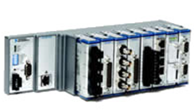

Other CompactRIO Form Factors
NI CompactRIO
Integrated Controller
NI Single-Board RIO
Notes:
The CompactRIO Integrated controller is a lower cost solution than the systems with separate controllers and chassis. The integrated solution is ideal for volume usage. The benefit of the separate controllers and chassis is that you can upgrade your processor speed, FPGA size, and/or number of slots independently of each other. The non-integrated solution might be a better choice while developing your application – but when you want to replicate it – the integrated system might be a better choice.
NI Single-Board RIO is a low-cost embedded deployment solutions based on NI CompactRIO platform. It is intended for high volume/OEM usage. You program it the same as other CompactRIO devices but you can customize the enclosure. The photograph in slide shows a single-board RIO device with a total of 4 modules – and space for one more. Note that CompactRIO devices have already been certified for shock and vibration. Users opting for SB-RIO will need to conduct these tests and obtain ‘packaging’ certification for their own enclosures.

Slide 43
FPGA “Size”
Historically, FPGA size was measured by “gate count”
The “larger” FPGA had more resources than a “smaller” FPGA
Now, FPGA logic blocks and resources differ so logic capacity and performance comparisons are tricky
FPGAs include a variety of resources and logic blocks
RAM, Multipliers, Flip-Flops, Look-up-Tables (LUTs)
Logic blocks differ in capabilities
4-input LUT vs. 6-input LUT
Difficult to map LabVIEW VIs into FPGA resources
Xilinx compiler optimizes code based on FPGA architecture
Verify that code fits by compiling for offline hardware targets
Resource estimation takes significantly less time than compilation
Notes:
Once you know your FPGA architecture and form factor, you need to consider other things like connectors, processor speed, etc. One consideration for both PC-based systems and CompactRIO based system is the FPGA Size.
Initial LabVIEW FPGA targets are based on the Xilinx Virtex II family of FPGAs. A “larger” FPGA always had more resources than a “smaller” FPGA, and performance was comparable. But, “gate count” is no longer an effective measurement of FPGA capacity or performance.
Xilinx introduced a Spartan series and other Virtex FPGAs that were optimized for different application needs. The Spartan series was a low-cost and low-power solution which still used “gate count” as a metric, but there were fewer specialty resources like block RAM and multipliers.
The Virtex 5 and 6 series increase the number of specialty resources and changed the logic components. Instead of 4-input LUTs used in the Virtex II family, the Virtex 5 and 6 series use 6-input LUTs.
Similar gate counts may have significantly different capabilities. Effective size depends upon application resource needs. Subtle internal differences impact resource utilization.

Slide 44
FPGA Resource Table
 | Virtex II 1000 | Spartan 3 1000 | Virtex 5 LX30 | Virtex II 3000 | Virtex 5 LX50 | Spartan 3 2000 | Virtex 5 LX85 | Virtex 5 LX110
Equivalent Logic Cells | 11,520 | 17,280 | 30,720 | 32,256 | 46,080 | 46,080 | 82,944 | 110,592
LUTs/FFs | 10,240 | 15,360 | 19,200 | 28,672 | 28,800 | 40,960 | 51,840 | 69,120
Multipliers | 40 | 24 | 32 | 96 | 48 | 40 | 48 | 64
Block RAM (Kb) | 720 | 432 | 1,152 | 1,728 | 1,728 | 720 | 3,456 | 4,608
Sample NI Products | cRIO-9101 | cRIO-9072 | cRIO-9111 PXI-7851R | cRIO-9104 PXI-7833R | cRIO-9113 PXI-7852R | cRIO-9074 | cRIO-9116 PXI-7853R | PXI-7854R
Refer to http://zone.ni.com/devzone/cda/tut/p/id/7440 for more information.
Notes:
In general:
If you are starting a new design, use a device with a Virtex 5 chip. These chips have higher performance and more specialty resources. New designs are often not the most efficient so you’ll need more resources. Virtex 5 are good for extensive math operations and SCTL. You should only buy any of the Virtex II unless you have a specific reason like a showstopper I/O mix, or replacements for an existing deployment.
Once you’ve optimized and know more about the resources your application needs – then consider deploying to a lower cost solution – such as a device using the Spartan 3 chip.

Slide 45
Exercise 2-1: Set up a CompactRIO System
Connect and power up a CompactRIO system.
Notes:
Prep discussion:
In this exercise, students get familiar with the course hardware by assembling and connecting a CompactRIO system to the Sound and Vibration Simulator demo box. They also connect power cables and power on Sound and Vibration Simulator demo box.
If using the 9074 controller, note that the FPGA is part of the integrated controller.
There are three cRIO I/O modules in the chassis – two input and one output module.
Note that cRIO supports hot-swappable modules, so you can change when controller is powered up. This is not true for PCI or PXI devices!
In preparation for future exercises, you’ll be making the following connections:
NI-9211 thermocouple module needs to be connected to two J-type thermocouples.
The NI 9263 analog output module needs to controls the fan speed. Therefore, one of the outputs needs to be connected to the fan speed control.
The NI 9233 input module needs to be connected to a two-axis accelerometer and to a tachometer.
Be sure to make sure students wire up BNC cables correctly – Y acceleration input wired to CH0 and X acceleration wired to CH1! Students sometimes accidently swap these.

Slide 46
Exercise 2-1: Set up a CompactRIO System
If you need to swap modules, do you first need to power off the CompactRIO system?
Both the FPGA and USER1 LEDs are user-configurable. What do you think are their differences?
Notes:
One of the advantages of CompactRIO is the modules are hot-swappable. Therefore, users can switch modules in the field without first turning off their systems. Not true for PCI or PXI devices!
Both the FPGA and USER1 LEDs are user configurable and can help provide status feedback. The FPGA VI is user configurable from the LabVIEW FPGA. The USER1 LED is often referred to as an RT user LED as it is configurable from LabVIEW Real-Time. Although there are digital modules available, this course setup doesn’t include one. Therefore, we will control the FPGA LED in a later lesson.
If using the 9074 controller, the 2nd Ethernet port can be used for an expansion module to access additional I/O or it can be used to connect to another Ethernet-based device. The 2nd Ethernet port is not intended to be used for redundancy.
The tachometer measures rotation speed of a shaft or disk. In this course it will be used to measure fan speed. The two-axis accelerometer will be used to measure fan vibration.
Note that students might have modules that won’t be used in this course. Extra module(s) should be in slot 4 or above.

Slide 47
D. Software Installation
Before installing any device:
Install LabVIEW
If using a Real-Time controller, install LabVIEW Real-Time
Install LabVIEW FPGA
Install NI-RIO or other target-specific software
Notes:
A. Hardware Configuration
Measurement & Automation Explorer (MAX) is the gateway for managing connections to all NI devices.
Before connecting any device, you must complete the following steps to install the software and drivers for the device.
Install LabVIEW
Install LabVIEW Real-Time
Install the compatible version of LabVIEW FPGA.
Install the latest compatible version of driver software for your device.
Refer to ni.com/updates to find the latest updated driver software .
After you install the appropriate software you can connect the device to the computer in use. The installation instructions may vary depending on which device is in use. Devices may be connected directly to the PC or connected remotely through a network connection.

Slide 48
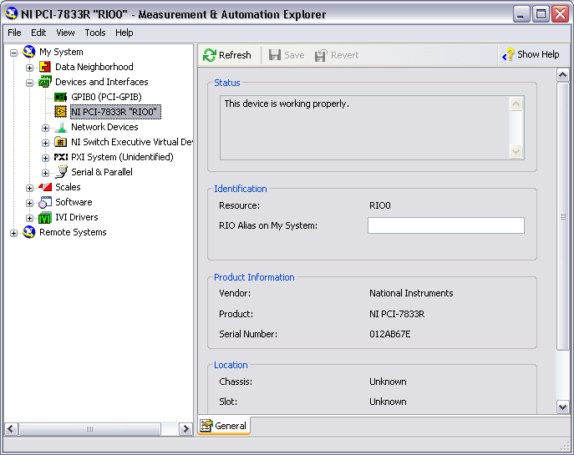
E. Windows Configuration
Notes:
If you are using a PCI or PXI device that is running in your Windows PC, follow the installation instructions included with the device to recognize the FPGA device. After following the installation instructions, your device will appear in MAX under My System»Devices and Interfaces, and you can directly target your FPGA device. This form of setup typically is the easiest because you do not have to worry about network connection problems.

Slide 49
F. Real-Time Configuration
Detect the Remote Target
View Devices and Interfaces
Add/Remove Software
Configure Target Network Settings
Select Host-Target Network Setup

Slide 50
Real-Time Configuration
Detect the Remote Target
View Devices and Interfaces
Add/Remove Software
Configure Target Network Settings
Select Host-Target Network Setup

Slide 51
Host-Target Network Setup
Options:
Host and Target connected to Local Area Network
Typically uses DHCP
Host and Target connected directly using a crossover cable
Host and Target need an IP Address
To configure remote system
Host and Target need to be on the same subnet
Might need to temporarily disable your Firewall

Slide 52
Configure Network Settings
IP Address – the unique address of a device
a set of four one- to three-digit numbers in the range 0–255
dotted decimal notation.
example IP address: 224.102.13.24
Subnet Mask – a code that helps the network device determine whether another device is on the same network.
255.255.255.0 is the most common subnet mask
Gateway (Optional) – address of a gateway server (a connection between two networks)
DNS Address (Optional) – address of a device that stores DNS host names and translates them into IP addresses
Notes:
The Gateway and DNS address settings are optional because they are automatically generated.

Slide 53
IP Addressing Options
Option | Description
DHCP assigned | IP address automatically assigned by DHCP server. DHCP is a common network protocol for administering IP addresses.
Link-local | IP address allocated using automatic private IP addressing when DHCP server not available. AutoIP attempts to assign an address using DHCP first then link local if DHCP fails. Address range: 169.254.x.x
Static IP | Manually assigned IP address
Notes:
Other names for link local: AutoIP, APIPA (Automatic Private Internet Protocol Addressing), Zero configuration network or zeroconf.

Slide 54
IP Addressing Options
Option | Windows Host | Real-Time Controller
DHCP | Default | Default
Link-local | Default if fail to connect to DHCP | Assigned automatically using AutoIP* or configurable in MAX.
Static IP | Configurable in Windows | Configurable in MAX
* AutoIP available with some controllers and/or versions of Real-Time.

Slide 55
Ethernet Cabling Options
Option | Use when…
Standard | Host and target are connected with hub, router, or network switch
Crossover | Directly connecting host and target

Slide 56
FPGA for Real-Time Configuration
Detect the Remote Target
View Devices and Interfaces
Add/Remove Software
Configure Target Network Settings
Select Host-Target Network Setup

Slide 57
Detect Remote Target - CompactRIO
Connect CompactRIO to PC through a network
Power up CompactRIO
Not configured CompactRIO – Status light blinks slowly
Open MAX (Start»Programs»National Instruments)
Remote Systems in MAX– Devices connected over the Ethernet

Slide 58
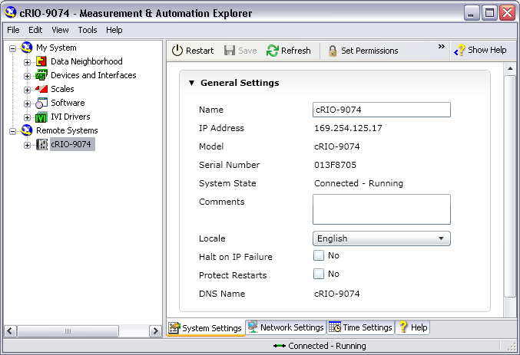
Detect the Remote Target

Slide 59
FPGA for Real-Time Configuration
Detect the Remote Target
View Devices and Interfaces
Add/Remove Software
Configure Target Network Settings
Select Host-Target Network Setup

Slide 60
Configure Network Settings – IP Address
Recommended approach:
Attempt to obtain IP address automatically
Will work if connected to DHCP or controller supports AutoIP
If fail, then specify IP address using suggested value

Slide 61
Configure Network Settings – DHCP & AutoIP
Automatic IP Address from DHCP Server or APIPA
Select Obtain an IP address automatically
Click Apply
Notes:
Address allocated on each reboot. Not guaranteed to be the same address.
Might need to enable IP Reset switch

Slide 62
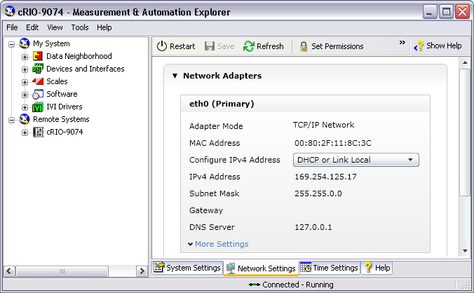
Configure Network Settings – DHCP & AutoIP
4
2
3
1
Notes:
If a Gateway and DNS are not available, leave them blank.

Slide 63
Configure Network Settings – Link Local or Static IP
Manually assign a static IP
Select Use the following IP address
Click on Suggest Values… to view suggested value
Click OK
Click Apply
Notes:
Address must be on same subnet as Windows host
Might need to enable IP Reset switch or set in Safe Mode

Slide 64
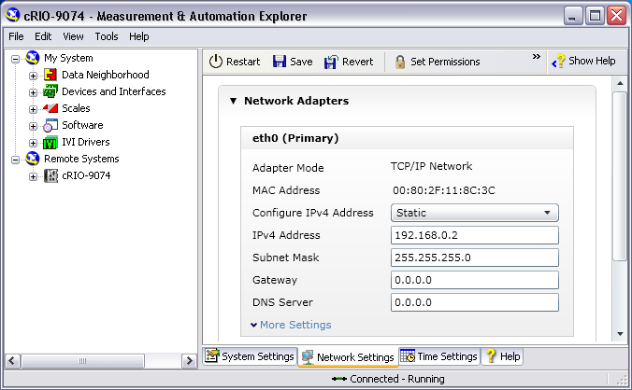
Configure Network Settings – Link Local or Static IP
2
3
1
Notes:
If a Gateway and DNS are not available, leave them blank.

Slide 65
FPGA for Real-Time Configuration
Detect the Remote Target
View Devices and Interfaces
Add/Remove Software
Configure Target Network Settings
Select Host-Target Network Setup

Slide 66
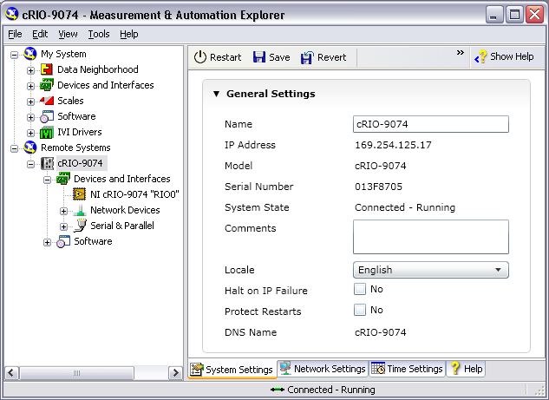
View Devices and Interfaces
Expand Devices and Interfaces to view the chassis
Notes:
Mention that “RIO0” is the name of the FPGA.

Slide 67
FPGA for Real-Time Configuration
Detect the Remote Target
View Devices and Interfaces
Add/Remove Software
Configure Target Network Settings
Select Host-Target Network Setup

Slide 68
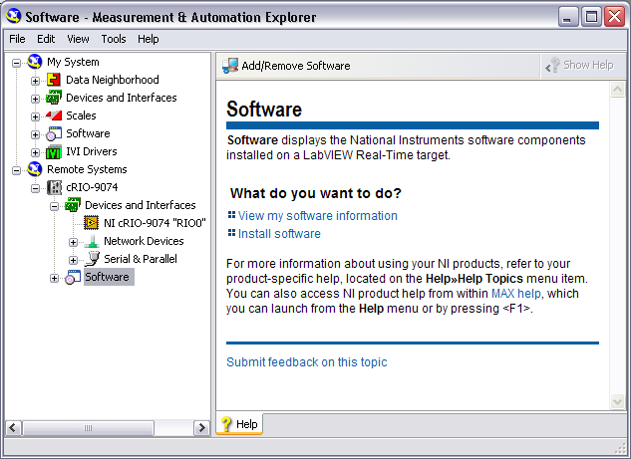
Add/Remove Software

Slide 69
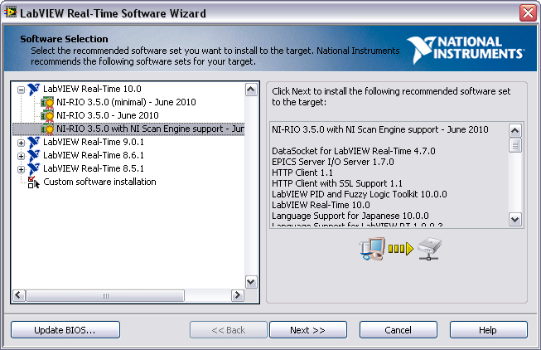
Add/Remove Software

Slide 70
Exercise 2-2: Configure a CompactRIO System
Use MAX to configure the CompactRIO.
Notes:
Prep discussion:
In this exercise, students connect their Windows host to the CompactRIO controller using a crossover Ethernet cable. The Windows host will default to AutoIP addressing. Students will configure the CompactRIO controller to use AutoIP addressing. They will use MAX to reformat their CompactRIO controller and install new software to the CompactRIO controller. For this course, students must install the NI-RIO driver to the controller.
Students are reformatting their controllers to experience the steps necessary to setup a new CompactRIO controller. New controllers only contain the ROM firmware needed for safe-mode boot setup. Students must install the Real-Time operating system and other software for the controller to be useful. Users will typically only reformat a controller if they don’t know the state of the software (for example, a coworker gave them a controller) and they want to start in a clean state.

Slide 71
Exercise 2-2: Configure a CompactRIO System
Why is it important to keep software synchronized between host PC and CompactRIO controller?
How would configuration change if you used DHCP?
Notes:
It is important to keep the software on the development machine synchronized with the software on the CompactRIO machine. If there are mismatches between the NI-RIO, LabVIEW Real-Time, and LabVIEW version software on the CompactRIO and those on the host machine, you will get errors when you attempt to deploy code to the FPGA and RT controller.
After initial software installation, users will typically not need to reformat their controller. They will only need to install new software on the on the controller (1) if they upgrade their software on the host machine as the NI-RIO driver needs to be synchronized between the controller and the host, or (2) they need to add or modify their software selection.

Slide 72
G. Creating a LabVIEW FPGA Project
Steps to create a LabVIEW FPGA Project:
Create a new project
Add a target
Add under “My Computer” if device is a local
Add under “Project” if device is a networked
Discover existing device or create a new device
For online devices, LabVIEW can also discover module and I/O nodes
For offline devices, add modules and I/O nodes
If device is a networked device, connect to the target
Notes:
G. Creating a LabVIEW FPGA Project
Select “Discover an existing” device is you’ve already configured your system in MAX and the device can be accessed from your development computer (i.e., an online device). Select “Create a new device” if the device cannot be accessed from your development computer (i.e., an offline device).
Students learn to add I/O nodes in Lesson 4.
Instructors: Indicate that users can also use the LabVIEW FPGA Project Wizard to create a new LabVIEW FPGA project. In this class, instructions will use the manual method.

Slide 73
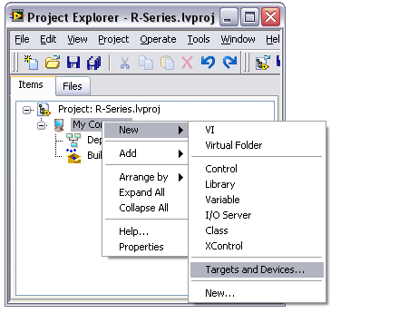
New FPGA Target – Windows
For local targets:
Right-click My Computer and select New»Target and Devices

Slide 74
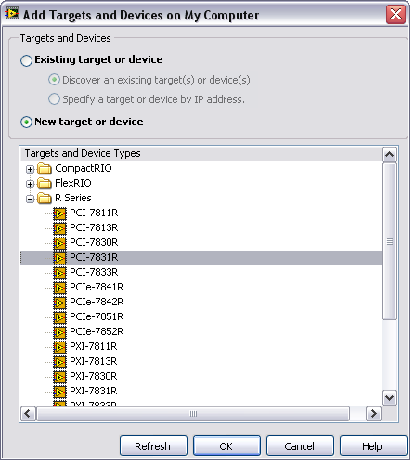
Add Targets and Devices – Windows
Existing target or device
Use when your device can be accessed from your development computer
New target or device
Use when you are not connected with a physical target or device is not present.

Slide 75
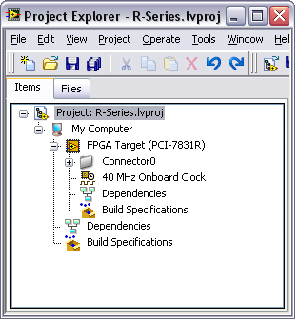
Windows Project
FPGA Target is under My Computer

Slide 76
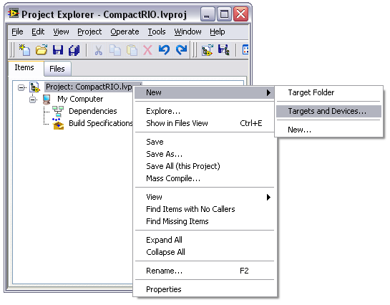
New Target – Real-Time Target
For remote targets:
Right-click on Project and select New»Target and Devices

Slide 77
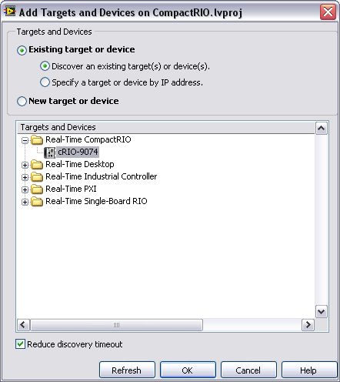
Add Targets and Devices – Real-Time Target
Existing target or device
Use when your device can be accessed from your development computer
New target or device
Use when you are not connected with a physical target or device is not present.

Slide 78
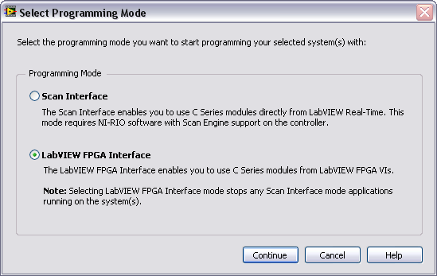
Select Programming Mode - CompactRIO

Slide 79
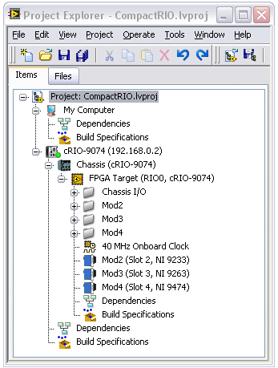
Project with CompactRIO Controller
My Computer and cRIO target are siblings
Bright green dot ➔ target connected
Dark green dot ➔ target not connected
Chassis is under cRIO target
FPGA target is under the Chassis
Notes:
Green light on Target indicates if the Target is connected or not. Bright Green → Connected. Dark Green → Not connected.

Slide 80
Exercise 2-3 & 2-4: Create Two LabVIEW FPGA Projects
Create LabVIEW FPGA Projects for the following two devices:
An offline PCI-7831R
An online CompactRIO 9074
Notes:
Prep discussion:
Students should pay particular attention to the steps in this exercise as in later exercises the instructions will not step users through the process but instead just instruct the students to create an R Series project for an offline device or a CompactRIO project for an online device.
Remind students that “offline” means a device that is not physically connected or accessible from the computer while “online” means a device that is accessible. In this course, student computers are connected to a cRIO controller. Student computers do not have an installed R Series board.

Slide 81
Exercise 2-3 & 2-4: Create Two LabVIEW FPGA Projects
Is it possible to create a simulated project for CompactRIO?
Manually add controller, chassis, and FPGA target
When would you not want LabVIEW to auto-discover your C Series modules?
Notes:
It is possible to create FPGA projects for CompactRIO devices. Since LabVIEW cannot auto-discover the chassis or modules, users will need to manually add the Chassis and modules. They do this through same right-click menu and selecting Add Target or Device. The Chassis needs to be added under the CompactRIO target. The FPGA appears under the Chassis. The user then adds the modules under the FPGA target.

Slide 82
Summary—Quiz
1. Which of the following operations are performed in MAX?
Install software on an R Series board
Install software on a CompactRIO target
Verify connection between host and a real-time target
Assign the IP address of your host computer

Slide 83
Summary—Quiz Answer
1. Which of the following operations are performed in MAX?
Install software on an R Series board
Install software on a CompactRIO target
Verify connection between the host and a real-time target
Assign the IP address of your host computer
Notes:
B and C.
MAX is used to install NI-RIO and other software onto a Real-Time controller such as CompactRIO. You do not install NI-RIO onto a R Series device.
You set the IP address of the controller in MAX. Your Windows IP address is configured in your Local Area Network properties.

Slide 84
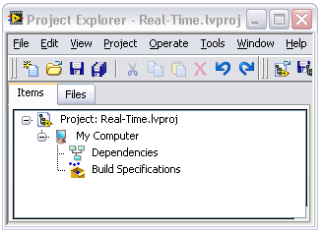
Summary—Quiz
2. Under which node do you add a CompactRIO target?
Real-Time.lvproj
My Computer
Dependencies
Build Specifications

Slide 85
Summary—Quiz Answer
2. Under which node do you add a CompactRIO target?
Real-Time.lvproj
My Computer
Dependencies
Build Specifications
Notes:
Since CompactRIO is a distributed system and doesn’t reside on the host computer, the CompactRIO controller target is added directly under the project. PCI R Series devices are added under My Computer.

Slide 86
Summary—Quiz
3. When would you select New target or device?
You evaluating an FPGA target to see if your application can run on the target
You are developing your application while traveling and you don’t have an FPGA target connected to your laptop
You are curious to see which NI-RIO targets and devices are supported under My Computer
All of the above

Slide 87
Summary—Quiz Answer
3. When would you select New target or device?
You evaluating an FPGA target to see if your application can run on the target
You are developing your application while traveling and you don’t have an FPGA target connected to your laptop
You are curious to see which NI-RIO targets and devices are supported under My Computer
All of the above
Notes:
There are many times where the desired hardware is not physically connected to your computer but you’d like to build an application, in which case you can still add the target or device manually.

Slide 88
Lesson 3 FPGA Programming Basics
Introduction
Defining FPGA Logic with LabVIEW
Developing the FPGA VI
Interactive Front Panel Communication
Selecting an Execution Mode
Compiling the FPGA VI
Basic Optimizations
Notes:
Lesson objectives:
Understand at a high level how logic is implemented on an FPGA.
Understand at a high level how LabVIEW code is translated and compiled into FPGA hardware.
Create an FPGA VI.
Recognize VI and palette differences under FPGA target vs. My Computer
Understand the relationship of interactive front panel communication with FPGA target
Execute a VI on the development computer and understand why it is beneficial to test on development computer before compiling/deploying.
Compile and run an FPGA VI.
Understand the compile report and know how to proceed if it fails.

Slide 89
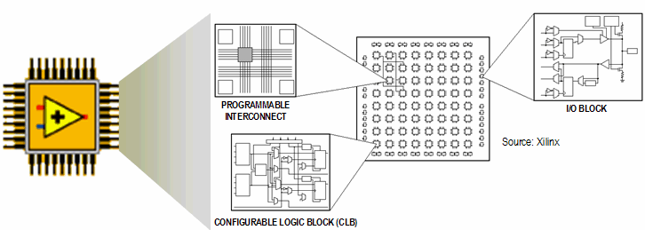
A. Introduction
FPGA Layout and Components
Notes:
A. Introduction
An FPGA is a chip that can be reconfigured through software for different applications. The LabVIEW FPGA Module targets the following NI reconfigurable I/O (RIO) devices:
R Series data acquisition (DAQ)
CompactRIO
Compact Vision
IF-RIO
Refer to ni.com for a current list of devices. R Series DAQ devices support complex data acquisition or real-time I/O applications. FPGA logic on an NI Compact Vision system adds custom triggering, pulse width modulation (PWM) signals, motion control, or custom communications protocols. CompactRIO uses FPGA for modularity, FPGA-timed I/O with built-in signal conditioning, and direct signal connectivity for maximum flexibility in embedded measurement and control applications.

Slide 90
How an FPGA Works
Programmable interconnect switches and wires route signals between various hardware resources in an FPGA
Hardware resources include logical gates, flip-flops, and block memories
For a more detailed description of how FPGA works, see http://www.ni.com/fpga_technology/.
Notes:
For a more detailed description of how FPGA works, see http://www.ni.com/fpga_technology/.
Specifically, it will be helpful to review FPGAs - Under the Hood.

Slide 91
How FPGA Works - Example
Implements a VI that calculates a value for F from inputs A, B, C, and D, where F = (A + B) x C x D
Notes:
An FPGA is analogous to a printed circuit board that has a large number of unconnected components. Traditionally, the devices are connected with physical wires soldered to the pins with a wire wrapping tool, or embedded in the printed circuit board. The physical wires are difficult to modify. However, the connections in an FPGA circuit are dynamically defined in software when the LabVIEW code compiles and the bitstream is downloaded. The bitstream causes semiconductor switches to turn on or off, thereby defining the connections between gates.

Slide 92
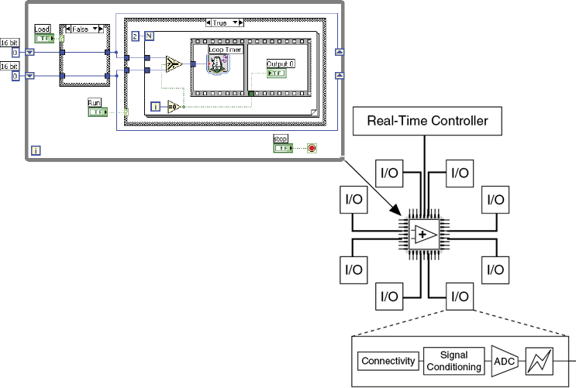
B. Defining FPGA Logic with LabVIEW
LabVIEW FPGA
Do not have to learn VHDL or Verilog
True parallel execution
Deterministic

Slide 93
True Parallel Execution
F = (A+B)C and Z = X+Y+M in separate gates on an FPGA

Slide 94
I/O, FPGA, and Host Communication
FPGA provides:
Timing
Triggering
Processing
Custom I/O
Each fixed I/O uses a portion of the FPGA hardware resources
The computer interface also uses a portion of the FPGA hardware resources

Slide 95
Timing Features of FPGA
Multi-loop analog PID loop rates exceed 100 kHz on embedded RIO FPGA hardware whereas they run at 30 kHz in real-time without FPGA hardware
Digital control loop rates can execute up to 1 MS/s or more depending on the target
Single-cycle timed loops execute up to 200 MHz or more depending on the target and clock configuration
Due to parallel processing ability, adding additional computation does not necessarily reduce the speed of the FPGA application

Slide 96
C. Developing the FPGA VI
There is no operating system on the FPGA
Download and run only one top-level VI at a time
FPGA can run independently of the host
FPGA can store data in memory
Edit VI under an FPGA Target to use the FPGA palette
Use integer or fixed-point math to perform calculations
Notes:
Instructor Note: Refer students to www.ni.com/ipnet for FPGA examples and intellectual property that other customers have developed and chosen to share. This site contains a number of module-specific examples as well as complete applications.
If you have an internet connection, navigate to this website and show the students around the site.
Also, there are shipping-examples available from the NI Example Finder.

Slide 97
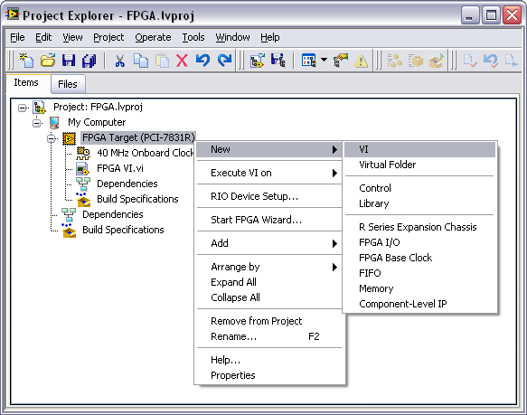
Add a VI Under the FPGA Target
Notes:
You start building the FPGA VI from the Project Explorer. Right-click the FPGA target and select New»VI as shown in the figure above. Save the VI in an appropriate folder and save the project.

Slide 98
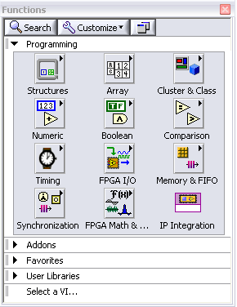
FPGA Palettes
VIs under the FPGA target inherit the FPGA Function Palette
Many palettes are similar to LabVIEW for Windows
FPGA-specific palettes
FPGA I/O
Memory & FIFO
Synchronization
FPGA Math & Analysis
IP Integration
Notes:
FPGA I/O, Memory & FIFO, Synchronization, FPGA Math & Analysis and IP Integration palettes are specific to the FPGA module and are only available when editing VIs under an FPGA target.

Slide 99
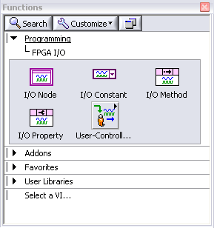
FPGA I/O Palette
Notes:
Provide communication with I/O modules

Slide 100
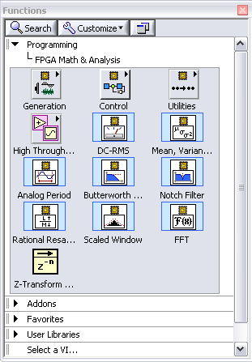
FPGA Math & Analysis Palette
Keep calculations as simple as possible to preserve space on the FPGA
Functions perform point-by point calculations
Notes:
LabVIEW 8.2 and prior
Only integer math
LabVIEW 8.5 and later
Allows for integer math and fixed-point calculations

Slide 101
Demonstration 3-1
Create an FPGA VI and explore the Functions palette supported under FPGA.
Notes:
Open the solution to Exercise 2-4, CompactRIO.lvproj
Create a new VI on the FPGA target.
Explore the function and control palettes.
Be sure to navigate to the FPGA I/O and FPGA Math and Analysis palettes

Slide 102
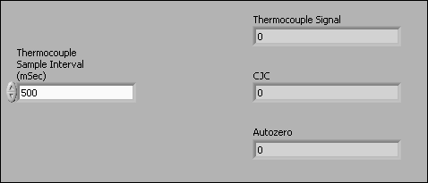
Top-Level FPGA VI Front Panel
Hardware resources inside an FPGA are limited
Use the minimum necessary controls and indicators for programmatic Front-panel communication to a host
Add temporary controls and indicators for debugging if necessary, but remove them
Notes:
“Simple controls and indicators” include numerics, Booleans, strings, etc. That is, any non-array/cluster control or indicator.

Slide 103
D. Interactive Front Panel Communication
FPGA has no user interface
Must communicate data from FPGA to Host PC or rely exclusively on I/O
Front Panel displayed on Host PC
Block Diagram executes on FPGA as compiled
Communication layer shares all control and indicator values
Cannot use debugging tools when running FPGA VI
Test with development computer first, or add indicators as probes

Slide 104
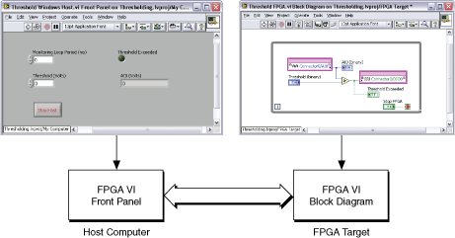
Interactive Front Panel Communication
Notes:
You use Interactive Front Panel Communication to communicate between the host computer and the VI running on the FPGA as shown in the figure above. You use Programmatic FPGA Interface Communication to programmatically control and communicate with FPGA VIs from host computer VIs. The front panel data you receive during Interactive Front Panel Communication is not deterministic.
You will learn alternate communication processes later in this course.

Slide 105
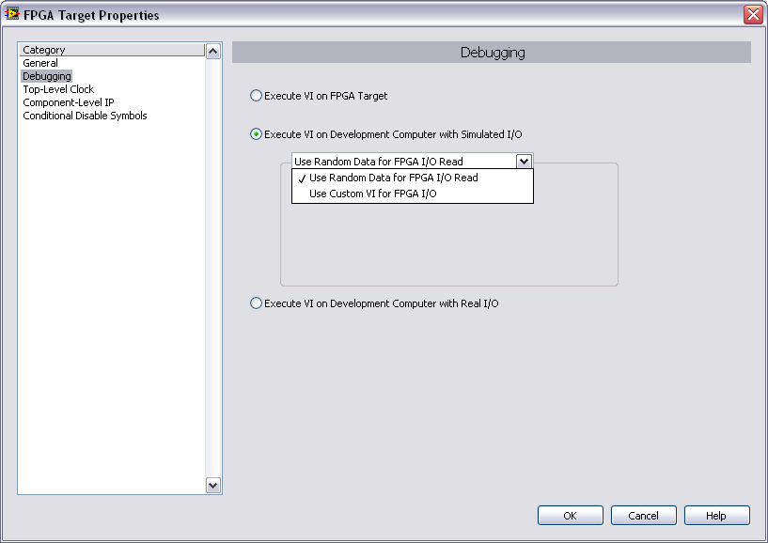
E. Selecting an Execution Mode
Right-click the FPGA Target in the Project Explorer window and select Properties to launch FPGA Target Properties dialog box
Or
Right-click the FPGA Target and select Execute VI on to select mode directly

Slide 106
Selecting an Execution Mode – Options
Execute VI on FPGA Target
Execute VI on Development Computer with Simulated I/O
Use Random Data for FPGA I/O Read
Use Custom VI for FPGA I/O
Execute VI on Development Computer with Real I/O
Not supported by all FPGA targets
Notes:
Execute VI on FPGA Target – The FPGA VI will execute on the FPGA target. Before running on the FPGA, the code must be compiled.
Execute VI on Development Computer with Simulated I/O – The FPGA VI will execute on the development computer using simulated data for any I/O. You can either use random data for I/O reads or you can create and use a custom VI to generate your simulated I/O.
Execute VI on Development Computer with Real I/O – This method executes the VI on the development computer but uses real I/O data from the FPGA target. This method is not supported by all FPGA targets and some of the targets that do support it do not support all I/O resources.

Slide 107
Testing with the Development Computer
Compiling to run on the FPGA can require a few minutes to several hours
Verify logic before compiling by executing the VI on the development computer (Windows PC)
Traditional debugging tools are available
Notes:
You can run the FPGA VI in Windows to check the logic of the application before compiling. The development computer simulates the I/O operations but does not duplicate the hardware timing. The development computer can use either simulated I/O or real I/O from the FPGA target. Simulated I/O can be generated using random data or a custom VI.
Troubleshoot using traditional debugging tools:
Execution highlighting – Execution highlighting shows the movement of data on the block diagram from one node to another using bubbles that move along the wires.
Single-stepping – Single-step through a VI to view each action taken by each VI on the block diagram as the VI runs.
Probe tools – Use the Probe tool to check intermediate values on a wire as the VI runs.
Breakpoints – Use the Breakpoint Tool to place a breakpoint on a VI, node, or wire and pause execution at that location.
When testing is complete, set the execution mode to the FPGA target so that the VI can be compiled and tested on the FPGA target.

Slide 108
Exercise 3-1: VI Execution on the Development Computer
Create an FPGA VI and verify the functionality of the VI using the development computer.
Notes:
Prep discussion:
In this exercise, students will open and modify the project that they worked on in Exercise 2-4.
They will develop a VI to perform basic arithmetic and test it on the development computer.
Encourage the students to explore the different palettes that are available on the FPGA target.

Slide 109
Exercise 3-1: VI Execution on the Development Computer
Note how quickly you were able to progress from development to testing.
Have you ever tried troubleshooting a VI without using the debugging tools?
Notes:
The debugging tools are only available when executing on the development computer. When you compile code to execute on the FPGA target, those tools will no longer be available.

Slide 110
F. Compiling the FPGA VI
Turn the FPGA VI into executable code
FPGA Module compiles VI
Graphical code translated to VHDL
Xilinx ISE compiler creates circuit from VHDL
Compiler optimizes the implementation
A bitstream file results
Bitstream loads at run-time
Windows OS
LabVIEW
FPGA VI
(1) Intermediate Files
Compile
Server
Compile
Worker
(1) Intermediate Files
Bit File Embedded
(2) Bit File
Notes:
Bitstream may reload at power-up if target is configured for that
On-board flash memory
Controller over PCI Bus

Slide 111
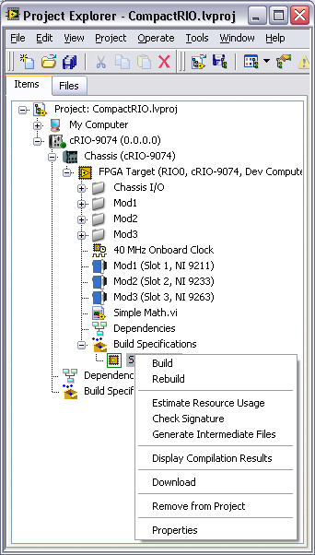
Working with Build Specifications
You must create a build specification before you can compile an FPGA VI
If you do not create one, LabVIEW creates and specifies a default specification for the VI
You can specify a default build specification
To create a build specification, right-click a build specification under an FPGA target in the Project Explorer window.
Available options vary by target
Notes:
You must create a build specification before you can compile the FPGA VI into an FPGA application. If you click the Run button without first making a build specification, LabVIEW automatically creates and specifies a default build specification for the corresponding VI. LabVIEW uses the build options you set to generate the HDL and bitfile from the block diagram.
Right-click a build specification under an FPGA target in the Project Explorer window and select from the following options. The options can vary depending on the hardware target.

Slide 112
Common Build Specification Actions
Build—This command compiles the VI.
Estimate Resource Usage—Estimates FPGA resource usages without compiling.
Generate Intermediate Files—Generates intermediate files without compiling the VI. Useful for catching certain code generations errors.
Display Compilation Results—Displays the Compilation Status window. You must build the build specification once to display the Compilation Status window.

Slide 113
Stages of the Compilation Process
Generation of Intermediate Files (HDL code)
Estimation of resource usage
HDL Compilation, Analysis and Synthesis
Mapping
Placing and Routing
Generating Bitstream
Notes:
Generate Intermediate Files – LabVIEW converts the VI into intermediate files to send to the LabVIEW FPGA Compile Server.
Estimation of resource usage– Estimate FPGA resource usages without compiling. If the generated code signature is not current, this command first generates intermediate files and then estimates resource usage.
HDL compilation, analysis, and synthesis—Transforms intermediate files into digital logic elements.
Mapping—Divides the application logic between the physical building block on the FPGA.
Placing and Routing—Assigns the logic to physical building blocks on the FPGA and routes the connections between the logic blocks to meet the space or timing constraints of the compilation.
Generating Bitstream—Creates binary data that LabVIEW saves inside a bitfile.

Slide 114
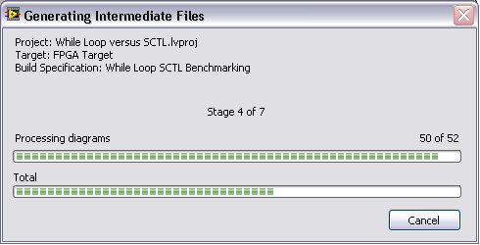
Generate Intermediate Files (HDL Code)
Click Run
Generating Intermediate Files window launches
Converts graphical code to VHDL
Generates intermediate files
Once compilation starts, do not edit the VI
Create a compilation queue by starting another compilation while the first is still running
Notes:
Do not edit VI while compiling. Either abort the compilation or save the modified VI under a different filename and perform your edits there.
You can create a queue of compilations by opening another FPGA VI and starting a compile for that VI while the first compilation is still running. Once the first compilation finishes, the next will start.

Slide 115
Exercise 3-2, Part A: VI Execution on the FPGA Target
Begin Exercise 3-2 to start compilation of a working VI to run on an FPGA target.
Do only Part A.
Notes:
Prep discussion:
Open existing project and modify to execute on FPGA target
Part A ends with initiating the compilation.
While the code compiles, lecture will resume. Ask students to indicate when they have started compiling so that you can resume lecture as soon as possible.
During lecture, students can open the dialogs that are being discussed.

Slide 116
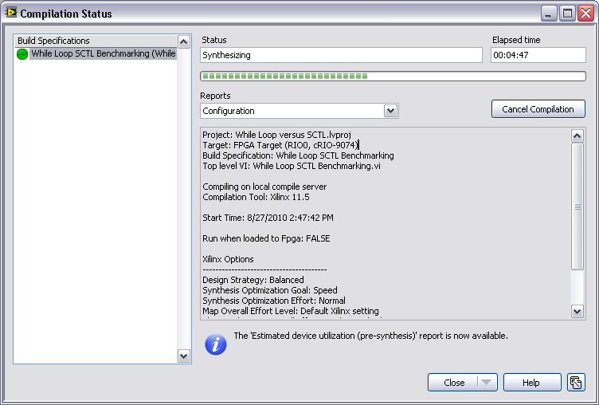
Compilation Status Window
Reports
Select the report that is displayed
Close Option
Close window
Disconnect All
Cancel All Compilations
Help
Notes:
The Compilation Status window appears when you compile an FPGA VI. If you have compiled a build specification already, you can right-click the build specification and select Display Compilation Results from the shortcut menu to display this window.
Use this window to view status and compilation information for the FPGA build specification. You also can use this window to disconnect from the compile server or cancel the compilation.
This window includes the following components:
Build Specifications—Lists the build specifications that are compiling or have compiled during this session of the Compilation Status window. To remove a build specification from this list, right-click the build specification and select Remove from List from the shortcut menu.
Status—Displays the progress of the FPGA VI compilation.
Last Update Time—Displays the last time the compile server updated the information.
Reports—Specifies the type of compiler information you want to view. Not all reports are available at the beginning of the compilation. A message appears in the Compilation Status window when reports become available to view.
Save—Saves the final compilation status report to a file. The Save button is available only for the Xilinx log report and only when the compilation is complete.
Investigate Timing Violation—Displays the Timing Violation Analysis window. This button is available only if a timing violation occurs.
Cancel Compilation—Cancels the compilation of the build specification you select in the Build Specifications list.
Close—Closes the Compilation Status window. Use the pull-down menu on this button to close the window with the following options.
Close Window (default)—Closes the window and continues communicating with the compile server.
Disconnect All—Disconnects LabVIEW from the compile server. Any compilation jobs running will continue, but LabVIEW will not receive any updates. Disconnect from the compile server when you want to shutdown LabVIEW. You do not need to disconnect from the compile server to perform other operations in LabVIEW while the FPGA VI is compiling.
Cancels All Compilations—Cancels the current compilation jobs.

Slide 117
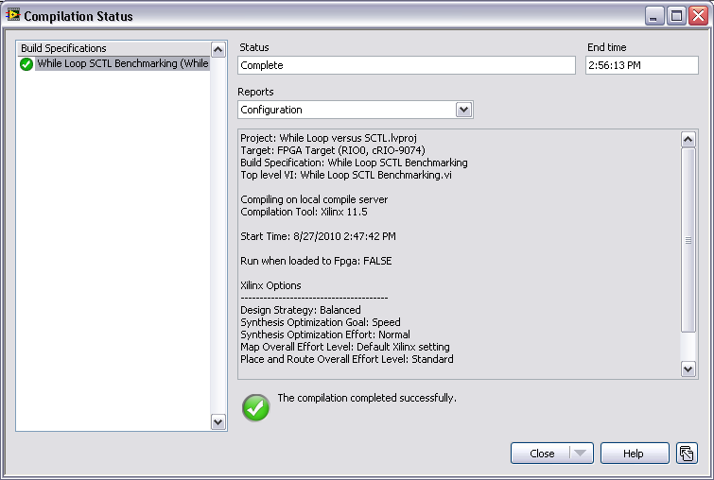
Configuration Report
Project information
Xilinx compiler configuration for the FPGA VI

Slide 118
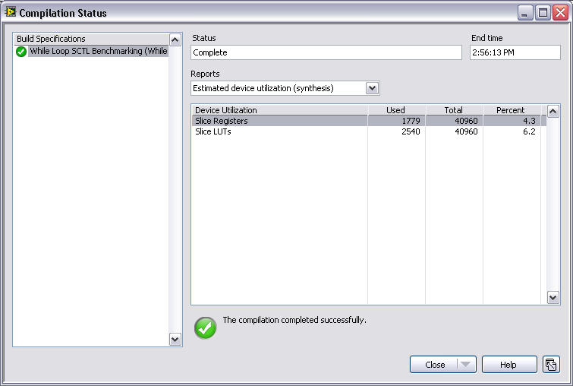
Device Utilization Report
Separate reports generated at pre-synthesis and synthesis stages of compilation
Notes:
Device Utilization Report Details
There are two Device Utilization reports generated. The first is available after the compilation server completes the synthesis step of compilation. The other is available after the mapping step.
This report contains a summary of the FPGA utilization, including the following information:
Device Utilization—Indicates the FPGA element, such as slices, flip-flops, LUTs, and blocks of RAM
Used—Indicates how much of the FPGA element the compiled FPGA VI uses.
Total—Indicates how much of the FPGA element is available.
Percent—Indicates the percentage of used FPGA element to total FPGA element.
If the Percent column approaches or exceeds 100%, you may want to stop the compilation and optimize your code. This condition is a good indicator of a potential failure in a later stage of compilation.

Slide 119
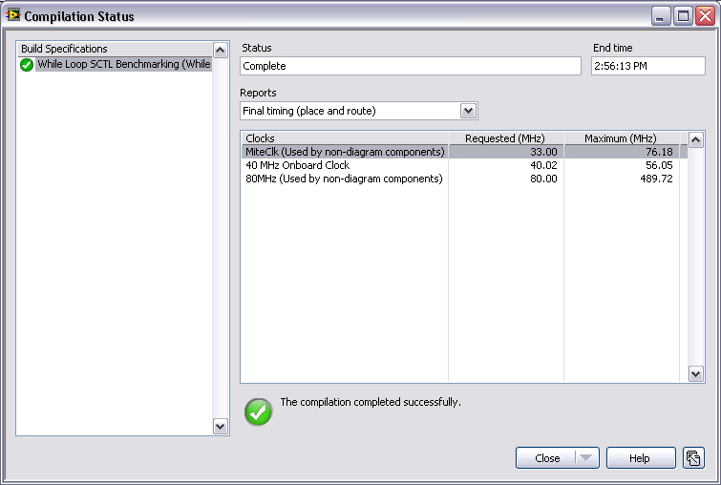
Timing Report
Separate reports generated at mapping (estimated values), and placing and routing (actual values) stages of compilation
Notes:
Timing Report Details
There are two timing reports generated over the course of compilation. The first is generated after the mapping stage and the second is generated after the placing and routing stage.
The second report is available after the compilation server completes the routing step of the compilation process. This report contains a summary of the FPGA clocks, including the following information:
Clocks—Indicates the clock rate, in megahertz, at which the compiled FPGA VI runs.
Requested (MHz)—Indicates the clock rate, in megahertz, at which the FPGA VI or FPGA VI component must be able to run.
Maximum (MHz)—Indicates the theoretical maximum compilation rate, in megahertz, for the FPGA VI or FPGA VI component.
If the requested rate approaches or exceeds the maximum rate, you may want to stop the compilation and optimize your code. If the compilation is not able to transfer your code to the FPGA in such a way that the requested rate falls under the maximum, then the compilation will fail.

Slide 120
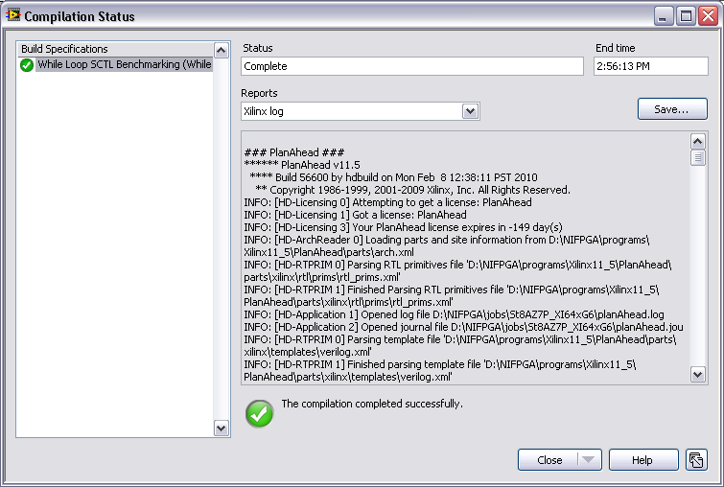
Xilinx Log Report
Includes xflow.log and xflow.twr files
Available after compilation is complete
Can be saved to a file
Notes:
Xilinx Log Report Details
This report includes the XilinxLog.txt and .twr files and is available only after the compilation is complete. The XilinxLog.txt file includes Xilinx-specific details about the compilation process. If you are familiar with Xilinx tools, you might be able to use this file to troubleshoot compilation failures. The .twr file is a trace report that provides detailed timing information. Click Save to save this information to a file.

Slide 121
Exercise 3-2, Part B: VI Execution on the FPGA Target
Complete Exercise 3-2 to view reports generated after compiling a working VI to run on an FPGA target.
Notes:
Prep discussion:
Has the compilation finished yet? Note the time indicated above the progress bar.
This is a simple VI and yet it took that long to compile. Larger, more complicated VIs will take longer.
In this exercise, the students are going to peruse several of the reports that were generated to observe the data that was logged.

Slide 122
Exercise 3-2, Part B: VI Execution on the FPGA Target
What is the benefit of having reports generated at different points of the compilation?
What if you hadn’t tested on the development computer and the VI did not function as intended?
What if your compilation fails?
Notes:
The benefit of having reports generated at different points of the compilation is that you can stop the compilation if any of your device utilization or timing parameters exceed the limits of the FPGA. That condition is an indicator of possible compilation failure.
If this were a more complicated VI and the student had compiled it without testing on the development computer, then the time spent compiling would have been wasted, because they will have to debug the application and try recompiling. They should ALWAYS test on the development computer first.
This is an open-ended question. It also leads in nicely to the next section on basic optimizations. It also ties into benchmarking (Lesson 5) and single-cycle timed loops (Lesson 7). Various other optimizations will be discussed throughout the course.

Slide 123
Compiling an FPGA VI Remotely
To free resources on the local computer, install the LabVIEW FPGA Compile Server and Compile Worker on a remote computer and compile the FPGA VI remotely
Refer to Compiling an FPGA VI Remotely (FPGA Module) in the LabVIEW Help for more information about compiling FPGA code remotely
Notes:
You can compile an FPGA VI on a computer other than the development computer. You might want to do this if the development computer is slow or does not have enough memory to compile the VI for the FPGA device. By default, LabVIEW assumes the LabVIEW FPGA Compile Server is installed on the local computer.
Also, refer students to the KnowledgeBase titled Installing and Activating LabVIEW FPGA Compile Server on a Remote Computer for more information on that topic.

Slide 124
Causes of Compilation Failure
Timing
Delays in the designed circuit exceed the period of the specified clock
Device utilization
The design requires more resources than are available on the FPGA
Notes:
FPGA VIs are limited primarily in two areas:
Speed—Relates to the actual execution speed of the FPGA gates. If the code does not execute at the loop rate you want, you must modify the application to increase the loop rate. These modifications can change the way you create and design the FPGA VI.
Size—Relates to the actual amount of space the application uses on the FPGA. If the application requires more hardware components than are physically available on the FPGA, the compile fails and the application cannot run on the FPGA.
Specific techniques for optimizing your code for each of these areas are presented later throughout this course.

Slide 125
G. Basic Optimizations
These types of optimizations are relatively easy to implement
Require no major changes in code architecture
Should be basic programming practice for all FPGA VIs
Basic Optimizations primarily affect FPGA size

Slide 126
Types of Basic Optimizations
Limit front panel objects
Use small data types
Avoid large functions

Slide 127
Limit Front Panel Objects
Each Front Panel Object on the Top-Level VI must have logic to interact with the host VI
Each read and write from the host to the FPGA is broken down into 32-bit packets to transfer across the bus
Arrays/Clusters with more than 32 bits require extra copy on the FPGA to guarantee all the data is read or written coherently
Notes:
When data is transferred across the bus between the FPGA and RT Host, it must be broken down into 32-bit packets. This limitation is due to the number of data transfer lines on the bus. Therefore if you have a front panel element that uses more than 32-bits, then that front panel element must be broken down into several 32-bit chunks and be passed along the bus piecewise. This breaking down of the data reduces overall transfer speeds and as such having larger front panel objects should be avoided.

Slide 128
Limit Front Panel Arrays
Avoid using arrays on the Front Panel
All arrays must be of fixed size
Compile fails if more bytes in array than are available
Can quickly use large amounts of FPGA size
Each bit in the array uses its own flip-flop on the FPGA
If only enough time to do 1 optimization, do this optimization
Notes:
Arrays consume significant space on the FPGA because each bit in the array uses a flip-flop on the FPGA.
When you wire an array as an input to an FPGA VI or function, the FPGA compiler creates the equivalent of a For loop to process each element of the array in sequence. If you wire a cluster as an input to an FPGA VI or function, the FPGA compiler creates parallel logic for each element of the cluster. The relationship between arrays and clusters is recursive such that if you wire a cluster of arrays as an input, the arrays are processed in parallel and the array elements are processed sequentially.
Note: Performing operations on arrays can limit the maximum top-level or derived clock rate. To maximize the FPGA clock rate, process single data points instead of arrays.

Slide 129
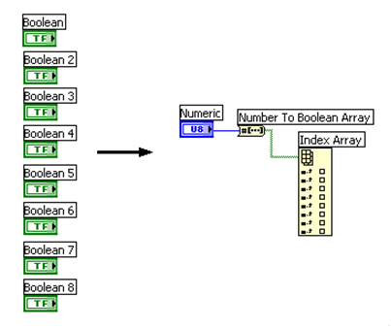
Bitpack Boolean Logic
Each control has overhead in addition to the size of the data type.
Maintain the same information using fewer controls
Display binary data as an integer
Use a Boolean array or cluster control/indicator
Notes:
Each control has enable chain overhead in addition to the size of the data type. This additional overhead requires the use of additional logic on the FPGA. By bitpacking Boolean logic, you remove this overhead.
Bitpacked logic maintains the same information using fewer controls.
Display binary data as an integer
U8 numeric control can replace eight Boolean controls
Use a Boolean array or cluster
Due to the small size of Boolean controls/indicators, this is an acceptable exception to the rule of avoiding arrays/clusters on the front panel.
You can use functions to manipulate data in the same manner as you would otherwise.

Slide 130
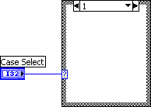
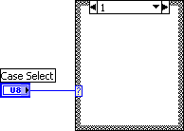
Use Small Data Types

Slide 131


Use Small Data Types - Coercion
Eliminate coercion dots
Determine necessary input format
Insert conversion function
Intentional coercion results in more efficient implementation
Notes:
Whenever a coercion dot is used it means that the complier must determine the proper data type and it can lead to inefficient conversion of data. Instead of leaving the coercion to chance it is better to directly specify the desired data type and insert the appropriate coercion function any time that you see a coercion dot on your block diagram.

Slide 132

Avoid Large Functions
Not all functions are equal
Notes:
These functions can take significant FPGA resources both in size and speed of your application.
Quotient Remainder: This function should typically be avoided if possible. If you want to divide by some power of 2, then it is best to use Scale by Power of 2 with a negative power to achieve the same results
Scale by Power of 2: This function is large when using a control for the input of the power; however, if you use a constant wired to the power, then the function is a ‘free’ function.

Slide 133

Avoid Large Functions – Quotient & Remainder
This function consumes significant space on the FPGA
Quotient & Remainder often used to increment based on iteration number
Consider replacing with actual increment function and shift register

Slide 134
Avoid Large Functions – Scale By Power of 2
Uses significant FPGA space if input for power is a control
However, if you wire a constant to the input, the function consumes no space on the FPGA
Use negative powers to replace Quotient & Remainder function whenever possible

Slide 135
Summary—Quiz
You developed a VI and set the project to execute the VI on the FPGA Target. You compile the code and run the VI. Which of the following statements is true?
The block diagram and the front panel both execute on the FPGA
The block diagram executes on the FPGA and the front panel executes on the host computer.
The block diagram executes on the host computer and the front panel executes on the FPGA.
The block diagram and front panel both execute on the host computer

Slide 136
Summary—Quiz Answer
You developed a VI and set the project to execute the VI on the FPGA Target. You compile the code and run the VI. Which of the following statements is true?
The block diagram and the front panel both execute on the FPGA
The block diagram executes on the FPGA and the front panel executes on the host computer.
The block diagram executes on the host computer and the front panel executes on the FPGA.
The block diagram and front panel both execute on the host computer
Notes:
Answer: B. The block diagram executes on the FPGA and the front panel executes on the front panel. This concept is known as interactive front panel communication. Values entered into the front panel controls are passed from the host computer to the compiled code that executes on the FPGA.

Slide 137
Summary—Quiz
Where should you first test of your FPGA VI’s functionality?
FPGA target
Development computer

Slide 138
Summary—Quiz Answer
Where should you first test of your FPGA VI’s functionality?
FPGA target
Development computer
Notes:
Answer: B. Development computer. Compilation is required before code can be executed on the FPGA target and that process can take a significant amount of time. Once the basic code functionality has been verified, then the code should be compiled and tested on the FPGA target.

Slide 139
Summary—Quiz
Which of the following is NOT the name of a report generated as part of the compilation process?
Summary
Final Device Utilization (map)
Final Timing (place and route)
Optimization

Slide 140
Summary—Quiz Answer
Which of the following is NOT the name of a report generated as part of the compilation process?
Summary
Final Device Utilization (map)
Final Timing (place and route)
Optimization
Notes:
Answer: D. Optimization. The reports that are generated can be used to determine where optimization should occur (size, timing, etc), but there is no report named Optimization.
The reports that are generated are:
Summary
Configuration
Estimated device utilization (synthesis) Estimated timing (map) Final device utilization (map)
Final timing (place and route)
Xilinx log

Slide 141
Summary—Quiz
Which of the following does NOT describe a VI that is developed under the FPGA target and set to execute on the FPGA?
The Front Panel of the FPGA VI executes on the FPGA target
Non-sequential code in an FPGA VI executes in parallel
FPGA VI executes independently of the host
Only one top-level VI can run on the FPGA at a time

Slide 142
Summary—Quiz Answer
Which of the following does NOT describe a VI that is developed under the FPGA target and set to execute on the FPGA?
The Front Panel of the FGPA VI executes on the FPGA target
Non-sequential code in the FPGA VI executes in parallel
The FPGA VI executes independently of the host
Only one top-level VI can run on the FPGA at a time.
Notes:
A. The Front Panel of the FPGA VI executes on the FPGA target. The Front Panel of the FPGA VI executes on the host computer. Only the block diagram is compiled and executed on the FPGA VI.

Slide 143
Lesson 4 FPGA I/O
Introduction
Configuring FPGA I/O
I/O Types
Integer Math
Fixed-Point Math
CompactRIO
Error Handling
Notes:
Lesson Objectives:
Add/Remove I/O from project.
Use I/O node on block diagram to read/write to I/O.
Identify situations where error handling is appropriate.
Access digital I/O from either line or port.
For R Series devices
Know that most scaling happens on the host
Know that analog I/O is of the integer data type.
Know that there is an optimization trade-off between divide and power of 2 operations on FPGA.
For CompactRIO devices
Use LabVIEW to learn about module-specific methods, properties, and timing.
Know that analog I/O is of the fixed-point data type.
Understand the fixed-point data type and how to perform arithmetic operations.

Slide 144

A. Introduction
FPGA I/O items connect I/O to the FPGA logic
Each FPGA I/O item has a type like analog or digital
FPGA VIs can have multiple types of I/O items
In the NI Example Finder, navigate to:
Toolkits and Modules»FPGA»CompactRIO»Basic IO

Slide 145
FPGA I/O Terminology
Terminal – a hardware connection, such as on a CompactRIO module
I/O Resource – a logical representation in LabVIEW FPGA of a hardware terminal
I/O Name – a name assigned in the LabVIEW project to a particular I/O Resource

Slide 146
B. Configuring FPGA I/O
Adding FPGA I/O to the LabVIEW project
If using CompactRIO, detect modules when you add your chassis.
All FPGA I/O added automatically
If using R Series, manually add FPGA I/O
Select which FPGA I/O channels you want to add
Notes:
Some developers find it simpler to see all available channels at all times; whereas other develops prefer to only have the project contain the channels necessary for their application. Neither method creates more efficient code than the other, so using or not using all FPGA I/O channels is a matter of preference.
You can also use the FPGA Project Wizard to create your project. In this case, all FPGA I/O is added automatically.

Slide 147

Adding FPGA I/O to a CompactRIO Project
Notes:
After you select to add an Existing Target for a CompactRIO target from the Add Targets and Devices dialog, you will be prompted with the Discover C Series Modules? dialog. Selecting Discover will halt any current FPGA execution and then add ALL the channels in all the modules. If you do not want to halt your current execution or you do not want to add all the channels in all the modules, select Do Not Discover. You can manually add each module and channel to your Real-Time project.

Slide 148


Adding FPGA I/O to an R Series Project
Notes:
To manually add FPGA I/O to your project:
Right-click the FPGA target from the Project Explorer and select New»FPGA I/O to launch the New FPGA I/O dialog box.
Select I/O in the left pane of the New FPGA I/O dialog box
Click right arrow button to add the I/O to the project.
You can name your I/O by clicking the default name and entering a meaningful name for your application.
Click OK to add the I/O to the project.

Slide 149

FPGA I/O Palettes
Notes:
The FPGA I/O palette includes the following functions for configuring the I/O hardware.
FPGA I/O Node—Reads or writes data from or to the FPGA I/O.
FPGA I/O Constant—Specifies an FPGA I/O item on the block diagram.
FPGA I/O Method Node—Invokes an I/O method for a specific channel or C Series module.
FPGA I/O Property Node—Reads or sets property attributes of a specific channel or C Series module.

Slide 150


Placing I/O Nodes

Slide 151




C. I/O Types
Digital Line – Writes and/or reads Boolean value to/from digital line
Digital Port – Writes and/or reads unsigned integer value to/from digital port (grouping of digital lines)
Analog I/O – Writes or reads data to/from an analog channel
R Series – Integer values
CompactRIO – Fixed-point values (can revert to integer)
Other
Motion
CAN

Slide 152

Digital I/O
Individual Lines – Boolean data type
Ports (collection of lines) – Integer data type (1 bit per line)
Depending on your hardware, digital I/O can be unidirectional or bidirectional
If the digital I/O line or port is bidirectional and you want to change direction of the line or the port from the FPGA VI, use the I/O Method Node, and select Set Output Enable method.
Notes:
The data type of the digital port will depend on the number of lines in the port.
Some CompactRIO modules are unidirectional and others are bidirectional. Refer to the hardware manual for the capabilities of specific modules.
Refer students to Digital Line Input and Output – cRIO example in the NI Example Finder.

Slide 153

Creating Counters from Digital I/O
FPGA does not have built-in counter hardware
Can be programmed into the FPGA
Minimum input pulse width detectable depends on loop period and hardware
On some hardware, you can get improved performance by replacing the While Loop with a Timed Loop.
Notes:
The example above has the following specifications:
About 10 ticks per iteration
250 ns to guarantee a high or low read
500 ns period = 2 MHz signals.
It can read a signal at a maximum of 2 MHz. It is important to benchmark your counter before using it in a final application. We’ll discuss benchmarking more in Lesson 5.
Refer to Toolkits and Modules»FPGA»Compact RIO/R Series» FPGA Fundamentals»Counters in the NI Example Finder for related examples.

Slide 154
Analog I/O
Different devices have different default data types for analog I/O
Signed integer (R Series Devices)
16-bit or 32-bit depending on the device
Data is raw (calibrated and unscaled)
Fixed-point data (CompactRIO modules)
Data is calibrated
Floating-point operations are ordinarily not performed in the FPGA
Use the host for floating-point analysis instead
Notes:
Because the FPGA requires fixed gates to be created for its logical pathways it cannot handle data with floating mantissa and exponent data. If you need to perform floating-point analysis it is typically simplest to offload those calculations to the host for processing.
However, not all calculations can or should be offloaded to the host. Therefore if you wish to perform calculations with the FPGA VI then all of those calculations will have to be done with Integer Math or Fixed-Point Math.

Slide 155
D. Integer Math
Analog Input
Converts binary representation of the voltage to a signed integer
Pass this raw, unscaled data to the host VI for conversion to Volts or other units
Analog Output
Convert value in Volts to binary representation in the host VI
Write the binary representation of the voltage to the D/A converter
Notes:
For example, an analog module may acquire voltage values that can range from -10 to 10V. The data type of an I/O node for that module may be an unsigned long (U32), meaning that the data read would range from 0 to 4,294,967,295, with -10V corresponding to 0 and 10V corresponding to 4,294,967,295. This unscaled integer data is referred to as the binary representation of the voltage value.
Conversion to/from the binary representation should occur in the RT or Windows host VI.

Slide 156

Numeric Palette
Most basic numeric functions can be used on the FPGA target
Calculations can be performed with integers and fixed-point numbers

Slide 157
Integer Division
Divide function cannot return an integer value, so you must use other functions for integer math.
Scale by Power of 2
Quotient & Remainder
Notes:
Recall the discussion of these functions in the Optimization section of Lesson 3 FPGA Programming Basics. Selection of function to use should be based upon size and speed factors.

Slide 158

R Series Scaling in LabVIEW FPGA
For variable scaling, you can determine and set the scaling factor and n from the host application.
To multiply the data from AI0 by 0.7 we could use:
Scaling Factor: 11500 Bit Shift: –14 bits Resulting Multiplication: 11500 / 2^14 = 0.7019
Notes:
There are some ways to manipulate integer math functions so that you can create “floating-point” operations. The most common techniques use the Scale By Power of 2 function which essentially multiplies or divides by any power of 2.
This figure above shows an example of scaling data in LabVIEW FPGA. We want to be able to scale the data by .70. To get this scaling very close we multiply the analog input by a scaling factor of 11500 then divide it by 16384 (use the Scale by the Power of 2 function to the –14th power). Additionally, you can divide numbers using the quotient and remainder function, however, this can use many slices when implemented.

Slide 159

Converting Binary Representations
R Series FPGA I/O Node:
Returns a binary representation of the voltage input
Value is signed integer
Convert value to a physical quantity with engineering units
Conversion occurs in the Host VI because FPGA does not support floating-point math

Slide 160
Converting Binary Representations (cont.)
Conversion is hardware dependent
Hardware-specific factors used in conversion
Voltage Range
ADC Resolution
Offset
CJC Value
Autozero Value
Notes:
Conversion to Binary Representation is hardware dependent. Each hardware target has its own specific voltage range, analog to digital converter precision, offset and autozero values. By looking at the Help documentation for the device that you are using, you can find these hardware-specific values and use the values for conversion of the binary data on the host.

Slide 161
Exercise 4-1 R Series I/O
Use I/O in LabVIEW FPGA to acquire analog and digital data from a simulated R Series device.
Notes:
Prep discussion:
The students are going to create a new project with a PCI-7831R as the FPGA target.
They will create a new VI that acquires both analog and digital data from Connector0.
They will add specific I/O resources to the project to keep the Project Explorer window from becoming cluttered.
They will rename the I/O resources that they are using to have more meaningful names.
They will use a while loop to acquire data continuously.
They will convert the integer value read from the digital port into an array of Boolean values.

Slide 162
Exercise 4-1 R Series I/O
How many I/O nodes did you have to place on the block diagram?
What is the value of renaming your I/O resources?
What is the value of the I/O node returning data from the digital port as a U8?
Notes:
The students only had to place one I/O node on the block diagram, but they were able to obtain data from two different I/O resources, one analog and one digital.
If the student is working on a VI with MANY I/O resources coming out of a single node or if they have multiple I/O nodes for different devices, then it can quickly become confusing to understand which resources are carrying what data. Using unique names for each I/O resource will help to distinguish them and make the block diagram more readable.
The I/O resource bitpacks the digital data into a U8 to conserve space and allow the user to work with the integer data type. In order to obtain data from an individual line within the port, you can convert the integer into a Boolean array and use the array functions to manipulate the data as necessary.

Slide 163
E. Fixed-Point Math
Greatly simplifies arithmetic on the FPGA
Simplifies computations
Size and speed advantages of integer math
Must configure the appropriate range when using fixed-point math
Limited to a maximum size of 64 bits.
Notes:
The fixed-point data type provides some of the flexibility of the floating-point data type but also maintains the size and speed advantages of integer arithmetic. By default, each operation on the fixed-point data type generates a fixed-point result that is large enough to hold all possible output values specified by the input types.
Note: FPGA Signal Generation VIs and some functions do not support the fixed-point data type.
Caution: If you wire a fixed-point number to an integer, you might lose fractional bits.

Slide 164
Fixed Point Data Types
Fixed-point is a collection of data types with different ranges of values
Range is defined by minimum value, maximum value and delta
Range of values and resolution are dependent upon three factors
Sign Encoding
Word Length
Integer Word Length
Notes:
Range – Defined by maximum and minimum values that can be represented
Delta – Smallest change in value that can be represented with the given fixed-point configuration.

Slide 165
Fixed Point Terminology
Sign Encoding – The option that determines whether the fixed-point data is signed (±) or unsigned (+)
Word Length – The total number of bits used for the Fixed-Point data
Integer Word Length – The number of bits used in the integer portion of the Fixed-Point data

Slide 166

Fixed-Point Context Help
Overflow Status
Sign Encoding
Delta
Word Length
Maximum
Integer Word Length
Minimum
Notes:
Overflow Status—Shown when Include Overflow Status. checkbox is enabled in Numeric Properties dialog. To determine whether overflow occurs, you can configure a fixed-point number to include an overflow status. When you include an overflow status in a fixed-point number, LabVIEW allocates additional storage space to track whether the fixed-point number is the result of an operatio that overflowed. After you configure a fixed-point number to include an overflow status, you can display an overflow status LED on fixed-point controls, constants, and indicators. This LED lights up when the overflow status of the fixed-point number is TRUE. You also can use the Fixed-Point Overflow? function to determine the overflow status of a fixed-point number. Use the Fixed-Point functions to manipulate the overflow status of a fixed-point number.
Sign Encoding—The setting that specifies whether the fixed-point value is signed or unsigned. If you select signed, the sign bit is always the first bit in the bit string that represents the data.
Word length—The total number of bits in the bit string that LabVIEW uses to represent all possible values of the fixed-point data. LabVIEW accepts a maximum word length of 64 bits. Certain targets might limit data to smaller word lengths. If you open a VI on a target and the VI contains fixed-point data with larger word lengths than the target can accept, the VI contains broken wires. Refer to the documentation for a target to determine the maximum word length the target accepts.
Integer word length—The number of integer bits in the bit string that LabVIEW uses to represent all possible values of the fixed-point data, or, given an initial position to the left or right of the most significant bit, the number of bits to shift the binary point to reach the most significant bit. The integer word length can be larger than the word length, and can be positive or negative.
Minimum – Minimum value that can be represented
Maximum – Maximum value that can be represented
Delta – Smallest change in value that can be represented

Slide 167
Numeric Representation Examples
Representation | delta | Min Value | Max Value
U8 | 1 | 0 | 255
I8 | 1 | -128 | 127
FXP <+,8,7> | 0.5 | 0 | 127.5
FXP <+,8,6> | 0.25 | 0 | 63.75
FXP <±,8,7> | 0.5 | -64 | 63.5
FXP <±,8,6> | 0.25 | -32 | 31.75
FXP <+,8,0> | 0.0039 | 0 | 0.9961
Notes:
The integer word length can be negative as well as positive. Any integer word length less than 1 will result in a decimal maximum value. This amounts to the entire word occurring to the right of the decimal point. As the integer word length becomes more negative, zeroes are used to pad the increasing distance between the fixed-point data and the decimal point. For example, <±,6,-2> would result in 0.00XXXXXX, where the X’s represent data stored in the 6-bit word.
If the integer word length is greater than the word length, then the fixed-point data will move to the left of the decimal point, with zeroes padding the distance between the integer word and the decimal point. For example, <±, 6, 8> would result in XXXXXX00.0, where the X’s represent the data stored in the 6-bit word.
Walk the students through a few of these calculations. This is a good time to move to a whiteboard.
FXP <+,X,Y>
Maximum = 2^{Y} – 1/(2^{(X-Y)})
Minimum = 0
FXP <±,X,Y>
Maximum = 2^{Y-1} – 1/(2^{(X-Y)})
Minimum = -2^{Y-1}
Examples:
FXP <+,8,6>
Maximum: 2⁶ – 1/(2⁽⁸⁻⁶⁾) = 64 – ¼ = 63.75
or
111111.11 = 2⁵+2⁴+2³+2²+2¹+2⁰+2⁻¹+2⁻² = 32+16+8+4+2+1+0.5+0.25 = 63.75
FXP <±,8,6>
Maximum = 2⁶⁻¹ – 1/(2⁽⁸⁻⁶⁾) = 31.75
Minimum = -2⁶⁻¹ = -32
FXP <±,6,-2>
Maximum = 2⁻²⁻¹ – 1/(2⁽⁶⁺²⁾) = 0.12109375
Minimum = -2⁻²⁻¹ = -0.125
FXP <±,6,8>
Maximum = 2⁸⁻¹ – 1/(2⁽⁻²⁾) = 124
Minimum = -2⁸⁻¹ = -128

Slide 168


Fixed Point Configuration
Notes:
Use the Fixed Point Configuration options on the Properties dialog box to increase or decrease the resources a function uses. Right-click a numeric constant, control, indicator, or function that accepts fixed-point data and select Properties from the shortcut menu to display the Properties dialog box. When you set the range on inputs, the FPGA Module propagates the range throughout the block diagram. The propagation reduces resources when possible. The FPGA Module does not propagate through subVIs, so coercion dots appear on the inputs of subVIs if the range is different than the range being propagated.
The Data Type page of the Numeric Properties dialog box will be slightly different for indicators. Specifically, it includes an Adapt to Source checkbox. This will modify the data type of the indicator to match the data type of the value wired to it.
Note If you change the Fixed Point Configuration in places other than the inputs, the VI might require additional hardware resources.

Slide 169
Fixed-Point Arithmetic
Range of output values will be large enough to accommodate largest possible input values, up to 64 bits
LabVIEW propagates the range of values along each wire. The representation is then calculated to be as small as possible without losing data.
We will examine the following operations and provide guidelines for representing the output:
Addition
Subtraction
Multiplication
Division
Notes:
Fixed-point data is limited to 64 bits, so if the resulting output could require more than 64 bits, precision may be lost.
LabVIEW type propagation strictly deals with the ranges of the wires and not so much the fixed-point representation necessary to hold those ranges. In other words, LabVIEW calculates and propagates the ranges of values each wire will have to pass along. LabVIEW then calculates the representation that is as small as possible but will hold that value without losing any data.
Therefore, the formulas in the following slides are helpful guidelines for calculating the representation of an output value, but are not the formulas that LabVIEW uses.

Slide 170

Fixed-Point Addition
Inputs should have the same range of values
If inputs have different ranges, then one or both will be coerced to a range that accommodates both
For the output, the word length and integer word length will each increase by one and the sign encoding will match the input sign encoding
<±,A,B> + <±,A,B> = <±,A+1,B+1>
Notes:
The integer word length of the output will be one bit longer, resulting in the word length increasing by one as well. The decimal word length does not change.
Examples:
<±,10,6> + <±,10,6> = ?
For the output, the integer word length increases by one to accommodate the maximum value. Since the integer word length increases, the word length must increase as well so that no accuracy is lost. Thus,
<±,10,6> + <±,10,6> = <±,11,7>
<±,10,7> + <±,10,6> = ?
To accommodate both configurations without losing any accuracy, there must be 7 integer bits and 4 decimal bits, resulting in an input configuration of <±,11,7>.
<±,11,7> + <±,11,7> = <±,12,8>
If one input is signed and the other is unsigned, then the word length and integer word length will increase by one more bit.

Slide 171

Fixed Point Subtraction
The output representation follows the same guidelines as addition
The output will be signed, regardless of whether or not the inputs were signed or unsigned.
<+,A,B> - <+,A,B> = <±,A+1,B+1>

Slide 172

Fixed-Point Multiplication
Inputs can have different ranges of values
For the output, the word lengths and integer word lengths are each added together
If either input is signed, then the output will be signed. Otherwise, the output is unsigned.
<+,A,B> * <+,C,D> = <+,A+C, B+D>
Notes:
For the integer value of the output to accommodate the largest possible value of each operand, the integer word length must increase to match the sum of the integer word lengths of the inputs. For the resolution of the output to accommodate the highest resolution of both inputs, the decimal word length must also increase. Thus, the word length of the output must increase to match the sum of the word lengths of the inputs.
Examples:
<±,10,6> * <±,10,6> = <±,20,12>
<±,8,2> + <±,10,6> = <±,18,8>

Slide 173


Fixed-Point Division
Inputs can have different ranges of values
Signed and unsigned division result in different ranges of values for the output.
Signed: <±,A,B> / <±,C, D> = <±,A+C+1,B+C-D+1>
Unsigned: <+,A,B> / <+,C,D> = <+,A+C, B+C-D>

Slide 174
Demonstration – Simple Fixed-Point Math
Observe the impact of addition, subtraction, and multiplication on the fixed-point data type.
Notes:
Open Basic CompactRIO.lvproj, located at <Solutions>\Exercise 3-1\
Open Simple Math.vi.
Enter values of 32767 and 10 for X and Y.
Run the VI on the development computer. Point out the bad results of X+Y and X * Y. These occur because the result is too large to be represented by the I16 data type.
Select all three indicators and right-click on one of them. Select Properties.
Select the Data Type tab and place a checkmark in Adapt to source. Click OK. This will result in all three indicators adapting to the data type of the wire connected to them.
Select both of the controls and right-click on one of them. In the Data Type tab, change the Representation to fixed-point. By default, the two controls will be configured as <±, 16, 16>. This is because they were originally I16s. Leave them in this configuration.
Turn on the Context Help and point out the data types of outputs (<±,17,17> and <±,32,32>)
Run the VI again with the same values as before (32767 and 10). Point out that the results are able to handle the data that was generated by the functions. Run the VI with values of 32767 and 32767. The results are still correct.

Slide 175

Configuring Fixed Point Functions
Adapt to Source
Rounding Mode
Overflow Mode
Notes:
Functions that support the fixed-point data type include modes to handle rounding and overflow. Use the Properties dialog box for the function to select the overflow and rounding modes. Right-click a function and select Properties from the shortcut menu to display the Properties dialog box.
Adapt to Source–Sets whether the configuration settings for the output value adapt to the input values you wire to the function. For fixed-point data, LabVIEW automatically sets the Fixed-Point Configuration settings to avoid data loss, if possible.
Rounding Mode–Determines how the function handles quantization conditions.
Overflow Mode–Determines how the function handles overflow conditions.

Slide 176
Rounding
Rounding Mode
Truncate
Round Half-Up
Round Half-Even (default)
Rounding – occurs when the precision of the input value or the result of an operation is greater than the precision of the output type.
Notes:
Rounding Mode:
Truncate—Removes fractional bits and therefore does not require any additional hardware resources. However, this mode produces the largest mean error for most data streams. This mode is the default for integer operations.
Round Half-Up—Rounds the value to the nearest value that the output type can represent. If the value lies directly between two such values, LabVIEW rounds to the higher of the two by adding half a least significant bit to the value and then truncating. This method has a higher impact on performance than the Truncate method, but produces a more accurate result.
Round Half-Even—Rounds the value to the nearest value that the output type can represent. If the value lies exactly between two such values, LabVIEW checks the value of the bit that becomes the least significant bit after rounding. If the bit is zero, then LabVIEW rounds to the lower of the two valid values, otherwise it rounds to the higher value. This mode has the highest impact on performance, but it is more accurate than the Truncate method and it eliminates the bias toward the higher value that can occur when you perform multiple Round Half-Up operations. This is the default option.
Overflow Mode
Wrap—Discard significant bits of the output value until it falls within the specified range.
Saturate—Coerce the output value to the maximum or the minimum, depending on which value was exceeded. This option has a higher impact on performance than the Wrap method. This is the default option.

Slide 177
Overflow
Overflow Mode
Wrap
Saturate (default)
Overflow – occurs when the result of an operation is outside the range of values that the output type can represent
Notes:
Rounding Mode:
Truncate—Removes fractional bits and therefore does not require any additional hardware resources. However, this mode produces the largest mean error for most data streams. This mode is the default for integer operations.
Round Half-Up—Rounds the value to the nearest value that the output type can represent. If the value lies directly between two such values, LabVIEW rounds to the higher of the two by adding half a least significant bit to the value and then truncating. This method has a higher impact on performance than the Truncate method, but produces a more accurate result.
Round Half-Even—Rounds the value to the nearest value that the output type can represent. If the value lies exactly between two such values, LabVIEW checks the value of the bit that becomes the least significant bit after rounding. If the bit is zero, then LabVIEW rounds to the lower of the two valid values, otherwise it rounds to the higher value. This mode has the highest impact on performance, but it is more accurate than the Truncate method and it eliminates the bias toward the higher value that can occur when you perform multiple Round Half-Up operations. This is the default option.
Overflow Mode
Wrap—Discard significant bits of the output value until it falls within the specified range.
Saturate—Coerce the output value to the maximum or the minimum, depending on which value was exceeded. This option has a higher impact on performance than the Wrap method. This is the default option.

Slide 178

Selecting an Overflow and Rounding Mode
Use same format for all related functions
Mixing fixed-point configuration types can cause data loss
Configure math functions to handle saturation, truncation, and rounding as needed

Slide 179
Exercise 4-2: CompactRIO I/O
Use I/O in LabVIEW FPGA to acquire analog thermocouple data from two channels of an NI 9211 module. Find the difference in the values returned by these two channels.
Notes:
Prep discussion:
The students will perform a similar task to the one that they performed in Exercise 4-1, this time using the CompactRIO chassis.
They will acquire real-world data from two thermocouples connected to the NI 9211.
This time they will be working with the fixed-point data type.
They will calculate the difference between the two thermocouple signals.
Have the students note the data type of the fixed-point data acquired from the NI 9211 and the data type of the output.

Slide 180
Exercise 4-2: CompactRIO I/O
If you wanted to convert the thermocouple data into Fahrenheit or Centigrade, where should that conversion take place?
What was the data type of Thermocouple Difference? Does the data type match what you expected it to be based on the inputs?
Notes:
Temperature conversion should take place on the host computer (RT or Windows). We will discuss how to pass data between the FPGA target and a host VI in Lesson 8.
Ask the students if they remember how subtraction affects the data type. <±, A, B> - <±, A, B> = <±, A+1, B+1>. The inputs were of the type <±, 24, -2>, so the students should report that they saw a data type of <±, 25, -1>.
The students may not understand how the integer word length can be negative. It may be worth taking a minute at the whiteboard and showing. E.g., show them that <±, 6, -2> would result in 0.00XXXXXX, where the X’s represent data stored in the 6-bit word.
Integer word length: The number of integer bits in the bit string that LabVIEW uses to represent all possible values of the fixed-point data, or, given an initial position to the left or right of the most significant bit, the number of bits to shift the binary point to reach the most significant bit. The integer word length can be larger than the word length, and can be positive or negative.

Slide 181
F. CompactRIO
Different modules can have different
Fixed-point configurations
FPGA I/O Methods
FPGA I/O Properties
Timing
Refer to the LabVIEW Help for module-specific information.

Slide 182
Module Data Types
Different modules return fixed-point data with different configurations
Based on accuracy and range of module values
Some I/O nodes return scaled and calibrated fixed-point values

Slide 183




Module Properties and Methods
Different modules have different properties and methods. These are two examples:

Slide 184
Module Timing
Timing is module-specific
NI 9211 (Thermocouple) – single samples
NI 9233 (Analog Input) – multiple samples at user specified rate using the data rate property

Slide 185

G. Error Handling
Right-click the I/O Node to show error terminals
Error information is useful for debugging and validating data, and is essential in some cases, but it uses space on the FPGA and can slow execution

Slide 186
Error Cluster Optimization
When FPGA resources are limited
Use sequence structures for data flow instead
Show error terminals only for modules whose functions are critical to system operation
Show terminals only once per module if multiple calls are made to the module
Do not pass error clusters through program or display the error cluster on the front panel
Unbundle the source and/or code items and handle the errors immediately.
Notes:
Showing error terminals and processing errors uses FPGA resources.
When resources are tight:
Use sequence structures for data flow. This has minimal cost on the FPGA.
Show error terminals only for modules whose functions are critical to system operation.
Show terminals only once per module if multiple calls are made to the module. The exception to this rule is for modules that have specific errors. Checking once allows you to check for general errors.
Do not pass error clusters through the program or display the error cluster on the front panel.
Unbundle the source and/or code items and handle the errors immediately.

Slide 187
Error Clusters for Reliability
Examples of FPGA I/O errors that need to be handled
Any safety-critical operations
Module-specific error codes for different CompactRIO modules
Examples
File not found (NI 9802)
Timeout (CAN modules)
Module has been removed or is not secure
Notes:
Refer to CompactRIO Error Codes (FPGA Interface) in the LabVIEW Help for more information regarding module-specific errors.
Checking for errors once-per-module is sufficient for most applications

Slide 188
Summary—Quiz
Match each FPGA I/O term to the definition that best fits it.
Terminal
I/O Resource
I/O Name
A name assigned by the developer to a particular I/O resource
A hardware connection, such as on a CompactRIO module
A logical representation in LabVIEW FPGA of a terminal

Slide 189
Summary—Quiz Answers
Match each FPGA I/O term to the definition that best fits it.
Terminal
I/O Resource
I/O Name
A name assigned by the developer to a particular I/O resource
A hardware connection, such as on a CompactRIO module
A logical representation in LabVIEW FPGA of a terminal
Notes:
Terminal – B. A hardware connection, such as on a CompactRIO module
I/O Resource – C. A logical representation in LabVIEW FPGA of a terminal
I/O Name – A. A name assigned by the developer to a particular I/O Resource

Slide 190
Summary—Quiz
What is the default data type of the result of adding two signed fixed-point numbers with a word length of 20 and an integer word length of 10?
<±,40,20>
<+,20,10>
<±,21,11>
<+,30,30>

Slide 191
Summary—Quiz Answer
What is the default data type of the result of adding two signed fixed-point numbers with a word length of 20 and an integer word length of 10?
<±,40,20>
<+,20,10>
<±,21,11>
<+,30,30>
Notes:
Answer: C. <±,21,11>. Since the inputs have the same data type, the integer word length and word length are each increased by one.
Answer A would have been correct if the values were being multiplied.

Slide 192
Summary—Quiz
Which of the following are parameters used to define the range of values that are represented by a fixed-point number?
Terminal
Sign Encoding
Word Length
Integer Word Length

Slide 193
Summary—Quiz Answer
Which of the following are parameters used to define the range of values that are represented by a fixed-point number?
Terminal
Sign Encoding
Word Length
Integer Word Length
Notes:
Answer: B, C, and D. The Sign encoding determines whether the value is signed or unsigned. Word length determines the number of bits used to represent the number. Integer word length determines the number of bits used to represent the integer portion of the number.

Slide 194
Summary—Quiz
Match each analog I/O device to its default data type.
NI PCI-7831R R Series board
NI 9233 CompactRIO module
Integer
Fixed-point

Slide 195
Summary—Quiz Answer
Match each analog I/O device to its default data type.
NI PCI-7831R R Series board
NI 9233 CompactRIO module
Integer
Fixed-point
Notes:
6. NI PCI-7831 R Series Board – A. Integer
7. NI 9233 CompactRIO Module – B. Fixed-point
CompactRIO modules can be configured to return integer data instead, but the default data type is fixed-point. The fixed-point configuration will depend on the module being used.

Slide 196
Lesson 5 Timing an FPGA VI
Timing Express VIs
Implementing Loop Execution Rates
Creating Delays Between Events
Measuring Time Between Events
Benchmarking Loop Periods

Slide 197

A. Timing Express VIs
Loop Timer Express VI
Implementing Loop Rates
Wait Express VI
Creating Delays Between Events
Tick Count Express VI
Benchmarking
Notes:
A. Timing Express VIs
The Timing palette contains most of the FPGA timing Express VIs, except those related to the Timed Loop. Timing control is critical to your FPGA application. The timing Express VIs include the Loop Timer, Wait, and Tick Count Express VIs.
Use the Loop Timer Express VI to control a For Loop or While Loop and set the iteration rate of the loop. A common use of the Loop Timer Express VI is to control the acquisition or update rate of an analog or digital I/O function.
The Wait Express VI adds an explicit delay between two operations on the FPGA. Use the Wait Express VI to control the pulse length of a digital output or add a trigger delay between the trigger signal and the resulting operation.
The Tick Count Express VI returns the current value of the FPGA clock. Use the Tick Count Express VI to benchmark loop rates or create your own custom timers.

Slide 198

B. Implementing Loop Execution Rates
Use the Loop Timer Express VI
Waits the value you specify in Count between loop iterations
Controls the period of a loop
Place the Loop Timer Express VI inside a loop
Perform I/O operations at a specific frequency
Control loop execution rate
Notes:
LabVIEW Help:
FPGA Module»Creating FPGA VIs»Using FPGA Clocks and Timing»Using the FPGA Timing Functions
VI Help for Loop Timer Express VI… see details section

Slide 199

Configure Loop Timer
Counter Units
Ticks — clock cycles
µSec — microseconds
mSec — milliseconds
Size of Internal Counter
32 Bit
16 Bit
8 Bit
Size of Internal Counter determines the maximum time a timer can track.
To save space on the FPGA, use the smallest Size of Internal Counter possible.

Slide 200

Loop Timer Express VI Functionality
First iteration
Records current time as initial time
Immediately executes the code in the next frame without any delay
Second iteration
Adds Count to initial time and waits until Count has elapsed from the initial recorded time
Executes the code in the next frame after Count has elapsed
Subsequent iterations
Loop Timer continues to increment the time record it initiated upon the first call
Does not reset each time
Notes:
Second execution adds timer count to initial time and waits until count has elapsed
If Loop Timer is parallel to code in the loop (meaning no sequence structure)
First iteration not guaranteed to be synchronized with the desired timing
Code in loop can execute twice within first desired loop time
Subsequent iterations match desired timing synchronization.
Info from Loop Timer VI Help… see Details section

Slide 201
Loop Timer Express VI Caveat
If an execution instance is missed, such as when the logic in the loop takes longer to execute than the specified Count:
Loop Timer returns immediately and establishes a new reference time stamp for subsequent calls
No delay
Notes:
LV Help»FPGA Module»Creating FPGA VIs»Using FPGA Clocks and Timing»Using the FPGA Timing Functions
VI Help for Loop Timer Express VI… see details section
“If the time specified by the Count is less than the time it takes the FPGA target to execute the code in the While Loop, the Loop Timer VI does not affect the timing of the While Loop.”

Slide 202
Implementing Loop Execution Rates
Watch out for rollover
Size of Internal Counter determines the maximum time the timer can track
Size of Internal Counter | Ticks | μs | ms
32-bit | 1 to 4,294,967,296 ticks | 1 μs to 71 minutes | 1 ms to 49 days
16-bit | 1 to 65,536 ticks | 1 μs to 65 ms | 1 ms to 65 seconds
8-bit | 1 to 256 ticks | 1 μs to 256 us | 1 ms to 256 ms
Notes:
Each timing Express VI has a configuration dialog box that appears when you first add the VI to the block diagram or when you right click the VI and select Properties. The dialog box allows you to configure the timing units and the size of the internal counter. The available Counter Units include ticks; a single clock cycle, the length of which is determined by the clock rate for which the VI is compiled; microseconds (µs), and milliseconds (ms). The Size of Internal Counter value determines the maximum time the timer can track. The free running counter rolls over when the counter reaches the maximum of Size of Internal Counter specified in the configuration dialog box. To save space on the FPGA, you should use the smallest Size of Internal Counter possible for the FPGA VI.
The configuration dialog box for the Loop Timer Express VI includes the following options:
Counter Units—Unit of time the VI uses for the counter.
Ticks—Sets the counter units to a single clock cycle, the length of which is determined by the clock rate for which the VI is compiled.
mSec—Sets the counter units to µs.
mSec—Sets the counter units to ms.
Size of Internal Counter—Specifies the maximum time (8, 16, or 32 bits) a timer can track. To save space on the FPGA, use the smallest.

Slide 203
Tick Period
Tick period is based on the frequency of the FPGA clock
If using a 40MHz FPGA clock, the tick period is 25ns
Must use ticks for nanosecond timing
Size of Internal Counter | Ticks | μs | ms
32-bit | 1 to 4,294,967,296 ticks | 1 μs to 71 minutes | 1 ms to 49 days
16-bit | 1 to 65,536 ticks | 1 μs to 65 ms | 1 ms to 65 seconds
8-bit | 1 to 256 ticks | 1 μs to 256 us | 1 ms to 256 ms
Notes:
Each timing Express VI has a configuration dialog box that appears when you first add the VI to the block diagram or when you right click the VI and select Properties. The dialog box allows you to configure the timing units and the size of the internal counter. The available Counter Units include ticks; a single clock cycle, the length of which is determined by the clock rate for which the VI is compiled; microseconds (µs), and milliseconds (ms). The Size of Internal Counter value determines the maximum time the timer can track. The free running counter rolls over when the counter reaches the maximum of Size of Internal Counter specified in the configuration dialog box. To save space on the FPGA, you should use the smallest Size of Internal Counter possible for the FPGA VI.
The configuration dialog box for the Loop Timer Express VI includes the following options:
Counter Units—Unit of time the VI uses for the counter.
Ticks—Sets the counter units to a single clock cycle, the length of which is determined by the clock rate for which the VI is compiled.
mSec—Sets the counter units to µs.
mSec—Sets the counter units to ms.
Size of Internal Counter—Specifies the maximum time (8, 16, or 32 bits) a timer can track. To save space on the FPGA, use the smallest.

Slide 204
cRIO Module Loop Execution Rates
Some cRIO modules have configurable timing
Do not need to use Loop Timer Express VI to time loop rate
Example
NI 9233
You can configure the data rate at which the NI 9233 module acquires and returns data
Static/Programmatic Configuration
C-Series Module Properties dialog box
FPGA I/O Property Node

Slide 205


Static Configuration of NI 9233 Data Rate

Slide 206


Programmatic Configuration of NI 9233 Data Rate

Slide 207

cRIO Module Loop Execution Rates
Loop Timer Express VI is not needed
While Loop rate is determined by NI 9233 data rate
If other code in the loop executes at a slower rate, the loop rate will be limited by the other code

Slide 208

Loop Conditional Terminal
False constant is acceptable
FPGA logic is often meant to run indefinitely on the FPGA
Controls and application logic is still acceptable
Notes:
Wiring a false constant to the Loop Condition terminal of a While Loop is acceptable in many FPGA applications. FPGA logic is often meant to run indefinitely on the FPGA. Wiring controls and application logic to the Loop Condition terminal instead is also acceptable.

Slide 209

While Loop Iteration Terminal Maximum
The iteration terminal count will keep outputting 2,147,483,647 once it reaches this value
If you need a counter to rollover when it reaches its maximum value, you should implement your own counter
Notes:
The iteration terminal count of the While Loop does not rollover. Instead, it will keep outputting 2,147,483,647 once it reaches that value. With FPGA speeds, it is possible for the While Loop iteration terminal to max out rather quickly.
If you need a counter to rollover when it reaches its maximum value, you should programmatically implement your own counter.

Slide 210
Exercise 5-1: While Loop Timing
Use the Loop Timer Express VI to time a While Loop running on an FPGA VI.
Notes:
Prep discussion:
The student is assigned the task of creating an FPGA VI that acquires data from the Connector0\AI0 analog input channel of a PCI-7831R FPGA board. If the data value is higher than the user-specified limit, then the FPGA VI must output a high voltage on the Connector0\DIO0 digital output line. The FPGA VI must execute these I/O operations at a user-specified sample interval.
The student will use the Loop Timer Express VI to time the code in a While Loop.

Slide 211
Exercise 5-1: While Loop Timing
If the code in the second frame of the Sequence structure takes longer to execute than the value of AI Sample Time control, how long would each iteration of the While loop take?
Notes:
Each iteration of the While Loop will last the same amount of time it takes to execute the code in the second frame of the Sequence structure.
Because the logic in the loop takes longer to execute than the specified interval of the Loop Timer, the Loop Timer returns immediately and establishes a new reference time stamp for subsequent calls.

Slide 212

C. Creating Delays Between Events
Use Wait Express VI to create a delay between events
Examples
Create delay between a trigger and subsequent output
Create a series of delays
Notes:
Creating Delays between Events
Use the Wait Express VI to create a delay between events in an FPGA VI. For example, you might want to create a delay between a trigger and a subsequent output. You can place the LabVIEW code for the trigger in the first frame of a sequence structure. Then place the Wait Express VI in the following frame. Finally, place the LabVIEW code for the output in the last frame of the sequence structure. You also can create a series of delays using multiple Wait VIs in a sequence structure, as shown in the following block diagram.
Block diagram screenshot shown in from LV Help»Creating FPGA VIs»Using FPGA Clocks and Timing»Using the FPGA Timing Functions.

Slide 213


Wait Express VI Configuration
Counter Units
Size of Internal Counter
Determines maximum possible wait time

Slide 214


Comparing Loop Timer and Wait VIs
Code structure is the same
Loop Timer does not wait the first time it is called
Wait Express VI waits every iteration of the While Loop
Notes:
You can time your FPGA code using the Loop Timer Express VI or the Wait Express VI. The Loop Timer and Wait Express VIs differ in how they affect code execution.
If you use the Loop Timer Express VI, during the first iteration the code executes right away. If you use the Wait Express VI, during the first iteration the code waits for the duration of the specified wait statement.
For both cases, the options for choosing the timing units and the counter size are available.
The Flat Sequence structure controls the flow of data and ensures that the wait occurs before the value on the digital output changes.

Slide 215

D. Measuring Time Between Events
Tick Count Express VI
Returns the value of a free-running FPGA counter in the units specified
Use Tick Count Express VI to measure time between events
Examples
Measure the time between edges on a digital signal
Determine the execution time of a section of code

Slide 216

Measuring Time Between Events
Calculate the difference between the results of two Tick Count Express VIs to determine the execution time
Subtract one from the result of the calculation to compensate for the execution time of the Tick Count Express VI
Notes:
From LV Help»FPGA Module»Creating FPGA VIs»Using FPGA Clocks and Timing»Using the FPGA Timing Functions
Measuring Time between Events
Use the Tick Count Express VI to measure the time between events such as edges on a digital signal. You can use the Tick Count Express VI when you need to determine the period, pulse-width, or frequency of an input signal or if you want to determine the execution time of a section of LabVIEW code.
For example, to determine the amount of time it takes a function or a section of LabVIEW code to execute, use a sequence structure with two Tick Count Express VIs, as shown in the following block diagram.
Place one Tick Count Express VI in the first frame of the sequence structure. Then place the LabVIEW code you want to measure in the second frame of the sequence structure. Finally, place the other Tick Count Express VI in the last frame of the sequence structure. You then can calculate the difference between the results of the two Tick Count Express VIs to determine the execution time. Subtract one from the result of the calculation to compensate for the execution time of the Tick Count Express VI.
The Tick Count Express VI has an internal counter to track time. The internal counter for each Tick Count Express VI you place on the same block diagram shares the same start time. Therefore, every Tick Count Express VI that uses the same values for the Counter Units and Size of Internal Counter options tracks the same time. For example, if you call two Tick Count Express VIs that use the same Configure Tick Count options at the same time, they return the same Tick Count value.
The Tick Count Express VI returns an integer value in Counter Units. The Tick Count value cannot represent any fractional time periods that might occur when Counter Units is configured for uSec or mSec. Configuring Counter Units for uSec or mSec can result in timing measurements that have an accuracy of ±1 Counter Unit value. For example, you can configure the Tick Count Express VIs in the block diagram above to measure time in milliseconds. If the first Tick Count Express VI executes at 47.9 milliseconds, Tick Count returns a value of 47. If the second Tick Count Express VI executes at 53.2 milliseconds, Tick Count returns a value of 53. Although this example has a 5.3 millisecond delay, the difference between the returned values is 6 milliseconds.

Slide 217

E. Benchmarking Loop Periods
Use Tick Count Express VI to measure loop periods
Calculate the time difference
Remove the benchmarking code later
Benchmarking code executes in parallel
Does not add additional time to the loop period
Notes:
The figure above shows an example that uses the Tick Count Express VI to benchmark the loop period of a While Loop.
Timestamp measurements are done in parallel because of the way the FPGA code is implemented. As long as any new code is not made within the same combinatorial path as another set of code the code execution times are independent from one another. Because of this behavior, whenever you add code to an FPGA VI for benchmarking, it has no affect on the loop execution time, provided that the code you are benchmarking takes longer to execute than the three ticks required to obtain and observe the loop rate.

Slide 218
Tick Count Rollover
Watch out for rollover
If the code you are benchmarking takes more than the maximum value Tick Count can handle, the elapsed time will be much lower than expected due to rollover
Size of Internal Counter | Ticks | μs | ms
32-bit | 1 to 4,294,967,296 ticks | 1 μs to 71 minutes | 1 ms to 49 days
16-bit | 1 to 65,536 ticks | 1 μs to 65 ms | 1 ms to 65 seconds
8-bit | 1 to 256 ticks | 1 μs to 256 us | 1 ms to 256 ms
Notes:
Benchmarking Loop Rates
It is important to benchmark the rate at which a VI runs. Because the FPGA code runs on the FPGA hardware, you cannot determine the precise timing until you compile the code. After you compile the code, the Tick Count Express VI to benchmark the VI and determine execution speed.
You must be careful of Tick Count rolling over. Because Tick Count has a maximum representation of 32 bits, the greatest number of ticks that it can count before returning to 0 is 2³² = 4,294,967,296. However, when the clock runs at 40 MHz, the clock rolls over about every 107 seconds. If the code you are benchmarking takes more than 107 seconds to execute, the elapsed time result will be much lower than expected because the final Tick Count rolled over to 0.

Slide 219
Exercise 5-2: While Loop Benchmarking
Benchmark the loop period of a While Loop containing code.
Notes:
Prep discussion:
The student is given a pre-built VI containing code in a While Loop. The student will add benchmarking code to the While Loop to display its loop period in units of Ticks. The student then converts the number of Ticks into the number of milliseconds.

Slide 220
Exercise 5-2: While Loop Benchmarking
If you configured the Tick Count Express VI to use Counter Units of μs or ms instead of Ticks, would the benchmarking results in this exercise still be reasonable?
If the code you want to benchmark executes within nanoseconds, what Counter Unit should you use?
Notes:
Yes, because the code you benchmark in this exercise has an execution time of about 70ms.
Ticks. You can then convert the amount of Ticks into nanoseconds (number of ticks / FPGA clock frequency * 1,000,000,000)

Slide 221
Summary—Matching Quiz
Loop Timer Express VI
Wait Express VI
Tick Count Express VI
Use to create delays between events
Use to benchmark execution speeds
Use to control loop execution rate

Slide 222
Summary—Matching Quiz Answers
Loop Timer Express VI
Wait Express VI
Tick Count Express VI
Use to create delays between events
Use to benchmark execution speeds
Use to control loop execution rate

Slide 223
Summary—Quiz
What is a potential drawback of using an 8-bit counter instead of a 32-bit counter?
Decreased FPGA resources used
32-bit clocks are slower
Maximum time the timer can track is not large enough for the application
Notes:
Answer is c.

Slide 224
Summary—Quiz Answer
What is a potential drawback of using an 8-bit counter instead of a 32-bit counter?
Decreased FPGA resources used
32-bit clocks are slower
Maximum time the timer can track is not large enough for the application
Notes:
Answer is c.

Slide 225
Summary—Quiz
True or False? If you place a Loop Timer Express VI inside a While Loop, the Loop Timer Express VI will wait during every iteration of the While Loop.
Notes:
Answer is False. The Loop Timer Express VI will not wait the first iteration of the While Loop because it will only record the initial time. Also, the Loop Timer Express VI will not wait if the execution time of the code in the While Loop exceeds the time specified by the Count input of the Loop Timer Express VI.

Slide 226
Summary—Quiz Answer
True or False? If you place a Loop Timer Express VI inside a While Loop, the Loop Timer Express VI will wait during every iteration of the While Loop.
False
Notes:
Answer is False. The Loop Timer Express VI will not wait the first iteration of the While Loop because it will only record the initial time. Also, the Loop Timer Express VI will not wait if the execution time of the code in the While Loop exceeds the time specified by the Count input of the Loop Timer Express VI.

Slide 227
Summary—Quiz
True or False? Adding benchmarking code to a While Loop will not affect the execution speed of the loop.
Notes:
Answer is True. The benchmarking code will execute in parallel with the code in the While Loop, so the benchmarking code will not add any additional time to the loop period.

Slide 228
Summary—Quiz Answer
True or False? Adding benchmarking code to a While Loop will not affect the execution speed of the loop.
True
Notes:
Answer is True. The benchmarking code will execute in parallel with the code in the While Loop, so the benchmarking code will not add any additional time to the loop period as long as the code in the While Loop takes longer to execute than the benchmarking code.

Slide 229
Lesson 6 Data Sharing on FPGA
Parallel Loop Execution
Shared Resources
Variables
Memory Items
Race Conditions
FPGA FIFOs
Comparison of Data Sharing Methods
Notes:
Lesson Objectives:
Identify different mechanisms to pass or share data between parallel loops and note at least one task suitable for each.
Implement a data sharing mechanism within a VI.
Understand why the Timed Out? output of a FIFO Read/Write is important.
Identify which mechanism is used to pass streamed and scanned data.
NOTE: Before starting this lesson, start compiling FPGA FIFOs.lvproj so that it will be ready when you reach the demonstration for this lesson. FPGA FIFOs.lvproj can be found at <Exercises>\Demonstrations\FIFO Bucket\.

Slide 230
A. Parallel Loop Execution
Graphical programming promotes parallel code architectures
LabVIEW FPGA implements true parallel execution

Slide 231

Parallel Loops with Different Sampling Rates
Notes:
The loops shown run in parallel because there are no shared resources between the two loops.
Parallel operations are a very powerful concept in current computer architecture. In a standard processor-based configuration, parallel operations are not truly parallel. In processor-based architectures, programs running on the processor are sliced into many fragments and are interleaved with code fragments of other processes. The operating system then decides which processes are the most important and schedules the fragments of code accordingly.

Slide 232

Loop Rate Limitation – Longest Path
AO takes ~35 ticks, DI takes 1 tick (HW Specific)
DI limited by AO when in same loop
38 Ticks
Notes:
Another advantage of running code in parallel is that some sections of code can run faster than other sections. As shown in the figure above, one set of code in a loop can severely limit the speed of another piece of code. In this application, the analog output runs 35 times slower than the digital input. This can become particularly critical if the code were arranged such that the digital line corresponded to an emergency stop switch and the recognition of the response had to happen immediately.

Slide 233

Loop Rate Limitation – Longest Path (continued)
38 Ticks
AO takes ~35 ticks, DI takes 1 tick (HW Specific)
Separate functions to allow DI to run independent of AO
This allows you to sample DI 10 times faster by using a separate loop
4 Ticks
Notes:
In the figure above, the code from the previous figure is divided into two parallel operations. The top loop runs at the same analog output-limited rate of about 1 MHz. However, the code in the bottom loop can run at a rate of 10 MHz, or 10 times faster. Often, when code runs too slowly you can separate the code into parallel operations to prevent unrelated processes from interfering with each other.

Slide 234
Sharing Data Between Parallel Loops
What if you want to pass data from one loop to another?
Since loops are executing in parallel, you cannot use a wire to pass data
Need access to a resource that can be shared by multiple processes

Slide 235
B. Shared Resources
Shared Resource – Any resource that is accessed by multiple objects in an FPGA VI.
Digital outputs on most targets
Analog inputs on most targets
Analog output on most targets
Digital inputs on some targets
Memories
FIFOs
Non-reentrant subVIs
Local and global variables
Notes:
The following list shows some components that are considered shared resources:
Digital outputs on most targets
Analog inputs on most targets
Analog output on most targets
Memory and FIFOs
Non-reentrant VIs – Discussed in Lesson 10
Local and global variables – We are only going to discuss local variables in this course.
Digital inputs on some targets (such as C Series modules with more than 8 inputs)
Some LabVIEW FPGA Module applications contain shared resources that are accessed by multiple objects, such as functions or subVIs, in an FPGA VI. Possible shared resources include digital output lines, analog lines, memory items, FIFOs, the interrupt line, local and global variables, and non-reentrant subVIs. Each shared resource contains one or more resource interfaces. A resource interface communicates between objects and shared resources. Resource contention occurs when you include two or more objects on the FPGA VI block diagram that simultaneously request access to the same shared resource through the same resource interface.
For more details view the LabVIEW Help Topic: Managing Shared Resources (FPGA Module)

Slide 236
B. Shared Resources
Before a task can begin using a shared resource, it must wait until the resource is free.
Task 1
Shared
Resource
Task 2
Running
Waiting
After Task 1 finishes, Task 2 can proceed.
Task 1
Shared
Resource
Task 2
Waiting
Running
Notes:
B. Shared Resources
Sharing resources between two different tasks or loops can affect the deterministic execution of the tasks, even when they are in parallel. Resources that may only be accessed by one task at a time can prevent code from executing independently and are referred to as shared resources.
As shown above, Task 1 runs and accesses a shared resource that can be accessed by only one task at a time. Task 2 must wait until Task 1 releases the resource before accessing it. After Task 1 finishes, Task 2 can access the shared resource and execute while Task 1 waits for the shared resource to be free.
Using shared resources causes jitter within the application. To maximize the determinism of our VI, we need to avoid shared resources.

Slide 237

Shared Resources Example
Notes:
Identify the shared resources above.
Both the analog input and the analog output are shared between the two loops.

Slide 238
C. Variables
Variables are block diagram elements that allow you to access or store data in the flip-flops of the FPGA
Store only the latest data you write to it
Good choice if you don’t need every value you acquire
Do not need extra code to discard unused values
Two types of variables on FPGA
Local – Accessible only by a single VI
Global – Accessible by any VI running on the FPGA target
Notes:
Global variables are outside of the scope of this course. For more information about global variables, please refer to the Global Variables topic of the LabVIEW Help.

Slide 239
Local Variables
Store data in front panel controls and indicators
Accessible only by a single VI
Use to maintain data separately for separate re-entrant subVIs
Create by right-clicking on a control or indicator on the block diagram and selecting Create»Local Variable
If you use this approach, you may find yourself creating controls and indicators only for data sharing within the VI they are on. Create a coding convention to help you distinguish such controls and indicators from those that meant for passing data in and out of VIs

Slide 240

Local Variable Example
Share data between parallel loops running in the same FPGA VI

Slide 241
D. Memory Items
Similar to variables in that only the most recent data is stored
Data can be stored in FPGA memory
Allocate an address or block of addresses
Can use all available memory on the FPGA
Use of block memory consumes relatively few logic resources
Unlike a fixed-size array
Caveats
Does not include extra logic to ensure data integrity across clock domains

Slide 242
Memory Item Usage
Useful if you do not need every data value that you acquire
If you need every data value, FIFOs are a better option
No need to discard old values
Two options for creation
Target-Scoped
VI-Defined
Notes:
If you do need every data point, then you should use a FIFO instead (Section E).
When using a memory item, data is overwritten on subsequent writes, so no additional code is needed to remove the value before another write can occur.

Slide 243

Target-Scoped Memory Item
Accessible by any VI running on the FPGA target
Use to store data that is accessed by multiple VIs
Creation
Right-click on FPGA Target
Select New»Memory
Launches Memory Properties Dialog Box

Slide 244

Memory Properties Dialog Box – General Page
Notes:
Requested Number of Elements – The number of elements the memory item can hold. The actual memory usage, in bytes, depends on the number of elements and the data type that is selected.
Implementation – Specifies how the FPGA stores the memory item
Look-Up Table – Stores the memory item in look-up tables available on the FPGA.
Block Memory (default value) – Stores the memory item using embedded blocks of memory on the FPGA.
DRAM –memory external to the FPGAs, available only on some targets.

Slide 245
Memory Items – Implementation
Use block memory when:
You need larger amounts of memory
You do not have enough logic resources available to use look-up tables
Use look-up tables when:
Accessing memory in a single-cycle timed loop and need to read data from memory in the same cycle as the one in which you give the address
The amount of memory needed is smaller than the minimum amount of embedded block memory on the FPGA
You do not have enough free embedded block memory on the FPGA
Notes:
Check hardware documentation for information regarding the amount of block memory available on your FPGA.

Slide 246

Memory Properties Dialog Box – Initial Values Page
Notes:
Use this page to initialize the memory item that you have created.
Initialization Method – Specify the method you want to use to initialize the memory item
Mode – Specifies the contents with which LabVIEW populates the address interval you select.
Start Address – The low end of the memory item interval you want to populate
End Address – The high end of the memory item interval you want to populate
Value – The constant LabVIEW enters into the memory item if you select Constant from the Mode pull-down menu.
Slope – Slope of the line LabVIEW enters into the memory item if you select Linear from the Mode pull-down menu.
Apply – Displays the initial values in the Graph Preview and Data Value tabs.
Graph Preview – Displays the current contents of the memory item in a waveform graph.
Data Values – Displays the current contents of the memory item.
Reset to Default Values – Resets the contents of the memory item to the default value for the data type contained in the memory item.

Slide 247

VI-Defined Memory Item
Use for data that you only access from a single VI
Use if maintaining separate data for separate instances of a re-entrant subVI
Creation
Place VI-Defined Memory Configuration Node from Memory & FIFO palette on block diagram
Double-click on node to launch Memory Properties Dialog Box

Slide 248

Memory Write and Read
Add Memory Method node from Memory & FIFO palette
Select the memory item to be modified
Right-click node and choose Select Memory
Choose to read from or write to the memory item
Right-click the node and choose Select Method

Slide 249


Memory Write and Read
Address – The location of the data in memory on the FPGA target
Data – The data to be written to or read from the memory on the FPGA target
Add error terminals to perform error handling

Slide 250

E. Race Conditions
Race conditions can result from accessing a shared resource at multiple locations.
What is the value of the Race Value after executing this VI the first time?
After the second?
After the third?
Notes:
This code has several problems:
It does not control the sequence of operations
There are multiple writers to the memory location
We don’t know the initial value of the memory location

Slide 251

Race Conditions – Possible Result
Notes:
LabVIEW reads the three instances of the memory at address 0 (whose value is 0 in the first execution).
The multiply function executes and writes 0 (5 x 0) to the memory at address 0.
The add function executes and writes 2 (which replaces 0) to the memory at address 0.
The initial value of the memory at address 0 (0) is written to the chart.
In the second execution, LabVIEW again reads the memory at address 0, but this time, the value is 2.
The multiply function executes and writes 10 (5 x 2) to the memory at address 0.
The add function executes and writes 4 (2 + 2) to the memory at address 0, replacing the previous value of 10.
The initial value of the memory at address 0 (2) is written to the chart.
The code consistently repeated the above execution sequence 15 times, but that execution sequence is not guaranteed.

Slide 252


Parallel Loops – Write and Read at Same Rate

Slide 253


Parallel Loops – Oversampling
Notes:
Oversampling is sampling at a rate at least twice the highest frequency component of interest in the signal and is usually desired.
Oversampling occurs when acquiring data from slower hardware (analog input signals, thermocouples, etc.) and then processing on faster hardware (FPGA).
Oversampling is often necessary when trying to capture fast edges, transients, and one-time events.

Slide 254


Parallel Loops - Undersampling
Notes:
Undersampling is essentially sampling too slowly, or sampling at a rate below the Nyquist frequency for a particular signal of interest. Undersampling leads to aliasing and the original signal cannot be properly reconstructed. Undersampling occurs when the processing loop loses samples because it is slower than the data acquisition loop.

Slide 255
Avoiding Race Conditions
Control shared resources
Properly sequence instructions
Reduce use of variables
Identify and protect critical sections within your code
Pass data between parallel loops by using FIFOs
Notes:
By default, parallel LabVIEW loops execute independently and in parallel when implemented in FPGA hardware. In order to time loops off of each other, you can affect the execution order or sequence of events so that each task is performed when you want. A structure commonly used for controlling the program flow and synchronizing parallel loops are local FPGA FIFOs.

Slide 256
F. FPGA FIFOs
FIFO – First-in first-out buffer. The first data item written to memory is the first item read and removed from memory.
Target-Scoped – A single FIFO transfers data between loops on multiple VIs running on the same target
VI-Scoped – A single FIFO transfers data between multiple loops in the same VI
Notes:
FPGA FIFO is similar to a fixed length queue (LabVIEW Core 2 course).

Slide 257

Target-Scoped FIFOs
Appear under the FPGA Target in the Project Explorer Window
Use to store data that you need to access from multiple VIs
Create Target-Scoped FIFOs From the Project Explorer window

Slide 258

FIFO Properties Dialog Box
Notes:
Note: The Type pull-down does not appear if you have created a VI-defined FIFO.

Slide 259
FIFO – Number of Elements
Number of elements FIFO can hold
Maximum depends on the Implementation that has been selected and the amount of space available on the FPGA for the implementation
You request the number of elements based on the needs of the application. LabVIEW specifies the actual number of elements. If the actual number is greater than the requested number, the difference is due to technical constraints.
Notes:
If the value specified is too large, The FPGA will fail to compile.
For DMA FIFOs, Number of Elements specifies the size, in elements, of the FPGA part of the FIFO

Slide 260
FIFO – Implementation
Flip-Flops – Use gates on the FPGA to provide the fastest performance. Recommended only for very small FIFOs <100 bytes.
Look-up Table – Store data in look-up tables available on the FPGA (2 per slice). Recommended only for small FIFOs < 300 bytes.
Block Memory – Store data in block memory to preserve FPGA gates and LUTs for your VI.
Notes:
The Memory Type property specifies the type of storage the FIFO uses on the FPGA. This option is disabled if you select DMA from the Type pull-down menu. DMA FIFOs will be discussed in Lesson 9, DMA Data Transfers.
Block memory available:
80 kB on a 1M gate FPGA
192 kB on a 3M gate FPGA
You cannot use FIFOs with a Memory Type of Flip-Flops or Lookup Table across multiple clock domains. If you select the Block Memory option, you might not be able to read data in a Target-Scoped FIFO or VI-Scoped FIFO until up to six clock cycles after you write the data to the FIFO. Use the Timed Out? output of the FIFO Read or FIFO Write function to determine when the data is ready.

Slide 261

VI-Scoped FIFOs
Create VI-Scoped FIFOs using the VI-Defined Configuration Node from the Memory & FIFO Palette
Right-click on the VI-Defined FIFO Configuration Node and select Configure to launch the FIFO Properties dialog box

Slide 262

FPGA FIFO Write and Read
Place a FIFO Method from the Memory & FIFO palette
Right-click the object and choose Select Method
Choose Write or Read
Right-click the object and choose Select FIFO
Associates node with a defined FIFO

Slide 263


FPGA FIFO Write and Read
Element –The data element to written or read
Timeout – Sets number of ticks the function waits for space if the FIFO is full.
Timed Out? – True if attempt to write failed. Does not overwrite or add new element.
FIFO transfer may be lossy if write times out
Notes:
The default Timeout value is 0, resulting in no wait.
If you set the Timeout value to -1, then the node will wait indefinitely.
FIFO write can fail if the FIFO was full at the time that the FIFO Write method was called.

Slide 264
FIFO Overflow and Underflow
Overflow – Write loop executing faster than read loop
FIFO is filled and the FIFO Write method times out
Data is not written to the FIFO until space is available in the FIFO
Space can be created by reading data or resetting the FIFO
Data is lost until space is made available.
Underflow – Write loop executing slower than read loop
FIFO is empty and the FIFO Read method times out

Slide 265

Handling FIFO Overflow and Underflow
Method for handling overflow/underflow depends on importance of lossless transfer
Latch Timed Out? output of read/write method so that operator can see if a timeout ever occurred
Use Timed Out? as a condition for termination of loop execution

Slide 266
Demonstration – FIFO Bucket
Test how a FIFO works by reading and writing data and observing the effect on the FIFO status.
Notes:
Open FPGA FIFOs.lvproj, located at <Exercises>\Demonstrations\FIFO Bucket\
Run the VI and set the Write Boolean control to True. Allow Bucket to fill and point out the FIFO Full indicator status. This corresponds to an overflow condition.
Set the Read Boolean control to True and the Write Boolean control to False. Allow Bucket to empty and point out the status of the FIFO Empty indicator. This corresponds to an underflow condition.
This VI demonstrates how elements are written to and read from a Target-Scoped FIFO on FPGA. Press Write to write elements to the FPGA FIFO and Read to read elements off of the FPGA FIFO. The bucket indicator shows how many elements are in FPGA FIFO.

Slide 267


Get Number of Elements to Read/Write
Get Number of Elements to Read
Returns the number of elements remaining to be read
Get Number of Elements to Write
Returns the number of empty elements remaining in the FIFO
These methods can be used to avoid underflow/overflow conditions by monitoring the status of the FIFO.

Slide 268

Separate I/O and Data Processing
Top loop acquires data and writes to FIFO
Bottom loop reads FIFO and processes data
Results in faster I/O
Notes:
This is an instance of where a FIFO would be useful.

Slide 269

Clear Method
FIFOs retain data if the FPGA is stopped and restarted.
Use the Clear Method to empty a target- or VI-scoped FIFO
Place FIFO Method node
Right-click on object and choose Select Method»Clear

Slide 270
Exercise 6-1 Accelerometer Threshold
Create a VI on the FPGA with parallel loops that pass data using an FPGA FIFO.
Notes:
Prep discussion:
Create a VI on the FPGA with parallel loops that pass data using an FPGA FIFO
You will use a target-scoped FIFO to pass data between an acquisition loop and a processing loop.
If overflow occurs during a write operation, use a local variable to halt execution of all three loops.
You will perform a conditional digital write to a the FPGA LED if the threshold value is exceeded.

Slide 271
Exercise 6-1 Accelerometer Threshold
Why is it important to configure the FIFO data type to match the data that you will be writing to it?
Could this application have been developed using a VI-defined FIFO?
What is the purpose of the FIFO Clear method in this exercise?
Notes:
If you do not pay attention to the data type that is generated by the NI 9233, or any other data that will be written to the FIFO, then your application may have coercion dots. Each coercion dot results in an extra copy of the data being stored, which requires the use of additional FPGA resources.
Yes, a VI-defined FIFO could have been used since we are not accessing the FIFO in any subVIs. However, if you want to use subVIs to handle your FIFO functions, then you MUST use a target-scoped FIFO to make the data available to every VI that executes on the target.
The FIFO Clear method is used to clear data from the FIFO before writing or reading data. This ensures that data generated in previous executions of the VI will no longer reside in the FIFO. This can be especially important if an overflow condition occurred in the previous execution, since the FIFO could still be full.

Slide 272
G. Comparison of Data Sharing Methods
Transfer Method | FPGA Resource | Lossy? | Common Use
Variables | Logic | Yes | Control, Simulation
Memory Items | Memory | Yes | Control, Simulation, Variable sized data
Flip-Flop FIFOs | Logic | No | Datalogging (FIFOs smaller than 100 bytes)
Look-Up Table FIFOs | Logic | No | Datalogging (FIFOs smaller than 300 bytes)
Block Memory FIFOs | Memory and Logic | No | Datalogging (FIFOs 300 bytes or larger)

Slide 273
Summary—Quiz
Which of the following is NOT a method for passing data between parallel loops on an FPGA?
Local variable
Memory item
FIFO
A wire containing the data

Slide 274
Summary—Quiz Answer
Which of the following is NOT a method for passing data between parallel loops on an FPGA?
Local variable
Memory item
FIFO
A wire containing the data
Notes:
Answer: D. A wire containing the data. A wire would cause the loops to execute in sequence instead of in parallel. To pass data between loops, you should use a local or global variable, memory item, or FIFO, depending on the amount of data that you want to transfer, what resources you want to allocate to the transfer, and whether or not you are concerned with transferring all data that is acquired.

Slide 275
Summary—Quiz
Which of the following may result if an FPGA VI with a FIFO Read or Write does not monitor the Timed Out? output, assuming that the Timeout is not -1 (infinite)? (Select all answers that apply)
Attempts to write when there is no room in the FIFO may go undetected
Attempts to read from an empty FIFO may be misinterpreted as having produces valid data
The FIFO may reset itself automatically
LabVIEW will report a code generation error
None of the above

Slide 276
Summary—Quiz Answer
Which of the following may result if an FPGA VI with a FIFO Read or Write does not monitor the Timed Out? output, assuming that the Timeout is not -1 (infinite)? (Select all answers that apply)
Attempts to write when there is no room in the FIFO may go undetected
Attempts to read from an empty FIFO may be misinterpreted as having produces valid data
The FIFO may reset itself automatically
LabVIEW will report a code generation error
None of the above
Notes:
Answer: A and B

Slide 277
Summary—Quiz
Match each method of FIFO implementation with its recommended usage.
Block Memory
Flip-Flops
Look-Up Table
For FIFOs smaller than 300 bytes
For FIFOs larger than 300 bytes
For FIFOs smaller than 100 bytes

Slide 278
Summary—Quiz
Match each method of FIFO implementation with its recommended usage.
Block Memory
Flip-Flops
Look-Up Table
For FIFOs smaller than 300 bytes
For FIFOs larger than 300 bytes
For FIFOs smaller than 100 bytes
Notes:
Answers:
Block Memory – B. Recommended for FIFOs larger than 300 bytes. This implementation uses FPGA memory to store data which only has a minor impact on the amount of logic available for the rest of the FPGA application.
Flip-Flops – C. Recommended for FIFOs smaller than 100 bytes. This implementation results in the fastest performance, but is costly in terms of the logic that is used.
Look-Up Table – A. Recommended for FIFOs smaller than 300 bytes. This implementation makes use of available look-up tables in the logic section of the FPGA.

Slide 279
Lesson 7 Single-Cycle Timed Loops
Dataflow in FPGA
Single-Cycle Timed Loop
FPGA Clocks
SCTL Errors

Slide 280

A. Dataflow in FPGA
Three components necessary to maintain data flow:
The corresponding logic function
Synchronization
The enable chain
Notes:
<EPS SOURCE>
How LabVIEW is Transformed for FPGA
LabVIEW executes code in a dataflow manner. A node executes when data is present on all the inputs for the node. When the node finishes execution, the outputs of the node pass data to the next node downstream. LabVIEW FPGA uses three components to maintain this dataflow paradigm. First, the node has logic corresponding to its function. In the figure above, notice the Boolean Not function and its associated logic. The next component needed for dataflow is synchronization. This component registers the outputs of the function in order to isolate the logic from timing uncertainties. Finally additional logic referred to as the enable chain coordinates the dataflow by validating the inputs and outputs.
Register (flip-flop) passes data from the input to the output on the rising edge of the clock.

Slide 281


Dataflow in FPGA
Notes:
Enforcing Dataflow in FPGA
The figure above shows a simple VI that has a Boolean control, a Not function and a Digital Output function.
The Boolean control has some logic associated with the data register to retrieve data from a host application. A flip-flop links the enable chain.
The Not function has the logic associated with the function itself, a synchronization flip-flop, and a enable chain flip-flop.
The Digital Output function has a synchronization flip-flop and an enable chain flip-flop.
When the program runs, the enable line goes high to enable the synchronization flip-flop associated with the Boolean control. Meanwhile, a rising edge of the clock pushes the data from the register through the flip-flop. Downstream, the previous values are held on the outputs of the flip-flops.
During the next rising edge of the clock, the synchronization flip-flop associated with the Not function passes the new value through. On the third rising edge of the clock, the enable in of the digital output is high and the new value is pushed through the flip-flop to the I/O pins.
The data is synchronized using a flip-flop that pushes the data through the flip-flop on the first rising edge of the clock.

Slide 282
Dataflow in FPGA
Each function or VI takes a minimum of 1 clock cycle
Functions can run in parallel
Some dependent functions must run in sequence
Application can only run as quickly as the sum of items in a sequence
While Loops have a 2 clock cycle overhead
Notes:
LabVIEW executes code in a dataflow manner. Nodes execute when data is present on all inputs. When the node finishes execution the outputs of the node pass data to the next node downstream. The previous figure shows an example of the FPGA hardware required to implement a Boolean operation.
LabVIEW code is transformed into FPGA logic in three sections—logic, synchronization, and the enable chain. The logic, shown in the upper third of the figure, corresponds to the actual LabVIEW operation. In this example, the LabVIEW code is a Not function corresponding to an inverter in the FPGA hardware. The synchronization register shown in the middle of the figure guarantees that data is output only on rising edges of the clock. The final portion of FPGA code that is generated from the LabVIEW code is the enable chain. The enable chain is an additional register that only outputs on the rising edge of the clock. The enable chain guarantees that the FPGA logic executes in the same order depicted on the block diagram.
Due to the enable chain overhead, each function or VI takes a minimum of one clock cycle. Some functions, such as analog input operations, can take hundreds of clock cycles depending upon the complexity of the operation and hardware limitations.
A VI can run only as fast as the sum of the items in a combinatorial path. One advantage of using an FPGA is that code can run in true parallel to another operation. Because you can create code in parallel, it is often best to design code so that as many parallel operations can take place as possible. This uses the same amount of FPGA space, and can increase the execution speed by reducing the combinatorial path size.

Slide 283

Execution of a While Loop
Use a single-cycle Timed Loop to convert this 12 clock-cycle While Loop
1
2
3
4
5
6
7
8
9
10
11
12
Notes:
<NO NAME>

Slide 284

Execution of a Single-Cycle Timed Loop
1
Into this 1 clock-cycle Single Cycle Timed Loop
Notes:
<NO NAME>
Single-Cycle Timed Loop (SCTL)
An SCTL is a Timed Loop that has been placed onto the block diagram of an FPGA VI. The structure name is the same as the Timed Loop structure as used in Real-Time and in Windows. However, the Timed Loop on the FPGA block diagram executes one iteration per clock cycle.

Slide 285
B. Single-Cycle Timed Loop
LabVIEW automatically optimizes code inside an SCTL
Removes enable chain registers from code inside the SCTL
Executes more quickly
Consumes less space on the FPGA
All code in the SCTL finishes executing within one tick of the specified FPGA clock

Slide 286


B. Single-Cycle Timed Loop
Single-cycle Timed Loop
Create by placing a Timed Loop on the block diagram of an FPGA target VI

Slide 287


B. Single-Cycle Timed Loop
Saved 6 ticks by placing this code in a SCTL
7 Ticks
1 Tick
Notes:
SCTL Example
The figure above shows example using the SCTL to perform some data processing within one clock cycle. The same operation in a While Loop would require about 6 clock cycles including the overhead of the While Loop. The SCTL also removes the enable chain overhead and therefore uses few FPGA slices. As shown, the SCTL uses 5% fewer slices than the code outside the SCTL.

Slide 288
Timed Loop Behavior Based On Target
FPGA Target
Executes as a single-cycle Timed Loop
Use to optimize performance, such as resource utilization and throughput, or to simply meet the performance requirements of your application
RT Target or Windows/My Computer Target
Executes as a Timed Loop
Implement multirate timing capabilities, precise timing, feedback on loop execution, timing characteristics that change dynamically, or several levels of execution priority
Use to separate deterministic from non-deterministic tasks
This is covered in the LabVIEW Real-Time Application Development course
Notes:
See Timed Loop VI Help for info on differences in FPGA and RT and Windows.

Slide 289
Exercise 7-1: While Loop versus Single-Cycle Timed Loop
Improve loop execution speeds using a single-cycle Timed Loop.
Notes:
Prep discussion:
In this exercise, the student will improve loop execution speeds by using a single-cycle Timed Loop. The student will examine a pre-built VI that contains benchmarking code. The student will add a single-cycle Timed Loop to the VI and examine the results of the benchmarking code comparing the execution speeds of code in a While Loop and code in a SCTL.

Slide 290
Exercise 7-1: While Loop versus Single-Cycle Timed Loop
Why does the code require more ticks in a While Loop than in a single-cycle Timed Loop?
What is the purpose of the Decrement function the right of each Sequence structure?
Notes:
LabVIEW automatically optimizes code inside a SCTL by removing the enable chain registers from code inside the SCTL. Therefore, code inside a SCTL executes more quickly. All code in a SCTL finishes executing within one tick of the specified FPGA clock.
The decrement function subtracts one from the result of the calculation to compensate for the execution time of the benchmarking code.

Slide 291

C. Using FPGA Clocks
This FPGA code always requires 5 clock ticks
Time of clock tick = 1 / clock frequency
The default FPGA clock frequency depends on the hardware. For example, clock frequency is 40 MHz for R Series boards and cRIO
Altering clock frequencies alters the execution speed of FPGA code

Slide 292
C. Using FPGA Clocks
FPGA Clocks
Determine the execution time of the individual VIs and functions on the FPGA VI block diagram
Types of FPGA Clocks
Base Clock and Derived Clock
Top-level Clock
Notes:
Info from LV Help»FPGA Module»Using FPGA Clocks and Timing»Changing the Top-Level FPGA Target Clock Rate.

Slide 293

Using FPGA Clocks – Base Clock
FPGA Base Clock
Digital signal existing in hardware that you can use as a clock for an FPGA application
FPGA targets have an onboard clock
Notes:
Info from LV Help»FPGA Module»Using FPGA Clocks and Timing.

Slide 294

Using FPGA Clocks – Derived Clock
FPGA Derived Clock
Created from a base clock
Can derive clock frequencies other than the base clock frequency
Can use derived clocks as a clock for an FPGA application
Notes:
Info from LV Help»FPGA Module»Using FPGA Clocks and Timing

Slide 295

Derived Clock Configuration

Slide 296

Using FPGA Clocks – Top-level Clock
FPGA Top-level Clock
Clock that the FPGA VI uses outside of SCTLs
Controls the execution rate of the code outside of SCTLs
Default top-level clock is the onboard FPGA clock
Notes:
Info from LV Help»FPGA Module»Creating FPGA VIs» Using FPGA Clocks and Timing»Controlling the FPGA VI Execution Rate.

Slide 297
Using FPGA Clocks – Top-level Clock
Changing the FPGA Top-level Clock Rate
Most LabVIEW FPGA functions are designed to compile successfully at clock rates of 40 MHz
Not all FPGA VIs successfully compile with faster clock rates
Compilation Status window will report a failure if the clock rate is too fast for the FPGA VI
Notes:
Info from LV Help»FPGA Module»Creating FPGA VIs»Changing the Top-Level FPGA Target Clock Rate.
LV Help»FPGA Module»Creating FPGA VIs»Understanding Timing Considerations for FPGA Vis.

Slide 298

Using FPGA Clocks with SCTL
Can configure a SCTL to use a specific FPGA clock as its timing source
Default timing source is the top-level clock
Can set a different base clock or derived clock as the timing source
Notes:
Info from LV Help»FPGA Module»Using FPGA Clocks and Timing»Selecting an FPGA Clock as the Timing Source for a SCTL.

Slide 299

Using FPGA Clocks with SCTL
All code in the SCTL must finish executing within one cycle of the selected timing source for the FPGA VI to compile successfully
FPGA compilation fails with a timing violation report when the code in the SCTL takes more than the specified time
SCTL code must finish executing within one cycle of the 80 MHz derived clock
Notes:
Info from LV Help»FPGA Module»Using FPGA Clocks and Timing»Selecting an FPGA Clock as the Timing Source for a SCTL.

Slide 300
FPGA Clock Summary
Base Clock
Digital signal existing in hardware that you can use as a clock for an FPGA application
Derived Clock
Created from a base clock that you can use as additional clocks for an FPGA application
Top-level Clock
Clock that the FPGA VI uses outside of SCTLs

Slide 301
D. SCTL Errors – Unsupported Objects
SCTL contents execute in a single clock period
Some VIs and functions cannot be used in the loop at all
Analog input, analog output (Most HW)
Nested loops (While Loop, For Loop, Timed Loop)
Loop Timer and Wait Express VIs
Objects requiring more than one clock cycle to execute
Divide function
Quotient & Remainder function
See the LabVIEW FPGA Help for a detailed list of unsupported objects
Notes:
You can use most VIs and functions available when you target an FPGA target in a single-cycle Timed Loop. However, you cannot use the following VIs, functions, and structures in a single-cycle Timed Loop. LabVIEW reports a code generation or compile-time error for the single-cycle Timed Loop when you try to compile an FPGA VI with any of the following VIs, functions, or structures in a single-cycle Timed Loop.
FIFO Clear function
For Loop
FPGA Math & Analysis VIs except the Linear Interpolation, Look-Up Table 1D, and Saturation Arithmetic VIs
FPGA I/O Method Node except with some FPGA targets
FPGA I/O Property Node except with some FPGA targets
Interrupt VI
Loop Timer VI
Multiple FPGA I/O Nodes configured for the same I/O resource if at least one node is inside the loop and at least one node is outside the loop
Non-reentrant subVIs if you use multiple instances
Quotient & Remainder function
Rotate 1D Array function
Timed Loop
Wait Express VI
Wait on Occurrence function
While Loop

Slide 302

SCTL Errors – Unsupported Objects
Code Generation Errors window shows unsupported objects
Appears if errors occur while generating intermediate files
Xilinx compilation process does not occur

Slide 303

SCTL Errors – Combinatorial Paths
SCTL limited by logic and routing delays in FPGA circuitry
If total path propagation takes longer than 1 clock cycle, compilation fails
No way to pre-determine path length
Try to reduce path length before using SCTL
Notes:
A combinatorial path is the path through logic between the output of a register and the input of another register on an FPGA. A register stores data on an FPGA and updates the data on the rising edge of a clock. Long combinatorial paths take more time to execute and limit the maximum clock rate of the clock domain.
Long combinatorial paths are typically a problem in single-cycle Timed Loops because the logic between the input register and the output register must execute within one period of the clock rate you specify. In the single-cycle Timed Loop, registers within and between components are removed, increasing the length of the combinatorial path between registers. If the code in a combinatorial path does not execute within a clock cycle, LabVIEW returns a timing violation in the Compilation Failure dialog box.
Note Deeply nested Case structures also can cause LabVIEW to return a timing violation in the Compilation Failure dialog box.
To reduce the length of a combinatorial path, first simplify the logic as much as possible. Once you have reduced the logic to its simplest form, you can further reduce the length of a combinatorial path by dividing the logic into discrete steps and pipelining your design.

Slide 304

SCTL Errors – Combinatorial Paths
Investigate timing violations with Timing Violation Analysis window
See logic, routing, and total delay of each item
Show path of timing violation on the block diagram
Notes:
A combinatorial path is the path through logic between the output of a register and the input of another register on an FPGA. A register stores data on an FPGA and updates the data on the rising edge of a clock. Long combinatorial paths take more time to execute and limit the maximum clock rate of the clock domain.
Long combinatorial paths are typically a problem in single-cycle Timed Loops because the logic between the input register and the output register must execute within one period of the clock rate you specify. In the single-cycle Timed Loop, registers within and between components are removed, increasing the length of the combinatorial path between registers. If the code in a combinatorial path does not execute within a clock cycle, LabVIEW returns a timing violation in the Compilation Failure dialog box.
Note Deeply nested Case structures also can cause LabVIEW to return a timing violation in the Compilation Failure dialog box.
To reduce the length of a combinatorial path, first simplify the logic as much as possible. Once you have reduced the logic to its simplest form, you can further reduce the length of a combinatorial path by dividing the logic into discrete steps and pipelining your design.

Slide 305
SCTL Errors – Combinatorial Paths
Timing Violation Analysis window
Fix the timing violations
Speed up path by optimizing the code in the SCTL
Select a slower clock for the SCTL timing source
Speed up path by moving some code out of the SCTL
Notes:
A combinatorial path is the path through logic between the output of a register and the input of another register on an FPGA. A register stores data on an FPGA and updates the data on the rising edge of a clock. Long combinatorial paths take more time to execute and limit the maximum clock rate of the clock domain.
Long combinatorial paths are typically a problem in single-cycle Timed Loops because the logic between the input register and the output register must execute within one period of the clock rate you specify. In the single-cycle Timed Loop, registers within and between components are removed, increasing the length of the combinatorial path between registers. If the code in a combinatorial path does not execute within a clock cycle, LabVIEW returns a timing violation in the Compilation Failure dialog box.
Note Deeply nested Case structures also can cause LabVIEW to return a timing violation in the Compilation Failure dialog box.
To reduce the length of a combinatorial path, first simplify the logic as much as possible. Once you have reduced the logic to its simplest form, you can further reduce the length of a combinatorial path by dividing the logic into discrete steps and pipelining your design.

Slide 306

E. Optimizing Code within a While Loop
Use SCTL within a While Loop to optimize sections of code
Place section of code to optimize inside a SCTL
Wire a True constant to the SCTL conditional terminal
Place objects unsupported outside of the SCTL
Notes:
Screenshot is from LV Help»Creating FPGA VIs»Optimizing FPGA VIs for Speed and Size»Using Single-Cycle Timed Loops to Optimize FPGA VIs.
You also can include logic in a single-cycle Timed Loop to optimize code in an FPGA VI, as shown in the following block diagram. If you use a single-cycle Timed Loop within a While Loop, as shown, wire a True constant to the condition terminal so that the code within the Timed Loop executes only once.
If you want to use the single-cycle Timed Loop, all operations inside the loop must fit within one cycle of the FPGA clock. You can use most VIs and functions in a single-cycle Timed Loop. However, LabVIEW reports a code generation or compile-time error for the single-cycle Timed Loop when you compile an FPGA VI with certain VIs, functions, or structures in a single-cycle Timed Loop. Refer to Timed Loop for more information about objects you cannot use in a single-cycle Timed Loop.

Slide 307
Exercise 7-2: Fixing SCTL Errors
Examine and fix errors in a single-cycle Timed Loop caused by unsupported objects and clock rates.
Notes:
Prep discussion:
In this exercise, the student inherits an FPGA VI that contains code in a single-cycle Timed Loop. When the student tries to compile the VI in this exercise, the student run into errors caused by unsupported objects and clock rates. The student will use the Code Generation, Compilation Status, and Timing Violation Analysis windows to examine and fix the errors.

Slide 308
Exercise 7-2: Fixing SCTL Errors
Why is the NI 9233 Analog Input FPGA I/O Node not supported in a single-cycle Timed Loop?
How can you estimate the fastest derived clock rate with which the SCTL will successfully compile?
Notes:
Code in a SCTL must finish executing within one clock cycle, and analog input typically takes longer than one clock cycle to execute.
Recall that the Timing Violation Analysis window shows the total time required by each path. The inverse of the total time will give you an estimate of the fastest clock rate that will still allow enough time for the code in the path to finish executing.
Instructor can go to the whiteboard and demonstrate this calculation. In this exercise, the path required approximately 8.29ns. The inverse (1/x) of 8.29ns is approximately 120 MHz. The fastest, successful derived clock rate for this SCTL should be around 120 MHz.

Slide 309
Summary—Matching Quiz
FPGA base clock
FPGA derived clock
FPGA top-level clock
Clock that an FPGA VI uses outside of SCTLs
Clock created from a base clock that you can use as additional clocks for an FPGA application
Digital signal existing in hardware that you can use as a clock for an FPGA application

Slide 310
Summary—Matching Quiz Answers
FPGA base clock
FPGA derived clock
FPGA top-level clock
Clock that an FPGA VI uses outside of SCTLs
Clock created from a base clock that you can use as additional clocks for an FPGA application
Digital signal existing in hardware that you can use as a clock for an FPGA application

Slide 311
Summary—Quiz
How does the single-cycle Timed Loop create a smaller FPGA footprint and execute within one clock tick?
By using other VIs logic functions when they are not in use
By eliminating the enable chain overhead
By passing the data to the real-time controller to process
By skipping some functions and having incomplete functionality
Notes:
Answer is a.

Slide 312
Summary—Quiz Answer
How does the single-cycle Timed Loop create a smaller FPGA footprint and execute within one clock tick?
By using other VIs logic functions when they are not in use
By eliminating the enable chain overhead
By passing the data to the real-time controller to process
By skipping some functions and having incomplete functionality
Notes:
Answer is b.

Slide 313
Summary—Quiz
Which of the following objects are NOT supported in single-cycle Timed Loops?
Add
For Loop
Loop Timer VI
NI 9211 Analog Input FPGA I/O Node

Slide 314
Summary—Quiz Answers
Which of the following objects are NOT supported in single-cycle Timed Loops?
Add
For Loop
Loop Timer VI
NI 9211 Analog Input FPGA I/O Node
Notes:
Answer is b, c, d.

Slide 315
Summary—Quiz
If the code in your SCTL causes a timing violation, which of the following methods can help fix it?
Optimize the code in the SCTL
Move some code out of the SCTL
Select a faster clock for the SCTL timing source
Select a slower clock for the SCTL timing source

Slide 316
Summary—Quiz Answers
If the code in your SCTL causes a timing violation, which of the following methods can help fix it?
Optimize the code in the SCTL
Move some code out of the SCTL
Select a faster clock for the SCTL timing source
Select a slower clock for the SCTL timing source
Notes:
Answer is a, b, d.

Slide 317
Lesson 8 Basic Host Integration – PC/Real-Time
Windows Host Integration
Developing a Windows Host VI
Introduction to Real-Time
Developing an RT Host VI
Front Panel Communication
Developing a Windows VI
Shared Variable Network Communication
Prepare RT Host for Final Application

Slide 318
A. Windows Host Integration
Windows Computer (PC or PXI)
FPGA
Windows
Host VI
FPGA
Interface
LabVIEW
FPGA VI
User
Interface
LabVIEW
for Windows
LabVIEW FPGA

Slide 319
A. Windows Host Integration
Common Windows host VI tasks:
Transfer data between Windows computer and FPGA
User interface
Do more data processing than you can fit on the FPGA
Perform operations not available on the FPGA target
Floating-point math
Sequence multiple FPGA VIs
Log data
Control the timing and sequencing of data transfer
Coordinate operation of several FPGA targets
Coordinate operation of FPGA targets with other measurement devices in the computer
Notes:
A. Introduction
The external host program might provide a remote graphical user interface, log data, and post process data. The host program can run in Windows on a PC or PXI controller; or it can run on a real-time operating system (RTOS) on a PC, PXI controller, Compact Vision System, or CompactRIO controller. The RT host controller communicates with the CompactRIO RT processor over the network using shared variables or low-level protocols such as TCP/IP.
The Host VI can perform the following tasks in this architecture:
Perform more data processing than you can fit on the FPGA
Perform operations not available on the FPGA target, such as floating-point arithmetic
Provide a multi-tiered application with the FPGA target as a component of a larger system
Log data
Sequence multiple FPGA VIs
Control the timing and sequencing of data transfer
Control which components are visible on the front panel window because some controls and indicators might be more important for communication than others
Programmatic FPGA Interface Communication (FPGA Module)
With Programmatic FPGA Interface Communication, you programmatically monitor and control an FPGA VI with a separate host VI running on the host computer. You might write a host VI to send information between the host computer and the FPGA target for the following reasons:
You want to do more data processing than you can fit on the FPGA.
You need to perform operations not available on the FPGA target, such as floating-point arithmetic.
You want to create a multi-tiered application with the FPGA target as a component of a larger system.
You want to log data.
You want to control the timing and sequencing of data transfer.
When you use Programmatic FPGA Interface Communication, the FPGA VI runs on the FPGA target, and the host VI runs on the host computer, as shown in the following illustration. Use the FPGA Interface Functions available for a Windows VI or a Real-Time target VI to create a host VI that communicates with the FPGA VI and performs other required functions.

Slide 320

B. Developing a Windows Host VI
Add a VI under My Computer
Note: The contents of right-click menus differ from those in this image depending on the software installed on your computer.

Slide 321

FPGA Interface Functions
Establish communication with a FPGA VI from a host VI
Control the execution of the FPGA VI on the FPGA target
Read and write data to the FPGA VI
Terminate communication with the FPGA VI
Notes:
Instructor: Walk through this palette for a quick discussion of other items available.
FPGA Interface Functions
When you install the LabVIEW FPGA modules in LabVIEW, if you open a VI under the host in the project hierarchy, the FPGA Interface Functions palette is available, as shown above.
Use the FPGA Interface functions to communicate with an FPGA VI from the host VI using the following operations:
Establish and terminate communication with the FPGA VI
Control the execution of the FPGA VI on the FPGA target
Read and write data to the FPGA VI
The FPGA Interface functions can return general LabVIEW error codes, specific FPGA interface error codes, or error codes specific to the FPGA target. Refer to the specific FPGA target documentation for a list of target-specific error codes.

Slide 322

Open FPGA VI Reference
Opens a reference to:
the FPGA build specification, FPGA VI, or bitfile
and FPGA target
Must open a reference to establish communication between the host and the FPGA
FPGA target may be specified
Explicitly, in all cases, by wiring the reference name input or
Implicitly, when opening a reference to an FPGA build specification or an FPGA VI
Notes:
Open FPGA VI Reference Function
Opens a reference to the FPGA VI or bitfile and FPGA target you specify. Right-click the Open FPGA VI Reference function and select Configure Open FPGA VI Reference from the shortcut menu to display the Configure Open FPGA VI Reference dialog box.
You must open a reference to the FPGA target before you can communicate between the host VI and the FPGA VI. You can download and run only one FPGA VI at a time on a single FPGA target. If you attempt to download a second VI to the FPGA target while the first FPGA VI is still in use, LabVIEW reports an error and the download fails.
Note: You can use the Open FPGA VI Reference function to interface with an FPGA bitfile even if you do not have the FPGA Module installed.

Slide 323


Open FPGA VI Reference Configuration
Select build specification, VI, or bitfile
Specify whether to run the FPGA VI if it is not already running when you run the host VI
Enable/Disable Dynamic mode. When you enable Dynamic mode, you can write reusable subVIs based on the FPGA VI reference.
Notes:
Open FPGA VI Reference
Opens a reference to the FPGA VI or bitfile and FPGA target you select in the shortcut menu or that you specify with the resource name input. You must open a reference to the FPGA target before you can communicate between the host VI and the FPGA VI.

Slide 324


Read/Write Control
Reads a value from or writes a value to a control or indicator in the top-level FPGA VI on the FPGA target.
Notes:
Read/Write Control
Reads a value from or writes a value to a control or indicator in the FPGA VI on the FPGA target.

Slide 325

Invoke Method
Invokes method or action from a host VI
The following methods are supported by most targets:
Run
Abort
Get FPGA VI Execution Mode
Reset
Wait on IRQ
Acknowledge IRQ
Download
DMA FIFOs
Configure
Read
Start
Stop
Write
Your target may support additional target-specific methods
Notes:
Invoke Method
Invokes an FPGA Interface method or action from a host VI on an FPGA VI. Use methods to download, abort, reset, and run the FPGA VI on the FPGA target, wait for and acknowledge FPGA VI interrupts, read DMA FIFOs, and write to DMA FIFOs. The methods you can choose from depend on the target hardware and the FPGA VI. You must wire the FPGA VI Reference In input to view the available methods in the shortcut menu.

Slide 326

Close FPGA VI Reference
By default, stops and resets the FPGA
Right-click and select Close from the shortcut menu to close the reference without resetting
Default is Close and Reset if Last Reference, which closes the reference, stops the FPGA VI, and resets the FPGA
Use free label to describe functionality
Notes:
Close FPGA VI Reference
Stops and resets the FPGA VI running on the FPGA target and closes the reference to the VI. Right-click the Close FPGA VI Reference function on the block diagram and select Close to close the reference without resetting the FPGA VI running on the FPGA target. The default is Close and Reset if Last Reference, which closes the reference, stops the FPGA VI, and resets the FPGA VI running on the FPGA target.

Slide 327
Developing a Windows Host VI
FPGA host interface functions on the Windows host VI control and communicate with the FPGA VI
Expose only necessary controls and indicators on the FPGA VI
Use the host VI to write values to the FPGA VI
Do not write values to the FPGA VI using the front panel of the FPGA VI

Slide 328
Exercise 8-1: Windows Host Integration
Create a user interface on a Windows host system that interacts with an FPGA VI on a simulated PCI-7831R R-Series board.
Notes:
Prep discussion:
In this exercise, the student has been assigned the task of creating an FPGA application that continuously acquires data from an analog input channel of the PCI-7831R FPGA board and outputs a high voltage on a digital output line if the analog input value is exceeds the threshold. You must design the application so that the user communicates with the FPGA through a VI running on a Windows system.
The user needs to set the threshold in units of voltage and see the analog input values in units of voltage using the front panel of the Windows host VI. Because the front panel will use voltage units and the analog input FPGA I/O node uses binary units, the Windows host VI will need to handle the conversions between voltage and binary units.
The student is given a pre-built FPGA VI and will develop the Windows host VI to communicate with the FPGA VI.

Slide 329
Exercise 8-1: Windows Host Integration
What functionality does the Windows host VI accomplish that the FPGA VI could not?
Will the same scaling calculations work for I/O channels that have a different resolution and voltage range?
Notes:
Double-precision calculations such as divide.
No. The scaling calculations in this exercise work specifically for a 16-bit resolution and -10V to +10V voltage range.

Slide 330
LabVIEW FPGA Architecture with LabVIEW Real-Time: RT Host VI
Windows System
LabVIEW Real-Time System
Reconfigurable
FPGA
Network
Communication
Inter-Thread
Communication
FPGA
Interface
Windows
VI
Normal Priority
Loop
Time-Critical
Loop
LabVIEW
FPGA VI
User
Interface
RT Host VI
Enterprise
Data Storage
LabVIEW
for Windows
LabVIEW FPGA
LabVIEW Real-Time
Notes:
FPGA for Real-Time is the other major architecture. It uses LabVIEW FPGA within a LabVIEW Real-Time System. This is the architecture for PXI and CompactRIO platforms that run LabVIEW Real-Time. This architecture has the following components:
LabVIEW FPGA VI—Implements custom I/O or ultra high-speed control. Because your LabVIEW code executes directly in hardware, you can achieve hardware-level (ns) determinism.
LabVIEW Real-Time Module—Adds deterministic floating-point processing and control algorithms on a dedicated processor.
LabVIEW for Windows Host VI—Contains the user interface for your real-time system.
Refer to the LabVIEW Real-Time 1 customer education course or visit ni.com/realtime for more information about developing well-architected LabVIEW Real-Time applications.

Slide 331
C. Introduction to Real-Time
Windows User Interface
Windows
RT Controller
Computer
FPGA
Windows VI
RT VI(s)*
FPGA VI
*Usually a Time Critical VI and a Normal Priority Communication
Stand alone
Stand alone
Stand alone
Stand alone
cRIO Controller
RT CompactRIO Controller
RT Controller
RT Controller
FPGA
FPGA
FPGA
FPGA
RT VI(s)
RT VI(s)
FPGA VI
FPGA VI
FPGA VI
FPGA VI
Common RT Configurations

Slide 332
Introduction to Real-Time
Advantages of Using a Real-time Host
Code execution is more deterministic
Ability to set tasks to run at different priorities including a time-critical priority
Ability to separate deterministic tasks from non-deterministic tasks
Real-time OS is more stable than Windows OS
Real-time targets can have 1MHz clocks (Windows has a 1kHz clock)

Slide 333
RT Host VI Common Tasks
Data processing
Perform operations not available on the FPGA target
Floating-point math
Sequence multiple FPGA VIs
Log data
Run multiple VIs
Control the timing and sequencing of data transfer
Coordinate operation of several FPGA targets
Coordinate operation of FPGA targets with other measurement devices in the computer
Control which components are visible on the Windows user interface VI if applicable

Slide 334
The LabVIEW Real-Time 1 Course
Configuring CompactRIO system
Real-time application design
Multithreading
Passing data between threads
Improving determinism
Priority levels
Memory management
Timed structures
Event response
Shared variables with RT FIFO
Network-published shared variables
Verifying timing and memory usage
Execution Trace Tool Kit
Deploying an application
Remote panels

Slide 335

D. Developing an RT Host VI
Add a VI under the RT target

Slide 336
Developing an RT Host VI
FPGA Interface Functions
Used the same way whether programming a Windows Host VI or RT Host VI

Slide 337

Developing an RT Host VI
After developing the RT host VI, run it
Deploying Status Window:

Slide 338

E. Front Panel Communication in LabVIEW Real-Time
Targeted
Notes:
Front Panel Communication
With front panel communication, the host computer and the RT target execute different parts of the same VI, as shown in the figure above. On the host computer, LabVIEW displays the front panel of the VI while the RT target executes the block diagram. A user interface thread handles the communication between LabVIEW and the RT Engine.
Use front panel communication between LabVIEW on the host computer and the RT Engine to control and test VIs running on an RT target. After downloading and running the VIs, keep LabVIEW on the host computer open to display and interact with the front panel of the VI.

Slide 339
Front Panel Communication in LabVIEW Real-Time
Advantages
Debug VIs
Quickly monitor VIs running on RT target during development
Caveats
You should not use Front Panel Communication for a final RT application
Learn how to build a proper final RT application in the LabVIEW Real-Time 1 course
Notes:
Front Panel Communication
You also can use front panel communication to debug VIs while they run on the RT target. You can use LabVIEW debugging tools such as probes, execution highlighting, breakpoints, and single stepping to locate errors on the block diagram. Front panel communication is a good communication method to use during development, because you can quickly monitor and interface with VIs running on an RT target.
Front panel communication causes sections of code that contain front panel controls and indicators to be non-deterministic. This is because LabVIEW must switch to the user interface thread, which is non-deterministic, to complete the task. Therefore if you are using front panel communication, you should not place front panel controls and indicators in time-critical sections of code. If no front panel terminals are in the time-critical section of code, then the time-critical section of code will run deterministically.

Slide 340
LabVIEW FPGA Architecture with LabVIEW Real-Time: Windows VI
Windows PC/PXI
LabVIEW Real-Time System
FPGA
Network
Communication
Inter-Thread
Communication
FPGA
Interface
Windows
VI
Normal Priority
VI
Time-Critical
Interface VI
LabVIEW
FPGA VI
User
Interface
Enterprise
Data Storage
LabVIEW
for Windows
LabVIEW FPGA
LabVIEW Real-Time
Notes:
FPGA for Real-Time is the other major architecture. It uses LabVIEW FPGA within a LabVIEW Real-Time System. This is the architecture for PXI and CompactRIO platforms that run LabVIEW Real-Time. This architecture has the following components:
LabVIEW FPGA VI—Implements custom I/O or ultra high-speed control. Because your LabVIEW code executes directly in hardware, you can achieve hardware-level (ns) determinism.
LabVIEW Real-Time Module—Adds deterministic floating-point processing and control algorithms on a dedicated processor.
LabVIEW for Windows Host VI—Contains the user interface for your real-time system.
Refer to the LabVIEW Real-Time 1 customer education course or visit ni.com/realtime for more information about developing well-architected LabVIEW Real-Time applications.

Slide 341
F. Developing a Windows VI
Windows VI possible tasks:
Act as a user-interface
Send data and commands to RT host VI
ActiveX and .NET functionality
Database connectivity
Log data
Data processing

Slide 342
Developing a Windows VI
Use network communication to transfer data between a Windows system and an RT target
Network communication allows you to
Run a VI on the RT target and a VI on the Windows system
Control the data exchanged
which front panel objects on the PC get updated and when
which RT target VI components are visible on the front panel of the Windows VI
Control timing and sequencing of the data transfer
Perform additional data processing or logging

Slide 343
G. Shared Variable Network Communication
Network-published Shared variables automatically publish data values over an Ethernet network
Shared variables communicate between
Parallel processes
Between VIs
Between computers

Slide 344

Creating Shared Variables
Create Shared Variables from the Project Explorer window
Shared Variables must be inside project libraries
LabVIEW automatically creates the library with the shared variable inside

Slide 345

Shared Variable Configuration
Configuring Network-published shared variables
Set Variable Type to Network-published

Slide 346

Shared Variable with RT FIFO
RT FIFO category
Enable RT FIFO
Shares data across a network without affecting the determinism of the VIs
FIFO Type
Single Element
Multi-element
Number of elements
Notes:
Network-Published Shared Variables—You can use network-published shared variables to share data between VIs running on different targets across a network. By enabling the real-time FIFO of a shared variable, you can share data across a network without affecting the determinism of the VIs. However, the transfer of the data across the network is not deterministic. Due to network latency, the most recently written data may not be available to a VI running on a machine across the network. In this case, the VI attempting to read from the network-published shared variable returns the previous value. For datalogging applications, you can use timestamps to programmatically ensure that each value is logged once and only once.

Slide 347


Shared Variable Programming

Slide 348
Network Communication Methods
There are multiple methods of transferring data between the VI running on the RT target and the VI running on the Windows system
Network-published shared variables
Network-published shared variables with RT FIFO enabled
TCP
UDP
This is covered in the LabVIEW Real-Time 1 course

Slide 349
Exercise 8-2: RT Host and Windows Integration
Develop an RT host VI that communicates with the FPGA and Windows VI that serves as a user interface for the Temperature Monitor project.
Notes:
Prep discussion:
The student is assigned the task of developing a user interface for a PC for the Temperature Monitor application. The user interface displays the temperature versus time in a graph, stops the CompactRIO controller and FPGA applications, controls the sample rate, and logs the data to the PC hard drive. The CompactRIO starts and runs independently of the Windows host.
The student is given a pre-built FPGA VI and RT Host VI. The student will modify the RT Host VI to use network-published shared variables to communicate with the Windows VI that they will create.

Slide 350
Exercise 8-2: RT Host and Windows Integration
Why was the temperature conversion to units of Celsius done in the RT Host VI instead of the FPGA VI?
What are the advantages of writing data to file on a Windows VI, and what would be the advantages of writing data to file on a RT Host VI?
Notes:
The temperature conversion calculation required using double-precision numbers which are not supported the FPGA target.
Windows PCs typically have larger hard drives.
Real-Time targets are more stable and reliable than Windows targets.

Slide 351
H. Prepare RT Host VI for Final Application
For final RT application
Do not use Front Panel Communication
Compile the RT VI into a startup EXE or startup VI
For more information, see the LabVIEW Real-Time 1 course

Slide 352
Summary—Quiz
Match the task with the VI in a FPGA/RT architecture
Logging data to file
I/O operations
Floating-point math
User interface
40 MHz logic
Inserting data into an enterprise database
Separating deterministic and non-deterministic tasks
FPGA VI
RT Host VI
Windows User Interface VI
Notes:
Answer is:
Logging data to file– B and C*
I/O operations – A
Floating-point math – B and C
User Interface – C
40 MHz logic – A
Inserting data into an enterprise database – C
Separating deterministic and non-deterministic tasks – B
* There is a cRIO module you can use to log data to file using an FPGA VI (NI 9802)

Slide 353
Summary—Quiz Answers
Match the task with the VI in a FPGA/RT architecture
Logging data to file (B,C)
I/O operations (A)
Floating-point math (B,C)
User interface (C)
40 MHz logic (A)
Inserting data into an enterprise database (C)
Separating deterministic and non-deterministic tasks (B)
FPGA VI
RT Host VI
Windows User Interface VI
Notes:
Answer is:
Logging data to file– B and C*
I/O operations – A
Floating-point math – B and C
User Interface – C
40 MHz logic – A
Inserting data into an enterprise database – C
Separating deterministic and non-deterministic tasks – B
* There is a cRIO module you can use to log data to file using an FPGA VI (NI 9802)

Slide 354
Summary—Quiz
Which of the following should you use in the host VI to communicate with the FPGA VI?
Array functions
Network-published shared variables
FPGA Interface VIs
TCP/IP VIs
Notes:
The answer is c.

Slide 355
Summary—Quiz Answer
Which of the following should you use in the host VI to communicate with the FPGA VI?
Array functions
Network-published shared variables
FPGA Interface VIs
TCP/IP VIs
Notes:
The answer is c.

Slide 356
Summary—Quiz
Which of the following are necessary in a host VI that reads and writes values of controls and indicators on the FPGA VI?
Open FPGA VI Reference
Read/Write Control
Invoke Method
Close FPGA VI Reference
Notes:
The answer is a, b, and d.

Slide 357
Summary—Quiz Answer
Which of the following are necessary in a host VI that reads and writes values of controls and indicators on the FPGA VI?
Open FPGA VI Reference
Read/Write Control
Invoke Method
Close FPGA VI Reference
Notes:
The answer is a, b, and d.

Slide 358
Summary—Quiz
You should use Interactive Front Panel Communication in your final RT application.
True
False
Notes:
Answer is False.

Slide 359
Summary—Quiz
You should use Interactive Front Panel Communication in your final RT application.
True
False
Notes:
Answer is False.

Slide 360
Lesson 9 DMA Data Transfers
LabVIEW FPGA and Host Communication
DMA FIFOs
Lossless Data Transfer
Interleaving
Notes:
Lesson Objectives
Understand that FPGA VI and host VI are inherently asynchronous.
Use DMA FIFO to control and exchange data between host and FPGA VI
Know difference between blocking and polling and impact on processor
Understand interleaving and de-interleaving channel data
Understand why the Timed Out? output of FIFO read/write is important.

Slide 361
A. LabVIEW FPGA and Host Communication
FPGA VI and host VI are inherently asynchronous
Each VI runs independently of the other
Data transfer synchronization needs to be implemented based on the application needs
Communication using front panel control and indicators is sufficient for applications that don’t require tight synchronization for control or data processing
Data buffering is required for tight synchronization and transferring large amounts of data for processing
Notes:
Communication between the FPGA VI and host VI consists of exchanging information and synchronizing the two applications.
On their own, the VIs on the host and the FPGA run asynchronously. To synchronize the VIs or to use timing information from the FPGA VI in the host VI, you must add synchronization code to your VIs.

Slide 362
Limitations of Front Panel Controls/Indicators
Only the most current data is transferred
Because FPGA VI and host VI are inherently asynchronous, data could be lost if one VI writes faster than the other reads
Large controls/indicators use significant logic resources on FPGA
Mixed-data clusters
Numeric arrays
Using CPU for host data transfer results in…
Transfer speed dependent on CPU processor speed
Slower data transfer from target to host
Consumption of CPU resources

Slide 363
Data Buffering
To transfer larger amounts of data at high rates between the target and the host you must buffer your data
The best way to buffer data is by using Direct Memory Access (DMA) data transfer methods
Buffer – An area of computer memory that stores multiple data items

Slide 364
B. DMA FIFOs
Consists of two parts – FPGA and host
Streams large amounts of data between computer memory and the FPGA
Done mostly without the CPU
Provides better performance than using the CPU to read and write data to the indicators and controls
DMA – A single FIFO transfers data to or from Host VIs by directly accessing memory.
Notes:
Emphasize the last point on this slide. Since the FPGA front panel runs on the host computer, the transfer rate from the FPGA to the host VI using front panel communication will be highly dependent upon the processor on the host.

Slide 365



Target to Host Transfer
Data element
Buffer
read operation
Point-by-point
write operation
DMA Engine
FIFO
Local Bus
PCI Bus
Buffer
Notes:
Note: Select the back arrow (on slide in lower left corner) or left arrow (keyboard) to restart animation.
DMA uses FPGA memory to store data and then transfer it at high speed to host processor memory with very little processor involvement. This uses much fewer processor cycles when sending large blocks of data compared to the front panel indicator with FPGA Read/Write method. Here are some programming tips for implementing DMA:
When setting the FPGA buffer size, you can use the default size (1023). Creating a larger FPGA memory buffer typically does not have benefits.
If you are passing an array of data, the Number of Elements input should always be an integer multiple of the array size. For example, if you are passing an array of 8 elements, the Number of Elements should be an integer multiple of 8 (such as 80, which would give 10 samples of 8 elements each.)
Each DMA transaction has overhead, so reading larger blocks of data is typically better. The DMA FIFO.Read function automatically waits until the Number of Elements you requested become available, minimizing processor usage.
Packing 16-bit channel data into a U32 (since DMA uses U32 data type) typically does not have benefits. That’s because the PCI bus has very high bandwidth for sending DMA data, so you most likely are nowhere near to using up all of the bus bandwidth. Instead, it’s typically the processor that is the bottleneck in processing the data being streamed. Packing the data in the FPGA means it has to be unpacked on the processor, adding additional processor overhead. In general, you should send each channel as a U32 even if you are acquiring 16-bit data.
The Timed Out? output on the DMA FIFO Write function is actually an error indicator. Under normal operation this should never occur so it’s recommended that you stop the application if this error occurs and reset the FPGA before restarting.

Slide 366
Relative Transfer Rates
Slow
Speed dependent on CPU speed and availability
Data element
Fast
Fast
Fast
DMA Engine
FIFO
Local Bus
PCI Bus
Buffer

Slide 367
Buffer Data Sizes
Data element
User specifies number of elements to read
Point-by-Point
DMA Engine
Local Bus
PCI Bus
Host DMA FIFO size: Default: 10,000 elements
User modifiable
User defines
FPGA DMA FIFO size

Slide 368

Create DMA FIFO
Notes:
Create DMA FIFOs from the Project Explorer window.

Slide 369

Configure DMA FIFO
Notes:
This is the same FPGA FIFO Properties
In the Type pull-down control, select either Target to Host – DMA or Host to Target – DMA.
Each DMA FIFO transfers data in one direction. Either from the host VI to the target or from the target VI to the host.

Slide 370

Use DMA FIFO in FPGA VI
Notes:
Place the DMA FIFO onto the block diagram of your FPGA VI by dragging it from Project Explorer window.

Slide 371


FPGA VI: DMA FIFO Write and Read
Put data into the DMA FIFO with the FIFO Write function
Retrieve data with the FIFO Read function
Use Timed Out? to determine the status of the FIFO
Notes:
Note: “DMA FIFO” is the name specified in the FIFO Configuration dialog.

Slide 372

Use DMA FIFO in Host VI
Open a reference to the FPGA
Add an Invoke Method function
For a Host to Target FIFO
Choose X»Read to read data from FPGA
For a Host to Target FIFO
Choose X»Write to write data to FPGA
X is the name of the FIFO that you created in the Project Explorer
Notes:
In the screenshot, two FIFOs have been created, one is named Host to Target – DMA and the other is Target to Host – DMA.

Slide 373


Host VI: DMA FIFO Read and Write
Target to Host Transfer
Host to Target Transfer
Notes:
Instructor Note:
There are two demonstrations that visually show how data is written to and read from the host buffer. These demonstrations can be found at:
<Exercises>\Demonstrations\Host to Target DMA FIFO
<Exercises>\Demonstrations\Target to Host DMA FIFO

Slide 374
Target to Host Architectures
Blocking – Host DMA FIFO Read waits indefinitely to read a fixed number of elements from the FIFO
Polling – Host DMA FIFO Read reads all of the available elements in the FIFO at a user-defined rate.
Polling with a Fixed Number of Elements – Host DMA FIFO Read reads a fixed number of elements at a user-defined rate.

Slide 375

Blocking
A: FPGA VI
B: Host VI
Notes:
Blocking
User specifies number of elements.
DMA Engine waits indefinitely until the requested number of elements are available.
DMA FIFO.Read actively uses CPU while waiting for data.

Slide 376

Polling
A: FPGA VI
B: Host VI
Notes:
Polling
First iteration of DMA FIFO Read returns number of elements available in the FIFO
Later iterations read the number of elements remaining after previous read
Wiring zero to Number of Elements for the first iteration quickly determines the number of elements that have already been written to the FIFO. Nothing will be returned by Data on the first iteration.
Every iteration of the Host VI will execute the read without waiting for data to be written. If there is nothing in the FIFO, then Elements Remaining will be zero.

Slide 377

Polling with a Fixed Number of Elements
A: FPGA VI
B: Host VI
Notes:
By specifying a Timeout value for the DMA FIFO Read method, we are controlling the rate at which the DMA Read executes. Specifying the Number of Elements that are read from the FIFO controls the amount of data that is returned in each iteration of the loop.
It is generally easier to process a fixed amount of data being returned at a fixed rate than to process a fixed amount of data at a variable rate (blocking) or a variable amount of data at a fixed rate (polling).
For this example, no processing is taking place aside from displaying the data on the front panel. Checking whether or not the Data array is empty tells us whether or not the DMA Read timed out. If there is no data returned, then the read timed out and we do not have to execute the processing code, which should reside in the False case of the Case Structure. You could handle the fact that no data was returned in the True case.

Slide 378
C. Lossless Data Transfer
Selecting FIFO Size
FPGA VI
Host VI
Ensuring lossless data transfer
Handling overflow
Handling underflow

Slide 379
Selecting FIFO Size
FPGA VI
In the FPGA FIFO Properties dialog box, use Number of Elements to set the size of the FPGA FIFO on the FPGA
Save resources by choosing the smallest size that is reasonable for your application
Host VI
Default is 10,000 elements
Use a Configure Method to specify a different size

Slide 380
Ensuring Lossless DMA Transfer
Overflow – FIFO is filled as a result of data being written faster than it is read, data may be lost
Reduce the rate at which you write data to the FIFO
Increase number of elements to read on host
Increase FPGA/host buffer sizes
Reduce load on CPU
Speed of CPU and competing tasks impact transfer rate from DMA to application memory
Notes:
The speed of the overall DMA transaction is limited by the processor (windows, real-time). The processor isn’t use for DMA transfer but the processor is used to copy the memory from DMA to application memory. Speed of CPU and competing tasks limit the availability of CPU resources.
With 10,000 elements on host, increasing host side isn’t likely the problem for most applications.

Slide 381
Ensuring Lossless DMA Transfer
Underflow – FIFO is emptied as a result of data being read faster than it is written, timeout is generated
Increase timeout
Read less frequently
Read smaller sets of elements

Slide 382


Handling Overflow and Underflow
Overflow – Check whether or not the Write Method timed out
Underflow – Check for error –50400 on the DMA Read method
Notes:
These same techniques can be used in reverse for Host to Target transfers. In that case, the Timed Out? output of the FPGA Read method would indicate an underflow condition and error -50400 on the Host Write would indicate an underflow condition.

Slide 383
Recovering from a FIFO Overflow
There are two primary methods for clearing the FIFO when an overflow occurs, depending on whether or not you want to keep the data that is in the FIFO
Reset the FPGA VI – Discards the data in the FIFO
Flushing the buffer – Reads the remaining data in the FIFO
Either method can be performed to initialize the FIFO at the beginning of execution

Slide 384


Resetting the FPGA VI
Execution on development computer
FIFOs automatically reset when the VI stops and restarts
Execution on FPGA Target
FIFOs do not automatically reset
To reset programmatically:
Use the Invoke Method function Or
Use the Close FPGA VI function configured to Close and Reset if Last Reference

Slide 385

Flushing the Buffer
Find out how much data remains in the FIFO
Read all of the remaining elements from the FIFO

Slide 386
Exercise 9-1 Custom Triggering
Develop an FPGA VI that waits for multiple trigger conditions to be met before acquiring analog data and writing to a DMA FIFO for transfer to the RT Host.
Notes:
Prep discussion:
Custom triggering is commonly used in FPGA applications that perform I/O.
You will implement custom triggering to control when analog input will be collected and transferred to the host VI via DMA FIFO.

Slide 387
Exercise 9-1 Custom Triggering
What are the benefits of implementing a custom trigger on the FPGA?
Which polling or blocking method was used to read the FIFO in the Host VI?
How did your code handle overflow/underflow?
Notes:
Triggering on the FPGA is processed much more quickly than it can be on Windows. Since the trigger was based on an analog input that was obtained from an I/O resource on the FPGA, we were able to write FPGA code that would read that value, compare it to the threshold values and perform the triggering without any processing of the trigger occurring on the host.
This application used polling with a fixed number of elements to acquire the data from the DMA FIFO.
Underflow was handled in the host VI by checking the DMA Read method for error -50400. If that error occurred, the error cluster was cleared. If that error did not occur, then the desired number of elements had been read and the host and FPGA VIs were stopped.

Slide 388
D. Interleaving
There is a limited number of DMA FIFO channels available
Three channels available for NI 7831R and cRIO-9074
What if you want to acquire and transfer data from multiple channels on multiple modules?
You can interleave data of the same type prior to writing to the DMA FIFO

Slide 389
Interleaving – FPGA VI
Combine multiple elements of the same data type into a single array
Module 1 Channel 0 → Index 0
Module 1 Channel 1 → Index 1
Etc…
Iterate through that array, writing the data one element at a time to the DMA FIFO

Slide 390
De-Interleaving – Host VI
Read data from the DMA FIFO
Divide the data into multiple arrays, each representing a single channel of acquisition
Process the data for each channel

Slide 391

Interleaving - Example
A: FPGA VI
B: Host VI
Notes:
Interleaving
FPGA VI – Write multiple channels of data to a DMA FIFO by interleaving.
Host VI – Read multiple an array of data from a DMA FIFO in the host and decimate the array to separate the data into different channels.

Slide 392
Exercise 9-2 AI Interleaved DMA
Create an FPGA VI that uses DMA FIFOs to transfer analog data from multiple devices and channels from the FPGA target to the RT Host using the blocking method of data transfer.
Notes:
Prep discussion:
You create an FPGA VI that uses DMA FIFOs to transfer analog data from multiple devices and channels from the FPGA target to the RT Host.
Since our FPGA device only has three DMA channels, we cannot use a separate DMA FIFO for each I/O resource.

Slide 393
Exercise 9-2 AI Interleaved DMA
Which polling or blocking method was used to read the FIFO in the Host VI?
What purpose does the Feedback Node serve in the FPGA VI?
What is the largest Samples per Channel value that you could acquire before causing an overflow condition to occur?
Notes:
This application used blocking to wait indefinitely at the Read Method in order to acquire all of the requested data.
The Feedback Node is used to latch whether or not an overflow condition ever occurred during the Write Method. It stores the value of Overflow Occurred from the previous iteration of the loop and passes that value into the compound OR function for the next iteration so that Overflow Occurred will remain True if that condition was ever met. The same functionality could have been implemented with a shift register.
The FPGA portion of the FIFO was configured to contain 1023 elements and the host buffer contains 10,000 elements by default, so the FPGA portion of the FIFO will be our limiting factor. We are acquiring data from two I/O resources per DMA channel, so we could acquire 1023/2 = 511.5 → 511 samples before causing an overflow condition.

Slide 394
Summary—Quiz
Identify whether each of the following statements describes communication using front panel controls/indicators or a DMA FIFO.
Well-suited to streaming large amounts of data
Consumes significant CPU resources
Only the most recent data is transferred
Suitable for use in asynchronous applications

Slide 395
Summary—Quiz
Identify whether each of the following statements describes communication using front panel controls/indicators or a DMA FIFO.
Well-suited to streaming large amounts of data - DMA FIFO
Consumes significant CPU resources - front panel controls/indicators
Only the most recent data is transferred – front panel controls/indicators
Suitable for use in asynchronous applications – DMA FIFO
Notes:
Well-suited to streaming large amounts of data – DMA FIFO
Consumes significant CPU resources – Front Panel Communication
Requires that LabVIEW switch to the user interface thread to complete execution – Front Panel Communication
Suitable for use in asynchronous applications – DMA FIFO

Slide 396
Summary Quiz
You have developed an application that acquires data and uses a DMA FIFO to transfer data to a host VI. However, the DMA FIFO repeatedly fills, resulting in an overflow condition. Which of the following techniques can be used to address this problem? (Multiple Answers)
Reduce the speed of acquisition on the FPGA VI
Increase the number of elements to read on the host
Decrease the rate at which the host reads data
Increase the rate at which the host reads data

Slide 397
Summary Quiz Answer
You have developed an application that acquires data and uses a DMA FIFO to transfer data to a host VI. However, the DMA FIFO repeatedly fills, resulting in an overflow condition. Which of the following techniques can be used to address this problem? (Multiple Answers)
Reduce the speed of acquisition on the FPGA VI
Increase the number of elements to read on the host
Decrease the rate at which the host reads data
Increase the rate at which the host reads data
Notes:
A, B, and D are all valid approaches to solving a FIFO overflow problem.

Slide 398
Summary Quiz
Match each target to host architecture to the description that best fits it.
Polling with Fixed Number of Elements
Polling
Blocking
Host DMA FIFO Read reads a fixed number of elements at a user-defined rate
Host DMA FIFO Read waits indefinitely to read a fixed number of elements from the FIFO
Host DMA FIFO Read reads all of the available elements in the FIFO at a user-defined rate

Slide 399
Summary Quiz Answer
Match each target to host architecture to the description that best fits it.
Polling with Fixed Number of Elements
Polling
Blocking
Host DMA FIFO Read reads a fixed number of elements at a user-defined rate
Host DMA FIFO Read waits indefinitely to read a fixed number of elements from the FIFO
Host DMA FIFO Read reads all of the available elements in the FIFO at a user-defined rate
Notes:
Polling with a Fixed Number of Elements – A. Host DMA Read reads a fixed number of elements at a user-defined rate
Polling – C. Host DMA Read reads all of the available elements in the FIFO at a user-defined rate
Blocking – B. Host DMA Read waits indefinitely to read a fixed number of elements from the FIFO

Slide 400
Lesson 10 Modular Programming
Review of SubVIs
Using SubVIs on the FPGA
Reentrancy and Non-reentrancy in FPGA
Using Name Controls and Constants
Testing FPGA SubVIs
LabVIEW FPGA IPNet

Slide 401
A. Review – Understanding Modularity
Modularity defines the degree to which a program is composed of discrete modules such that a change to one module has minimal impact on other modules
Modules in LabVIEW are called subVIs

Slide 402
Review – SubVIs
A VI within another VI is a subVI
The upper right corner of the front panel and block diagram displays the icon for the VI
This icon identifies the VI when you place the VI on the block diagram

Slide 403

Review - Icon and Connector Pane
After you build a VI, build the icon and the connector pane so you can use the VI as a subVI
The icon and connector pane correspond to the function prototype in text-based programming languages
Every VI displays an icon in the upper-right corner of the front panel and block diagram windows
An icon is a graphical representation of a VI
If you use a VI as a subVI, the icon identifies the subVI on the block diagram of the VI

Slide 404

Review - Icon and Connector Pane – Setting up the Connector Pane
Right-click the icon in the upper right corner of the front panel and select Show Connector
Each rectangle on the connector pane represents a terminal
Use the terminals to assign inputs and outputs
Select a different pattern by right-clicking the connector pane and selecting Patterns from the shortcut menu

Slide 405

Review - Using SubVIs – Terminal Setting
Bold: Required terminal
Plain: Recommended terminals
Dimmed: Optional terminals

Slide 406


Review - Using SubVIs – Section to SubVI
To convert a section of a VI into a subVI:
Use the Positioning tool to select the section of the block diagram you want to reuse
Select Edit»Create SubVI

Slide 407
B. Using SubVIs on the FPGA
You can run only one top-level FPGA VI
You can use multiple VIs on the FPGA by placing subVIs on the block diagram of the top-level FPGA VI
Placing large controls and indicators on the front panel of a subVI is acceptable
SubVI controls and indicators are not exposed to the host
Notes:
LabVIEW allows you to encapsulate common sections of code as subVIs to facilitate their reuse on the block diagram. While you can run only one top-level FPGA VI, you can use multiple VIs on the FPGA by placing subVIs on the block diagram of the top-level FPGA VI.
Front panel objects in subVIs do not communicate directly with the host VI and therefore do not consume additional space on the FPGA. SubVI controls and indicators that must hold state information from one call to another use registers to store data. SubVI controls and indicators that only pass data into and out of a subVI consume no logic resources on the FPGA.

Slide 408

C. Reentrancy and Non-reentrancy in FPGA
Reentrant FPGA SubVI Configuration
Default configuration of VIs created under an FPGA target
Multiple calls to the same subVI run in parallel using separate FPGA resources
Notes:
Instructor note: The two radio buttons underneath the Reentrant execution checkbox are not used by LabVIEW FPGA (even though they still show up in this window).
From LV Help»FPGA Module»Creating FPGA VIs»Using SubVIs on the FPGA

Slide 409



Reentrant FPGA SubVI
Each instance of the reentrant FPGA subVI on the block diagram becomes a separate hardware resource
Notes:
From LV Help»FPGA Module»Creating FPGA VIs»Using SubVIs on the FPGA
Generally improves speed because instances of the subVI execute in parallel
Each instance of the subVI on the block diagram becomes a separate hardware resource. For example, if you have five instances of an event counter configured as a reentrant subVI on the block diagram, LV implements five independent copies of the event counter hardware on the FPGA.

Slide 410
Nonreentrant FPGA SubVI
Single instance shared among multiple callers
Each call to the subVI waits until the previous call ends
Does not allow parallel execution
Notes:
From LV Help»FPGA Module»Creating FPGA VIs»Using SubVIs on the FPGA
Generally saves FPGA space because each instance of the subVI shares the same FPGA hardware… see arbitration caveat.

Slide 411


Nonreentrant FPGA SubVI
Only a single copy of the nonreentrant FPGA subVI becomes hardware and all callers share the hardware resource
Notes:
From LV Help»FPGA Module»Creating FPGA VIs»Using SubVIs on the FPGA
Generally saves FPGA space because each instance of the subVI shares the same FPGA hardware… see arbitration caveat.

Slide 412
Reentrancy and Non-reentrancy in FPGA
Tradeoffs
Reentrant is the default VI Type for FPGA VIs
Comparison | Reentrant SubVI | Nonreentrant SubVI
FPGA Resources for VI Logic | Separate for each instantiation | Single set for all instantiations
Parallel Execution | Yes | No
Optimized for… | Speed | Size (Typically)
Use in Single-Cycle Timed Loop | Yes | Only if called from one place

Slide 413

D. Using Name Controls and Constants
Using FPGA Name Controls in SubVIs
FPGA I/O control
FPGA Clock control
Memory control
FIFO control
Notes:
Using Name Controls and Constants (FPGA Module)
The FPGA Module includes the following controls you can use to create VIs with reusable I/O, memory, FIFO, and clocks. These controls are located on the Modern»Name Controls palette. Use the Name Controls to reference FIFOs, memory, clocks, and I/O in subVIs.
FIFO control—Use FIFO controls to specify a FIFO item on the block diagram.
FPGA Clock control—Use FPGA clock controls to pass FPGA I/O clocks to a subVI.
FPGA I/O control—Use FPGA I/O controls to create reentrant subVIs with configurable I/O items.
Memory control—Use memory controls to specify a memory item on the block diagram.
The FPGA Module includes the following constants you can use to create VIs with reusable I/O, memory, FIFO, and clocks.
FIFO constant
FPGA Clock constant
FPGA I/O constant
Memory constant

Slide 414


FPGA I/O Control
Passes FPGA I/O items to subVIs
Create VIs that can be used as reentrant subVIs with configurable I/O items
Notes:
Use the FPGA I/O control to pass FPGA I/O items to the block diagram. You can use FPGA I/O controls to create VIs that can be used as reentrant subVIs with configurable I/O items. When you use an FPGA I/O control as an input on a subVI, the input accepts only I/O items that match the specific data type you define for the FPGA I/O control.

Slide 415


FPGA I/O Control
Place FPGA I/O Node in subVI
Right-click FPGA I/O In input and select Create»Control
Wire the FPGA I/O control to the subVI connector pane

Slide 416


FPGA Clock Control
Pass FPGA Clocks to subVIs
Notes:
Use the FPGA clock control to pass FPGA I/O clocks to the block diagram. For example, the pulse train generator shown in the following block diagram uses an FPGA clock control, Clock, wired to the Source Name input of a Timed Loop.
In the block diagram, the pulse train generator is configured as a reentrant subVI with an FPGA clock input. FPGA clock constants specify the clocks used in each instance of the subVI.

Slide 417


FPGA Clock Control
Place SCTL in subVI
Right-click the Source Name input of an SCTL and select Create»Control.
Wire the clock control to the subVI connector pane

Slide 418


FPGA Memory Control
Pass memory items to subVIs
Right-click the Memory In input of a Memory Method node and select Create»Control
Wire the memory control to the subVI connector pane
Notes:
Memory control—Use memory controls to specify a memory item on the block diagram.

Slide 419


FPGA FIFO Control
Pass FPGA FIFO items to subVIs
Right-click the FIFO In input of a FIFO Method node and select Create»Control
Wire the FIFO control to the subVI connector pane
Notes:
Use FIFO controls to specify a FIFO item on the block diagram.

Slide 420
FPGA Control Restrictions
You cannot change the value of FPGA controls and indicators while an FPGA VI runs on the development computer or when using Interactive Front Panel communication
You cannot access FPGA controls and indicators from the FPGA Interface
You can bundle FPGA controls into clusters with other FPGA controls, but not with other data types
Notes:
You can change the value of an FPGA control on the front panel only when the VI is not running. This is because FPGA control refnums must be constant references during run-time.

Slide 421
E. Testing FGPA SubVIs
Test subVIs as top-level VIs
Execute on development computer
Execute on FPGA target

Slide 422

F. LabVIEW FPGA IPNet
LabVIEW FPGA IPNet
Resource for downloading and sharing LabVIEW FPGA functions and intellectual property
Acquire IP needed for your application
Download examples to learn programming techniques
Share your LabVIEW FPGA IP
Notes:
The LabVIEW FPGA IPNet is your one-stop resource for browsing, understanding, and downloading LabVIEW FPGA functions or IP (intellectual property). The table below is a collection of FPGA IP and examples gathered from the LabVIEW FPGA function palette, internal National Instruments developers, and the LabVIEW FPGA community. You should use this resource to acquire IP that you need for your application, download examples to help learn programming techniques, and explore the depth of IP offered by the LabVIEW FPGA platform. In addition to exploring what is offered here, you can also share your LabVIEW FPGA IP or submit an update to existing IP for the LabVIEW community by clicking the link below.
www.ni.com/ipnet

Slide 423
Exercise 10-1: Creating an FPGA SubVI
Create an FPGA subVI and call it from an FPGA main VI.
Notes:
Prep discussion:
In this exercise, the student will create a reentrant FPGA subVI that monitors an AI channel and controls a DIO line. The student will create a FPGA I/O name control in the subVI.
The student will then create a FPGA main VI that monitors three AI channels and controls DIO lines simultaneously by calling three instances of the FPGA subVI in parallel While Loops.

Slide 424
Exercise 10-1: Creating an FPGA SubVI
If you needed to monitor additional AI channels and control additional DIO lines, how would you change your code?
How would the behavior of this application change if you changed the subVI from reentrant to nonreentrant?
Notes:
Make an additional While Loop containing the reentrant subVI for each AI/DIO pair you need to monitor and control.
Each call to the subVI waits until the previous call ends instead of executing in parallel.

Slide 425
Summary—Quiz
True or False? Controls and indicators on an FPGA subVI are exposed to the host VI.

Slide 426
Summary—Quiz Answer
True or False? Controls and indicators on an FPGA subVI are exposed to the host VI.
False.
Notes:
Answer is false.

Slide 427
Summary—Quiz
Which of the following are true for reentrant subVIs in LabVIEW FPGA?
Default configuration of VIs created under an FPGA target
Each instance on the block diagram becomes a separate hardware resource
Optimized for FPGA size
Each call to the subVI waits until the previous call ends
Multiple calls to the same subVI run in parallel

Slide 428
Summary—Quiz Answers
Which of the following are true for reentrant subVIs in LabVIEW FPGA?
Default configuration of VIs created under an FPGA target
Each instance on the block diagram becomes a separate hardware resource
Optimized for FPGA size
Each call to the subVI waits until the previous call ends
Multiple calls to the same subVI run in parallel
Notes:
The answer is a, b, and e.

Slide 429
Summary—Quiz
Which of the following are FPGA name controls that can be passed into FPGA subVIs?
FPGA I/O control
FPGA Clock control
FPGA FIFO control
FPGA Memory control

Slide 430
Summary—Quiz Answers
Which of the following are FPGA name controls that can be passed into FPGA subVIs?
FPGA I/O control
FPGA Clock control
FPGA FIFO control
FPGA Memory control

Slide 431
Appendix A: Pipelining
Pipelining
Using Pipelining in SCTLs

Slide 432

A. Pipelining
Within a loop, you can split your code into different loop iterations to reduce the duration of each iteration
Handle different parts of the process flow in parallel within one loop iteration
Pass data to next piece of code using shift registers
Notes:
Pipelining
Pipelining is the process of separating code within a loop and dividing it into different iterations of the same loop. Therefore the length of the data flow process within one loop iteration is reduced and the loop can run faster while executing the same code in parallel.
The figure above illustrates how a process consisting of A and B can be divided and run in parallel to reduce the length of each loop iteration.

Slide 433

Pipelining – Feedback Nodes
Maintain the look and feel of original application using Feedback Nodes
Same functionality as a Shift Register
Maintains more congruous VI appearance
Notes:
Feedback Nodes
Feedback Nodes are identical in functionality to a shift register, and are often preferable from a user standpoint because they maintain a more congruous appearance similar to that in the initial code. The Feedback Node uses the value wired to the initializer terminal as the initial value for the first iteration or execution. The Feedback Node then stores the previous iteration result for each subsequent execution. If you do not wire a value to the initializer terminal, the Feedback Node uses the default value for the data type and continues building on previous results in subsequent executions.
You can use the Feedback Node to implement a pipeline and reduce long combinatorial paths. When you use the Feedback Node inside a Case structure, the Feedback Node updates data only on clock cycles when the owning subdiagram executes.
The Feedback Node is implemented as a register and requires logic resources in proportion to the width of the data type. Using the initialization terminal slightly increases logic resource usage.

Slide 434
Pipelining
Pipelining is a technique you can use to increase the throughput or speed of the FPGA VI.
Takes advantage of the parallel processing capabilities of the FPGA
By using parallel processing increases the efficiency of sequential code
Must divide code into discrete steps
Wire inputs and outputs of each step to Feedback Nodes or shift registers

Slide 435
Pipelining Drawbacks
Requires code to be restructured
Greatly reduced by using Feedback Nodes
N-cycle delay before valid output data
Where N = #Discrete Steps Used – 1
May increase latency
Where Latency Increase (clock ticks) = 2 x N
Usually negligible
Notes:
When you implement a pipeline, the output of the final step lags behind the input by the number of steps in the pipeline and the output is invalid for each clock cycle until the pipeline fills. The number of steps in a pipeline is called the pipeline depth, and the latency of a pipeline, measured in clock cycles, corresponds to its depth. For a pipeline of depth N, the result is invalid until the Nth loop iteration, and the output of each valid loop iteration lags behind the input by N-1 iterations.

Slide 436

Basic Example of Pipelining
Simple set of code with inputs and outputs
Takes 7 clock cycles to execute
5 cycles for the code, 2 for the loop
If Input = 1 for i = 0..3
Output = 1, 5, 9, 13

Slide 437

Basic Example of Pipelining
Pass data to next step of code by using shift registers
Takes 5 clock cycles to execute
3 cycles for the code, 2 for the loop
If Input = 1 for i = 0..3
Output = ?, ?, 1, 5

Slide 438

Basic Example of Pipelining
Maintain look and feel of original application by using Feedback Nodes in sequence with code
Same functionality as a Shift Register
Maintains more congruous VI appearance

Slide 439




Pipelining
172 clock cycles (4.3 μs)
~ 19% Faster
212 clock cycles (5.3 μs)
Notes:
Pipelining Example
Pipelining the analog input and output operations drastically reduces the loop period, increasing the sample rate, or control loop rate. Because the analog input and analog output operations both take a long time to run on the FPGA, it is efficient to put them in parallel on the FPGA and have them run at the same time.
NOTE:
There are blue coercion dots on the math functions. Any arithmetic functions performed on fixed point data will generate outputs with larger integer and word lengths to accommodate any possible outputs. To control the fixed point word and integer lengths, right-click on the arithmetic function and select Properties. Navigate to the Output Configuration tab and de-select Adapt to Source. In the Encoding section, you can specify the integer and word length of the fixed point data that is generated.

Slide 440

Pipelining Optimization
What to do if your diagram executes too slowly?
12 clock cycles
1
2
3
4
5
6
7
8
9
10
11
12
FFs
FFs
FFs
FFs
FFs
FFs
FFs
FFs
FFs
FFs
FFs
FFs
FFs
FFs
Notes:
Improving Loop Performance
In the figure above, the longest path is from the DIO to the position indicator. Because little is done in parallel, perform the operations in the Case structures in parallel.

Slide 441

Pipelining Optimization
Shorten the longest path using basic optimizations
9 clock cycles
1
2
3
4
5
6
7
8
9
FFs
FFs
FFs
FFs
FFs
FFs
FFs
FFs
FFs
FFs
FFs
FFs
Notes:
Reduce the Depth of the Data Flow
Execute the increment and decrement functions in parallel to shorten the path.

Slide 442

Pipelining Optimization
Implement Pipelining
1
2
3
4
5
6
Watch out for pipeline effects including increased latency
6 clock cycles
FFs
FFs
FFs
FFs
FFs
FFs
FFs
FFs
FFs
FFs
FFs
FFs
Notes:
Pipeline the Diagram
Implement pipelining to reduce the loop rate to 6 clock cycles.

Slide 443
B. Using Pipelining in SCTLs
SCTL limited by propagation delays through the FPGA circuitry
If total combinatorial path propagation takes longer than 1 clock cycle, compile fails
First, shorten the longest path using basic optimizations
If necessary, reduce the length of the combinatorial path further using pipelining
Notes:
A combinatorial path is the path through logic between the output of a register and the input of another register on an FPGA. A register stores data on an FPGA and updates the data on the rising edge of a clock. Long combinatorial paths take more time to execute and limit the maximum clock rate of the clock domain.
Long combinatorial paths are typically a problem in single-cycle Timed Loops because the logic between the input register and the output register must execute within one period of the clock rate you specify. In the single-cycle Timed Loop, registers within and between components are removed, increasing the length of the combinatorial path between registers. If the code in a combinatorial path does not execute within a clock cycle, LabVIEW returns a timing violation in the Compilation Failure dialog box.
Note Deeply nested Case structures also can cause LabVIEW to return a timing violation in the Compilation Failure dialog box.
To reduce the length of a combinatorial path, first simplify the logic as much as possible. Once you have reduced the logic to its simplest form, you can further reduce the length of a combinatorial path by dividing the logic into discrete steps and pipelining your design.

Slide 444

Using Pipelining in SCTLs
Notes:
Within this SCTL the combinatorial path is too long for the FPGA to successfully compile. You must reduce the combinatorial path by pipelining the block diagram.

Slide 445

Using Pipelining in SCTLs

Slide 446

Using Pipelining in SCTLs
Notes:
The combinatorial path is now broken into two discrete steps, both of which are short enough to run successfully within the SCTL. The application is still optimized for speed and size, and the code still executes at a rate of 1 clock cycle per iteration, with a 1 clock cycle latency because of the pipelining effects of the data.

Slide 447
Continuing Your LabVIEW Education
Instructor Led Training
LabVIEW Real-Time 1
LabVIEW Real-Time 2
LabVIEW Performance
Notes:
Customize this list according to the software and the level of your course.

Slide 448
Continuing Your LabVIEW Education
Training and Certification Membership upgrade
Includes access to all our regional and online classes plus all certifications from 1 yr of purchase
Please contact Customer Education at (866) 337-5918 to receive a quote for Training and Certification Membership
Apply the cost of this course to your membership if you purchase within 30 days

Slide 449
Continue Your Learning
ni.com/support
On Demand training modules: ni.com/src
Access product manuals, KnowledgeBase, example code, tutorials, application notes, and discussion forums
Info-LabVIEW: www.info-labview.org
User Groups: ni.com/usergroups
Alliance Program: ni.com/alliance
Publications: ni.com/reference/books/
Practice!

Slide 450
New User Experienced User Advanced User
LabVIEW Core 1
LabVIEW Core 2
LabVIEW Core 3
Managing Software Engineering in LabVIEW
Advanced Architectures in LabVIEW
LabVIEW Connectivity
Object-Oriented Design and Programming in LabVIEW
LabVIEW Performance
Certifications
Certified LV Associate Developer Exam
Certified LabVIEW Developer Exam
Certified LabVIEW Architect Exam
Other Courses
LabVIEW Real-Time 1
LabVIEW Real-Time 2
LabVIEW FPGA
DAQ & Signal Conditioning
LabVIEW Instrument Control
LabVIEW Modular Instruments
LabVIEW Performance
LabVIEW Machine Vision
Notes:
<Remove this slide if your class is not in the LabVIEW series.>

Slide 451
Thank you!
Please complete the course survey and retrieve your course CD.

